Slide 1
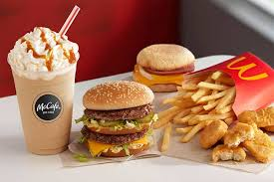
Mindless Eating
Mini-Experiment
Crystal Nzewi
&
Jacqueline Nickels

Slide 2
Food for Your Mood
Our research was done on the role that our mood plays on the food we eat. Meaning, how the emotions that we have on a day to day basis affect the meal plan/choice we decide to have on that day.
In order to find information on this topic, we asked a few questions:
Our target group were athletes at Dhall
We asked how their mood was and what impacted that mood
We then asked if their mood affected what they chose to eat at that time and if they were in a different mood, would they eat differently
The last question was what the percentage had their mood played in their choice of food

Slide 3
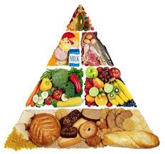
The importance of understanding the impact of our mood on our eating habits
This research experiment is relevant for the general population because when we eat, although we are unaware of it, most of the time our eating habits are determined by our mood. Craving a certain food while feeling sad is very common. For athletes, understanding the relationship between our moods and eating habits is vital in order for us to have the best sports performance possible.

Slide 4
Experiment
12 students were studied in total
6 Female
6 Male
All between the ages of 18-22

Slide 5
Hypothesis
More than 60% of people will have their mood affect their meal choice. If a person is in a bad mood or a celebratory mood, they are more likely to opt for unhealthy food options.
Most times, where consciously or unconsciously people tend to eat more when they are unhappy or in a sad mood. On the other hand, they also tend to eat alot when they are celebrating circumstances. That is why there is a feast during Thanksgiving, Christmas, New Years, Easter e.t.c.

Slide 6
Study Methods
The study took place in dhall because it would be easier for people to think of the effect of their mood on food when they were actaully eating.
A series of questions were asked as stated in the second slide. These questions were the same for each student.
Student athletes who had already gotten their food were asked the questions.
They were told what the study implicated and knew what the research was for.

Slide 7
Research Questions:
How would you explain your mood today?
What do you think caused this impact on your mood?
Do you think that your mood may have affected your meal choice?
If you were in a different mood, would you eat differently?
How would you rate the percentage of how food affects your mood?

Slide 8
Results
Subject #1 (Female)
Energetic and enthusiastic
Had enough sleep and excited for practice
Yes, ate a sandwich
Yes, anxiety makes her eat unhealthy foods
60%
Subject #2 (Female)
Neutral
Not wanting to wake up early
No
Yes, anger (no food or little amount)
60%
Subject #3 (Male)
Happy and content
Had a good day yesterday
Yes, good mood (better eating)
Yes
50%
Subject #4 (Male)
Happy
Good grades
No
No
20%

Slide 9
Subject #5 (Male)
Happy
Slept well and friend’s laughter
No
No
20%
Subject #6 (Female)
Good mood
Nice day
No
Maybe, when sad she eats more
25%
Subject #7 (Male)
Happy
He got more sleep
No
Sometimes he eats more when tired and happy
30%
Subject #8 (Female)
Happy
The weather was nice
Yes
Yes, eats unhealthy when in a different mood
30%
Can you do the conclusion cause i have to study for an exam

Slide 10
Subject #9 (Female)
Neutral
Tired
Yes
Yes, healthier
10%
Subject #10 (Male)
Optimistic
Getting a lot of sleep
Yes
Yes, eats healthier
75%
Subject #11 (Male)
Sensational
No classes
No
Yes (stress not that much)
30%
Subject #12 (Female)
Mixed/ stressed
Quizzes and papers due
No
Yes (eats more when happy)
60%

Slide 11
Result Explanation
From the results, it is evident to see that;
Of those 12, the six females all said that their mood affected choice of food. Four out of six of the male also said that their mood affected their choice of food.
3 Students - 60% (mood plays on food choice)
1 student- 50%
3 students- 20% range
3 students- 30%
1 student- 10%
1 student- 75%
Only 33% had food affect them by 60% or higher

Slide 12
Observation/Opinion
A lot of moods were affected by fatigue. Either due to getting good enough sleep or the lack thereof.
The results were mostly similar for the people who were studied as all of them except two said that their mood affects what they chose to eat.
We also believe that due to the good weather, a lot of people were in a good mood today.
Most of the student said that if they were tired, sad, or anxious that they would eat more and unhealthier.

Slide 13
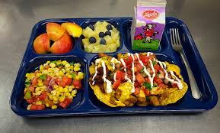
How these results can help change “Mindless Eating”
The results show that more students are likely to opt for larger portions or unhealthy foods when they were tired, sad or anxious.
Questioning and being aware of how their mood may affect their meal choices will help them be more cautious of their eating habits and thus, they will be able to control it better.

