Slide 1
Revising for Elaboration and Tone
Courtney Fisher

Slide 2
Agenda
Define elaboration and tone
Discuss strategies
Tone in Multimedia projects
Example of how to revise for elaboration and tone
Guided Practice: Class example of how to elaborate for elaboration and tone
Collaboratively elaborate for revision and tone within group

Slide 3
Definitions
Elaboration: “planned or carried out with great care; marked by complexity, fullness of detail, or ornateness”
Tone: “a quality, feeling, or attitude expressed by the words that someone uses in speaking or writing”

Slide 4
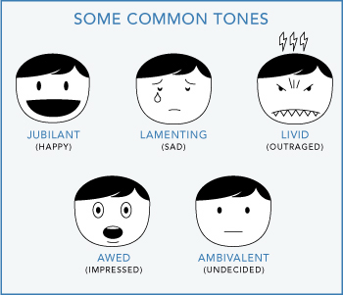
Tone Words
Absurd
Angry
Scared
Cheerful
Worried
Apologetic
Frank
Grim
Mocking
Optimistic
Playful
Satirical
Annoyed
Confident
Sympathetic
Ambivalent
Judgmental
Confused
Lamenting
Pessimistic

Slide 5
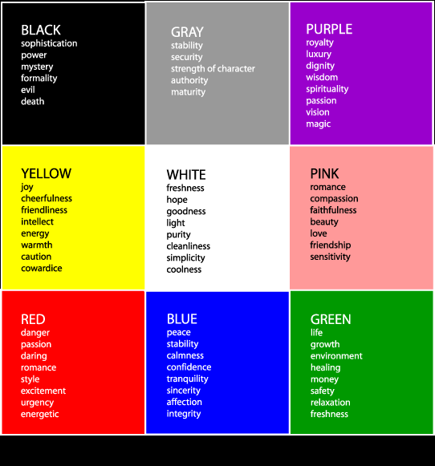
Tone in Multimedia Projects
Music can impact tone
https://www.youtube.com/watch?v=ovEYV0GAV2k
Colors can also impact tone

Slide 6
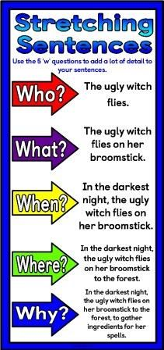
Strategy for Elaborating

Slide 7
Strategies for Tone
What is the denotation?
Dictionary definition
What is the connotation?
Positive and negative associations of a word
Chose the most specific nouns
Chose the most specific verbs

Slide 8
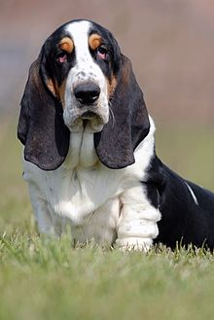
Example
The dog barked.
The floppy-eared barked.
The floppy-eared dog whined.
The floppy-eared dog whined as his
master drove away.
The floppy-eared Basset Hound
whined as his master drove away.
The floppy-eared Basset Hound
whined pitifully as his master drove
away.

Slide 9
Class Example
https://docs.google.com/document/d/1gCXoSFCHCSXZeMkME-CNFjqOovI5s323AzidnLY7hv8/edit

Slide 10
Group Practice
Group 1
https://docs.google.com/document/d/19rEXHfUpmUIo_tRUi8j-aO1ep8dSxipbqVHwHkqcBaM/edit
Group 2
https://docs.google.com/document/d/19rEXHfUpmUIo_tRUi8j-aO1ep8dSxipbqVHwHkqcBaM/edit

