Slide 1
Paleocene Eocene Thermal Maximum
56 million years ago
Troy Clift

Slide 2
Paleocene Epoch

Slide 3
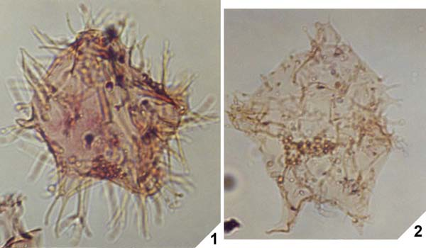
Rapid Climate Change
Rapid increase in greenhouse gases
Global temperature increase of 5 degrees
Fossil record gives a good understanding of how climate and life were affected
Apectodinium

Slide 4
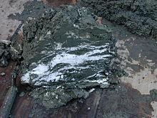
Causes
Methane hydrates
Decomposing organic material
Volcanism

Slide 5
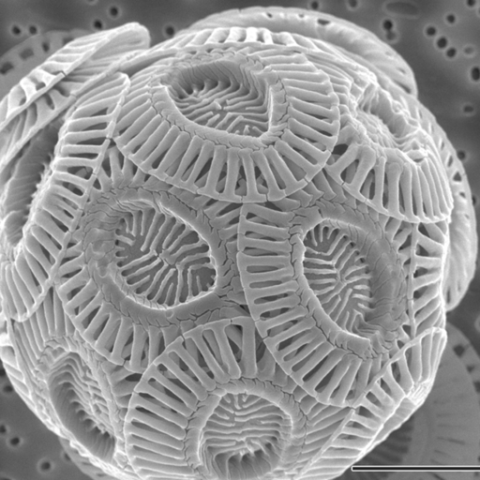
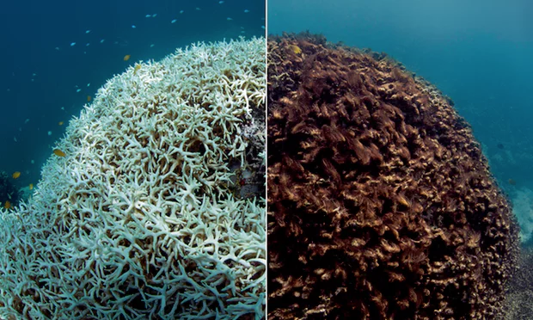
Mass Extinction Event
Many Coccolithophores went extinct
Coral bleaching

Slide 6
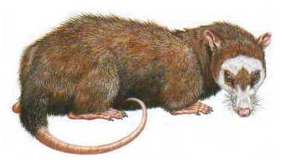
On Dry Land
Ground dwelling herbivores Ectocion and Copecion appear have their usual size
Primates were much smaller than their immediate descendants

Slide 7
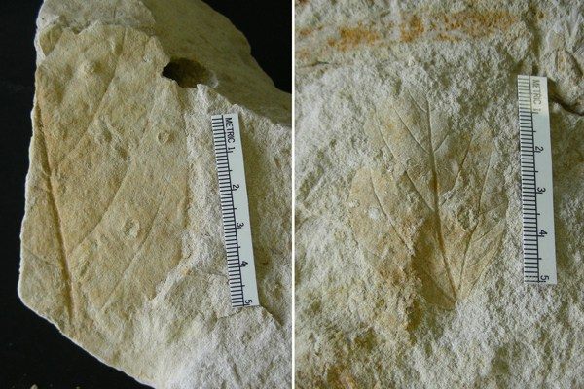
Plants
Increased CO2 levels reduce nutritional value of leaves
Slowed growth rate
Made leaves harder to digest

Slide 8
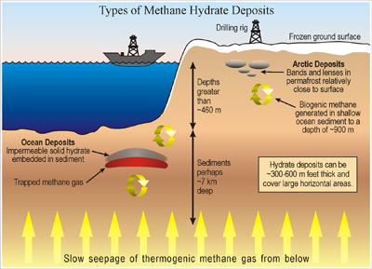
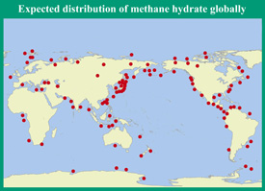
Discussion
How is this event similar to what we face today?
Could methane hydrates play a role in climate change today?

Slide 9
Refences
http://www.palaeontologyonline.com/articles/2011/the-paleocene-eocene-thermal-maximum/
https://www.wunderground.com/climate/PETM.asp#compare
https://www.sciencedaily.com/releases/2016/09/160901102730.htm

