Slide 1
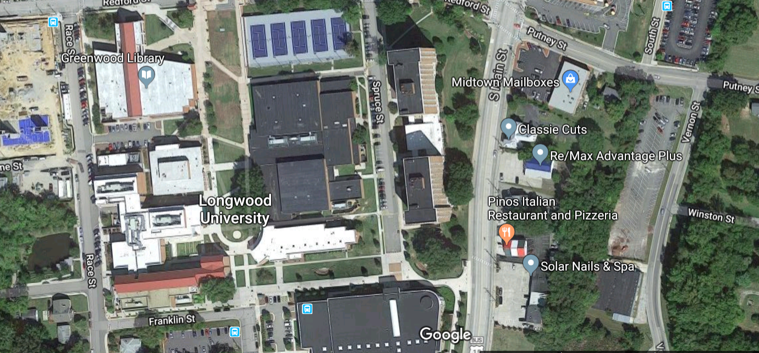
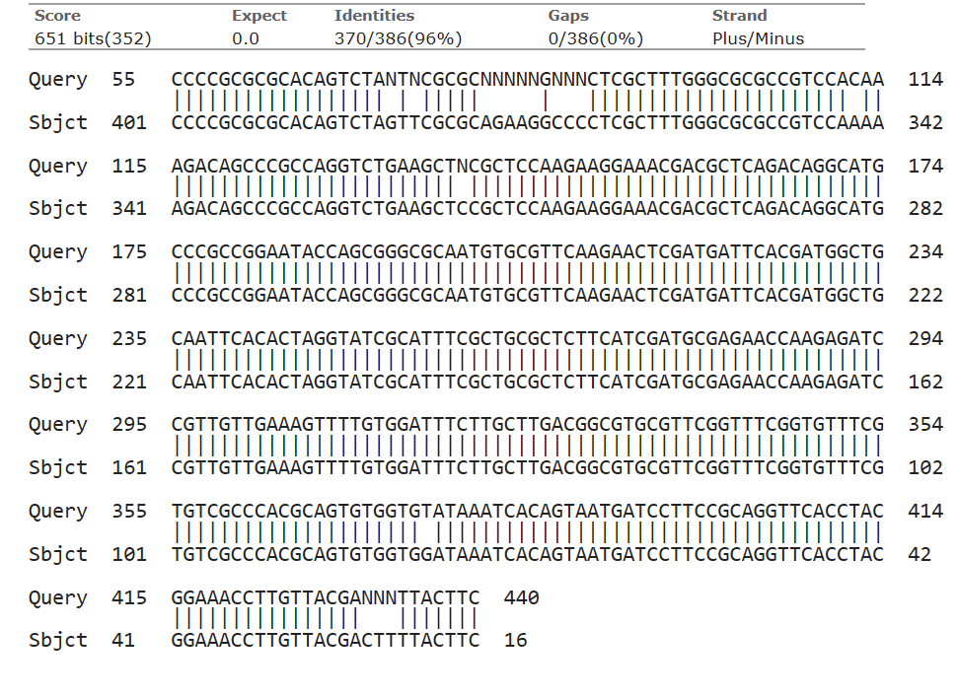
Yeast Presence in Farmville Waterways
Kirsten Bauer and Sage Church
BIOL 250, Longwood University
Background
Results
Yeast occurs naturally in our environment
Yeast is present
in freshwater
bodies
Small systems
(streams, creeks,
and ponds)
lack investigation
Rhodotorula
freshwater yeast
Figure 2. Electropherogram of sample yeast from base pair 90-170.
Species | % Identity
Pichia fermentans Strain Pferm 62 | 95.85
Pichia fermentans Culture CBS:4611 | 95.60
Pichia fermentans Culture CBS:1876 | 96.54
Pichia fermentans Culture CBS: 2057 | 96.54
Pichia fermentans Culture CBS:4807 | 96.54
Figure 1. Both sample sites are circled in red. On the left is the storm water retention pond and on the right is Gross Creek.
Question & Hypothesis
Question: What yeast species are present in the small waterways on Longwood University's campus and how abundant are they in these systems?
Hypothesis: Yeast will be abundant in Longwood’s stormwater retention pond and Gross Creek and a variation of the species Rhodotorula will be identified.
Table 1. The top five species hits when the sample FASTA was run through BLAST analysis.
Figure 3. Alignment of sample FASTA and the most similar retrieved fungi (Pichia fermentans) FASTA sequences.
Methods
Sample collection, dilution, and growth
Conclusions
Morphology
Polymerase Chain Reaction (PCR)
Hypothesis was not supported
-Pichia fermentans
-Fermentation
Future Direction:
Pollutant degradation
-K, N, P, Ca, and Mg
Identify role and source
Figure 4. Phylogenetic tree of yeast samples from varying bodies of water on Longwood University's campus including puddles, the storm water retention pond (PCR16) , Sandy River (PCR5), and Briery Creek (PCR6) .
Amplicon Purification and Nanodrop Test
Gel Electrophoresis
Biochemical Assays
References
Butinar L., Santos S., Spencer-Martins I., Oren A., Gunde-Cimerman N. 2005. Yeast diversity in hypersaline habitats. FEMS Microbiology Letters, 244:229–234.
Gadanho, M. and Sampaio, J. 2004. Application of temperature gradient gel electrophoresis to the study of yeast diversity in the estuary of the Tagus River, Portugal. FEMS Yeast Research, 5:253–261.
Kurtzman, C.P., Fell JW, Boekhout, T. and Robert, V. 2011. Methods for Isolation, Phenotypic Characterization and Maintenance of Yeasts. The Yeasts, NA:87–110.
Rosa, C.A., Resende, M.A., Barbosa, F.A.R., Morais, P.B. and Franzot, S.P. 1995. Yeast diversity in a mesotrophic lake on the karstic plateau of Lagoa Santa, MG-Brazil. Hydrobiologia, 308:103–108.
Sanna, M. L., Zara, S., Zara, G., Migheli, Q., Budroni, M., and Mannazzu, I. 2012. Pichia fermentans dimorphic changes depend on the nitrogen source. Fungal Biology, 116:769-777. Taccari, M., and Ciani, M. 2011. Use of Pichia fermentans and Candida sp. strains for the biological treatment of stored olive mill wastewater. Biotechnology Letters, 33: 2385-2390. Woollett, L.L., and Hedrick, L.R. 1970. Ecology of yeasts in polluted water. Antonie van Leeuwenhoek, 36:427–435.
DNA sequencing and Basic Local Alignment Search Tool analysis (BLAST)

