Slide 1
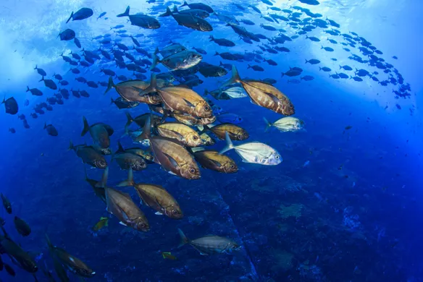
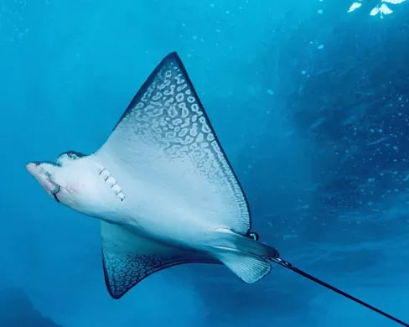
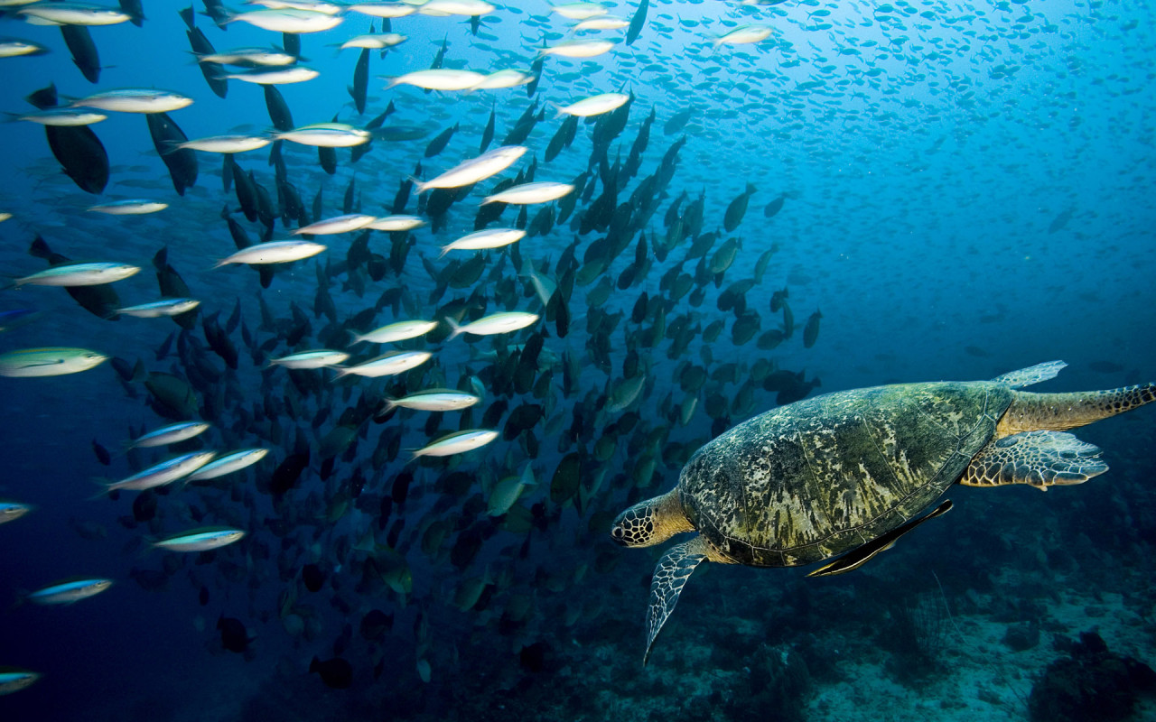
MPA’s:
Drawing the Line
Charlotte Pfamatter

Slide 2
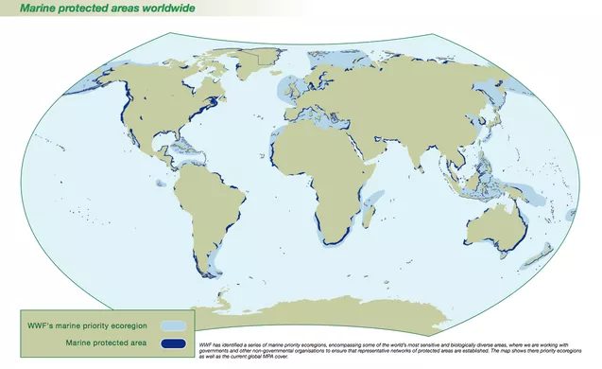
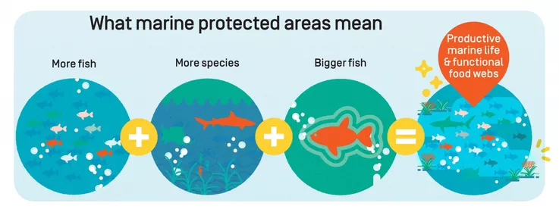

Slide 3
“Press Release”. Press release. The Convention on Biological Diversity. June 5, 2017.

Slide 4
Projection
Boonzaier, L. & Pauly, D., (2016): Marine protection targets: an updated assessment of global progress. Oryx. 50(1), pp 27–35.

Slide 5
Synthesis:
What factors are postponing the goal of having MPA’s protecting 10% of global waters by 2020 (and future goals)?

Slide 6
Earth, Wind, & Water
Jameson, S., Tupper, M., & Ridley, J., (2002): The three screen doors: Can marine protected areas be effective?. Marine Pollution Bulletin. Vol 44. pp 1177-1183.

Slide 7
Society
Bennett, N. & Dearden, P. (2014): Why local people do not support conservation: Community perceptions of marine protected area livelihood impacts, governance, and management in Thailand. Marine Policy. Vol 50(A). pp 96-110.

Slide 8
“Paper Parks”
Fox, H., Holtzman, J., et al. (2014): How Are Our MPAs Doing? Challenges in Assessing Global Patterns in Marine Protected Area Performance. Coastal Management. Vol 42. pp 207-226.

Slide 9
Not reaching 10% goal
Paper parks
Natural forces
Social, cultural, and economic limitations

Slide 10
How can the goal be reached faster?
Reporting higher quality data
Critical calculations
Obtainable goals and efficiency for MPAs
Educating communities
Continued support
Wood, L., Fish, L., Laughren, J., & Pauly, D. (2008): Assessing progress towards global marine protection targets: shortfalls in information and action. Oryx. Vol42(3). pp 340-351.

Slide 11
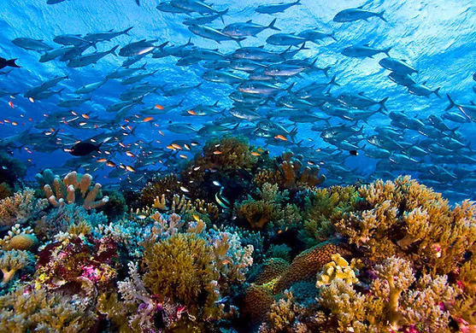
Questions?

