Slide 1

Brazilian Oil Spill
By Reece Theakston
https://www.aljazeera.com/news/2019/10/brazil-oil-spill-2-000km-northern-beaches-contaminated-191014105724674.html

Slide 2

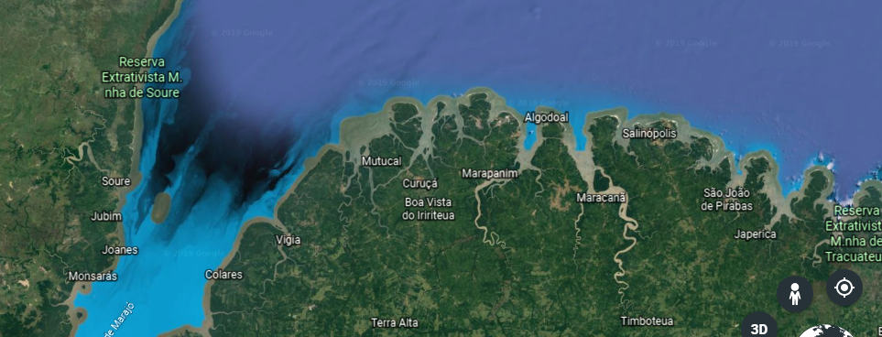
The oil spill is on the Northeast region of Brazil
First reports of the oil spill September 2nd 2019
A Greek flagged ship was the source of the spill

Slide 3
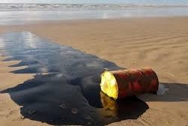
The worst oil spill in Brazilian history
Also the largest environmental disaster to happen on the Brazilian coast

Slide 4
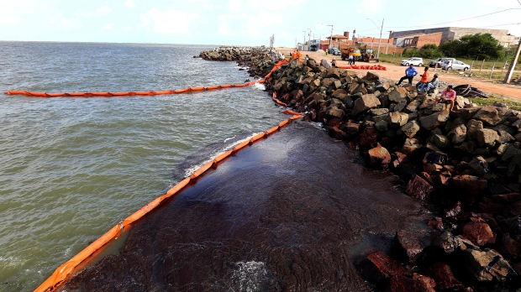
There are a lot of harmful toxins in crude oil, the most harmful toxins include Hydrogen sulfide, Benzene, and Toluene.
This spill has affected everyone who lives on the coast and those who use the coast as a source of food and work.
The spill has covered more than 1,240 miles of Brazilian Coastline

Slide 5
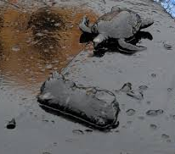
Most commonly absorbed through inhalation, ingestion, or dermal exposure. commonly found during the drilling and production of crude oil and natural gas.
Colorless, flammable, poisonous and corrosive, with a rotten egg smell.
Metabolized by sulfur dioxygenase, which is present in higher levels in the liver and kidney
Hydrogen sulfide

Slide 6
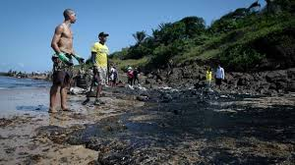
Hydrogen sulfide
Acute exposure includes nausea, headaches, delirium, disturbed equilibrium, tremors, convulsions, and skin and eye irritation.
Inhalation of high concentrations of hydrogen sulfide can produce extremely rapid unconsciousness and death.
Dermal exposure to the liquified gas can cause frostbite injury

Slide 7
Benzene
Benzene is a chemical that is a colorless or light yellow and liquid at room temperature. It has a sweet odor and is highly flammable.
Most commonly absorbed through inhalation
Natural sources of benzene include volcanoes and forest fires. Benzene is also a natural part of crude oil, gasoline, and cigarette smoke.
Benzene is metabolized, primarily in the liver, to a variety of hydroxylated and ring-opened products that are transported to the bone marrow where subsequent secondary metabolism occurs.

Slide 8
Benzene
Benzene works by causing cells not to work correctly. For example, it can cause bone marrow not to produce enough red blood cells, which can lead to anemia. Also, it can damage the immune system by changing blood levels of antibodies, causing the loss of white blood cells.
The seriousness of poisoning caused by benzene depends on the amount, route, and length of time of exposure, as well as the age and preexisting medical condition of the exposed person.

Slide 9
Toluene
is an aromatic hydrocarbon. It is a colorless, water-insoluble liquid with the smell associated with paint thinners.
alcohol dehydrogenase and aldehyde dehydrogenase leading to benzoic acid which, upon conjugation with glycine, results in hippuric acid, the major urinary metabolite.
Most commonly absorbed through inhalation and ingestion

Slide 10
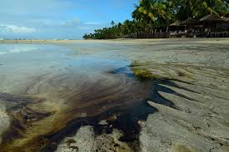
Toluene
Symptoms of toluene poisoning include headache, dizziness, ataxia, drowsiness, euphoria, hallucinations, tremors, seizures, and coma, ventricular arrythmias, chemical pneumonitis, respiratory depression, nausea, vomiting, and electrolyte imbalances.

Slide 11
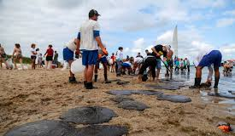
Public Response
Currently over 2,000 tonnes of oil have been cleaned up.
So far it is mainly the public working to clean up the oil spill, the government has provided little help with this crisis. The community did not have to be relocated.
The owner of the Greek company that owns the ship that was the source of the oil spill has been arrested by authorities.

Slide 12
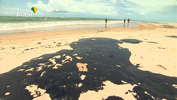
Public Response
A regulation that should have been followed is the double hull regulation. The regulations that currently affect how the toxins are measured/ controlled include environmental regulations and forensic regulations which are applied in the testing and removal of the oil.
Volunteers have been reported to have symptoms of nausea, diarrhea, and headaches

Slide 13

Current situation
Local authorities are providing little aid to local citizens and are monitoring the spill
Some volunteer groups are the ones providing the most materials like gloves and masks to help reduce exposure
The oil spill is still spreading down the Brazilian coast affecting more and more citizens and wildlife

Slide 14
References
Avila, Tori. “Oil Spill Continues to Decimate Brazilian Coast Two Months On.” Earth Island Journal, 2019, www.earthisland.org/journal/index.php/articles/entry/oil-spill-brazil-coast-wildlife-fishing/.
“CDC.” Centers for Disease Control and Prevention, Centers for Disease Control and Prevention, 4 Apr. 2018, emergency.cdc.gov/agent/benzene/basics/facts.asp.
Edokpolo, Benjamin, et al. “Health Risk Assessment for Exposure to Benzene in Petroleum Refinery Environments.” MDPI, Multidisciplinary Digital Publishing Institute, 12 Jan. 2015, www.mdpi.com/1660-4601/12/1/595.
Garcia, Pablo. “Oil Spill Clean-up on Brazilian Beaches Making Volunteers Sick.” Reuters, Thomson Reuters, 25 Oct. 2019, www.reuters.com/article/us-brazil-environment-oil-health/oil-spill-clean-up-on-brazilian-beaches-making-volunteers-sick-idUSKBN1X42I8.
Hosny, Gihan. Health Risk Assessment for Exposure to Benzene in Petroleum Refinery Environments. 2017, pdfs.semanticscholar.org/6e30/a7c087f1ca64789a9bde2588c341db1583cd.pdf.
“Toxic Substances Portal - Hydrogen Sulfide Carbonyl Sulfide.” Centers for Disease Control and Prevention, Centers for Disease Control and Prevention, www.atsdr.cdc.gov/mmg/mmg.asp?id=385&tid=67.
Warenycia, Marcus W., et al. “Acute Hydrogen Sulfide Poisoning: Demonstration of Selective Uptake of Sulfide by the Brainstem by Measurement of Brain Sulfide Levels.” Biochemical Pharmacology, Elsevier, 20 Nov. 2002, www.sciencedirect.com/science/article/abs/pii/0006295289902888.
Zhang. “Effect of Inhaled Hydrogen Sulfide on Metabolic Responses... : Pediatric Critical Care Medicine.” LWW, 2008, journals.lww.com/pccmjournal/Fulltext/2008/01000/Effect_of_inhaled_hydrogen_sulfide_on_metabolic.21.aspx?casa_token=TqeBj-4eDnYAAAAA%3Au8Y0qdCHYnYcTbbFmkIp0K-In6hSW2sLUGuF6yyk1zHYFf2JaNhk2J8NvRwWLAhpdni9g3rfh8zqudJ9HkWtXxU.

