Slide 1
Reading Between the Pixels
Media Literacy Instruction in the Digital Age
Carol Pippen &
Ian Shih

Slide 2
What is media literacy?
“the ability to access, analyze, evaluate, and create media in a variety of forms”
Aspen Institute Conference Report, 1992 ¹
“a framework to access, analyze, evaluate, and participate with messages in a variety of forms”
Center for Media Literacy ²
“an informed and critical understanding of the nature of the media, the techniques used by them, and the impact of those techniques. Also the ability to understand and use the mass media in an active, critical way.”
Ontario Curriculum, Grades 1-8, Language, 2006 ³

Slide 3
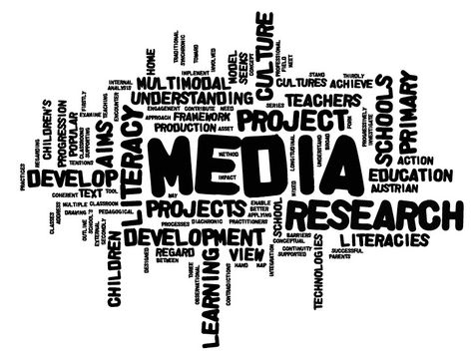
What media literacy is not
It is not just using videos, CDs, or other digital media material. It also involves learning about media.

Slide 4
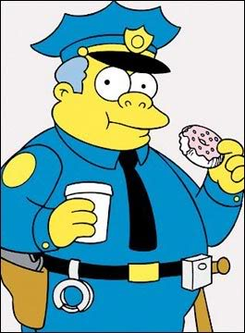
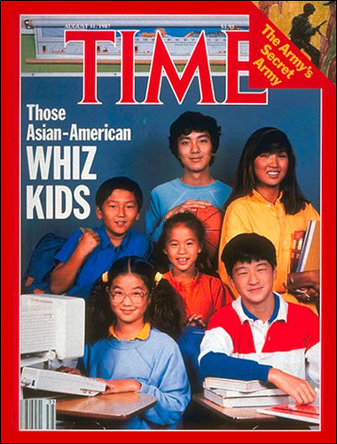
What media literacy is not
It is not simply looking for political agendas, stereotypes, or misrepresentations. It is also an exploration of the systems that make those representations appear “normal.”

Slide 5
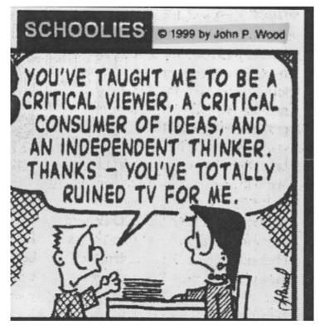
What media literacy is not
It is not media “bashing.” However, it does involve adopting a critical stance with respect to the media.
Media literacy does not mean “don’t watch,” but “watch carefully, think critically.”
Adapted from Andersen et al., 2003 ⁴

Slide 6
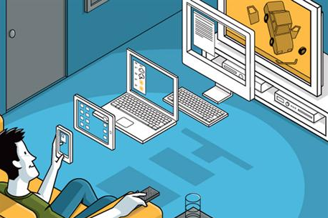
Why media literacy is important
Children spend nearly a third of their day with media:
7 hours and 38 minutes for children 8-18, on average; that’s more than 53 hours a week!
10 hours and 45 minutes if you count “multitasking.”
Report from the Kaiser Family Foundation, 2010 ⁵

Slide 7
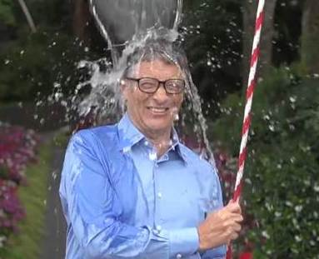
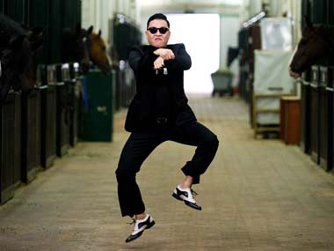
Why media literacy is important
Media experiences are now highly personal and new technologies make it always available:
Tablets, smartphones, glasses, and watches draws media ever closer into our personal lives.
Transformative power is undeniable.

Slide 8
Why media literacy is important
Foundational literacy skills are not enough for students to gain a full understanding of media messages.
Students must be able to “read” beyond the face value of a message.
New literacies are required for full participation in the Information Age.
Leu et al., New Literacies, 2013 ⁶

Slide 9
Categories to consider
A. Construction of the message
B. Analysis and evaluating
C. Purpose and Audience
Notes:
When consuming media literacy, we have three categories to consider in order to critically analyze the message. First we want to consider the construction of the message. This is the author and the techniques to build the message. Next, we look at the message to analyze it for authenticity, author, techniques, and persuasiveness. Last, we want to evaluate the purpose of the message. Are we to change a view, consume an item, or become a participant. The five questions presented today stem from these three categories.

Slide 10
SOL strands for media literacy
4.3 & 5.3- Learning the who, what, why, and how
6.3, 7.3-Understand the elements, Is it fact or opinion and comparing visual imagery techniques
8.3,9.3,10.2, 11.2, & 12.2-Construction-Students produce, analyze, and evaluate media messages

Slide 11
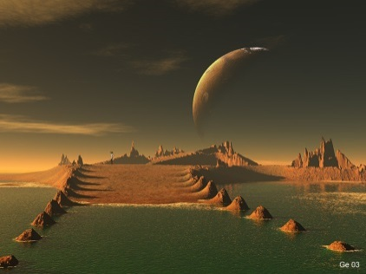
1. Who created the message?
What genre-
Technologies used-
How is the message similar or different from other messages I’ve seen?

Slide 12
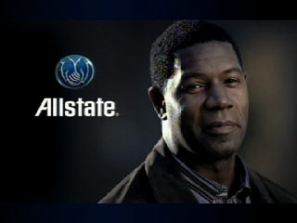
2. What creative technologies were used to attract my attention?
Is the message realistic?
Jimmy Johns
Conventions of story telling?
Beginning, Middle and End
Visual symbolism used?
Visual imagery and symbolism

Slide 13
3. How might people understand this message differently?
Would individuals respond differently to the same message?
Dr. Pepper 10
Does the message fit with the interpreters life experience?
What reason might someone be interested in the message?

Slide 14
4. What values or points of view are represented?
What social message is part of the messages’ subtext?
Electronic Cigarette
What behaviors and what kind of consequences are being depicted?
What type of person is the reader invited to identify with?

Slide 15
5. Why is this message being sent?
Purpose-
Who is the target audience?
Who is the intended audience?

Slide 16
FAMME
Format
Audience
Message
Mode
Expected

Slide 17
Let’s Practice
We do
Practice 1
You do
Practice 2

Slide 18
Citations
¹ The Aspen Institute. (1992). A report of the national leadership conference on media literacy. Queenstown, MD: Aufderheide, P.
² Center for Media Literacy. (2011). What is media literacy: A definition…and more. Retrieved from: http://www.medialit.org/reading-room/what-media-literacy-definitionand-more
³ Ontario Ministry of Education. (2008). A guide to effective literacy instruction grades 4 to 6. (Vol. 7). Retrieved from: http://www.eworkshop.on.ca/edu/resources/guides/Guide_Lit_456_Vol_7_Media_Literacy.pdf
⁴ Andersen, N., Hobbs, R., Share, J., Sullivan, S., & Worsnop, C. (2003). Retrieved from: http://www.medialit.org/reading-room/what-media-literacy-not
⁵ The Kaiser Family Foundation. (2010). Generation m²: Media in the lives of 8- to 18- year olds. Retrieved from: http://kff.org/other/report/generation-m2-media-in-the-lives-of-8-to-18-year-olds/

