Slide 1
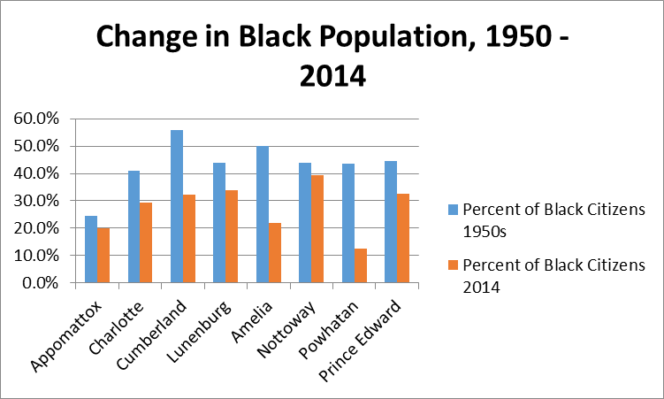
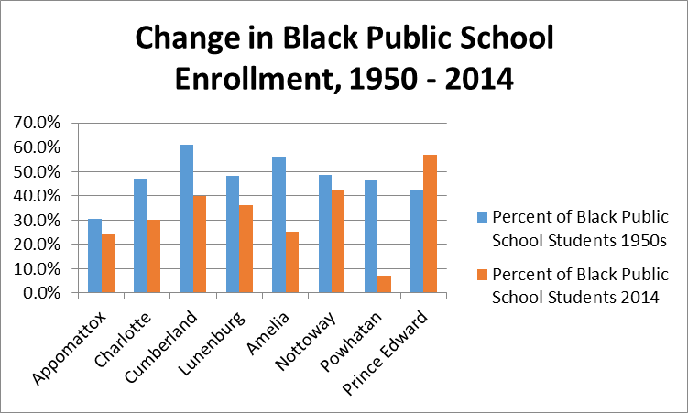
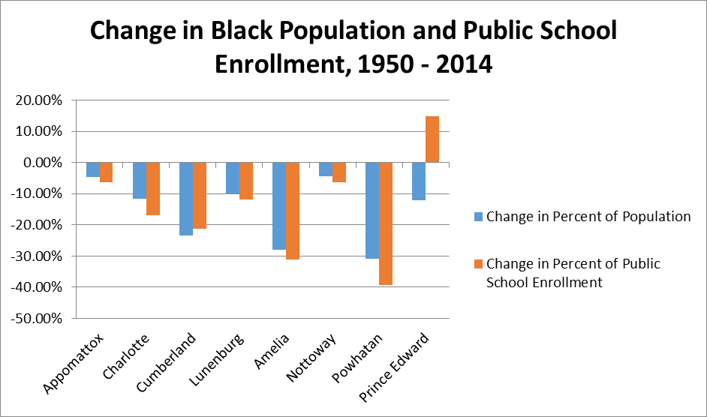
A Continuance of Prejudice
Emilia Gamble, Victoria Allen, Walter Coleman, and Jacob Carney Longwood University
Introduction
The Brown v. Board of Education case in 1954 was intended to desegregate the country, but today there appears to be a leaning towards segregation in public schools across the country, which may suggest a national white flight. White flight, as defined by Renzulli (2005), is white residents fleeing a community because of the lowering status of a school due to an increase in nonwhite enrollment (p. 400). In other words, white flight can be considered a consequence of the Racial Threat Theory (RTT). RTT, as defined by Giles (1994), is the “relationships between groups as a function of their competitive positions in political, economic, and social arenas” (p. 317).
Prince Edward County (PEC) is infamous for closing its public schools from 1959-1964 following the Brown v. Board of Education decision in 1954. Although PEC operates racially integrated public schools today, the stigma of racism from the past still exists.
Results
Figure A shows the percentage of black residents in Prince Edward and its surrounding counties from 1950 and 2014. The percentage of black residents decreased in all the observed counties by an average of 15.6 percent. Figure B displays the percentage of black public school students in the eight counties. Likewise, with the decrease of black residents, there was a decrease of black student public school enrollment by an average of 14.8 percent. Figure C shows the change in the percentage of black residents and the percent of black students. Theoretically, the change in percent of black public school students should be similar the percent of black residents in each of the counties. However, uniquely in PEC the percent of black residents had greatly decreased as compared to the increase in the percent of black student enrollment. Therefore in PEC, Racial Threat Theory can be observed because there is now a smaller percentage of white students in PEC’s public schools while there is a higher percentage of white residents in PEC.
Conclusions
In PEC and its surrounding counties, there are more white residents than black residents, but in the PEC’s public schools there appears to be a smaller percentage of white students as compared to black students. However, in surrounding counties with similar demographics to PEC, the percentage black residents was similar to the percent of black students in their public schools.
Based off of this collected data, there appears to be a trend in PEC towards white students leaving the public school system but remaining in the county.
This disproportion of black and white residents helps support RTT in PEC. Whites in PEC may not believe that the public school system is sufficient enough to educate their children, thus they most likely enroll their children elsewhere while black families tend to keep their children in the system.
Furthermore, the trends can be interpreted as a continuance of prejudice in PEC that has not ended since 1964. However, the disproportion is only a piece of data with no story or history behind it. Furthermore, the situation in PEC, while not dire, could be observed more closely by trained experts dedicated to improving education for all students.
Figure A
Figure B
Figure C
Methodology The data was gathered from the public census of the United States, the Virginia Department of Education and Hana Brown’s ‘They must be discontented’ article published in 2010. The seven surrounding counties were selected because they were demographically similar to PEC at the time of the school closings in PEC. However, there are trends unique to PEC that cannot be observed in the surrounding counties.
The surrounding counties are Amelia, Appomattox, Charlotte, Cumberland, Lunenburg, Nottoway and Powhatan.
Additional Information
Further research is need to look into whether the school closing is a direct effect on the percentage of black and white students in PEC. Limitations include the lack of background information about the disproportion of black students and residents. In addition, rounding errors or inaccurate information could have lead to the numbers being as they are. However, there are references below for an interested viewer to locate if further detail is required.
References
Brown, H. (2010). ‘They Must be Discontented’: Racial Threat, Black Mobilization and the Passage of School Closing Policies. Ethnic and Racial Studies, 33(8), 1392-1411.
Giles, M. W., & Hertz, K.. (1994). Racial Threat and Partisan Identification. Brookover, W. B. (1993). Education in Prince Edward County, Virginia, 1953-1993.Journal of Negro Education, 62(2), 141-161.
The American Political Science Review, 88(2), 317–326. http://doi.org/10.2307/2944706
Renzulli, L. A., & Evans, L.. (2005). School Choice, Charter Schools, and White Flight. Social Problems, 52(3), 398–418. http://doi.org/10.1525/sp.2005.52.3.398
United States Census. (2015). Prince Edward County, Virginia [Data file]. Retrieved from http://www.census.gov/quickfacts/table/PST120214/51147,51145,00
Virginia Department of Education (2015). Fall membership for the Commonwealth of Virginia [Data file]. Retrieved from http://bi.vita.virginia.gov/doe_bi/rdPage.aspx?rdReport=Main&subRptName=Fallmembership
Notes:
Copyright Colin Purrington (http://colinpurrington.com/tips/academic/posterdesign).
1

