Slide 1
Sustainability
in Action
Julia White, Camryn Ridpath, and Victoria Adame

Slide 2
Our Group’s Focus Area
Our sustainability focus area is Dining Services and Education. We will focus on how to promote sustainability on campus and how to educate students on actions already being taken by Longwood University. Our goal is to place dining sustainability on the forefront of students’ dining experience. At the end of our project we hope to reinvent the dining experience at Longwood insuring that sustainability efforts being done by Longwood can be recognized by students and staff.

Slide 3
How can we effectively educate and engage students/staff in regards to sustainability?

Slide 4
What We Want to Know
How can we assist D-Hall effectively educate campus on dining sustainability?
What is the minimum and maximum amount dining management is willing to spend on education?
How can we create something that will have a lasting impact at Longwood University?
Where would it be possible to hang permanent posters? And who might we talk to to find out that information?
Notes:
gdsg

Slide 5
The Problem at a Local and Global Level
Global
Globally, importance of sustainability is not widely recognized
Most individuals may not recognize what can/cannot be recycled
Local
Many students, including work study students, are unaware of D-Hall sustainability
Ex: composting, locally grown produce

Slide 6
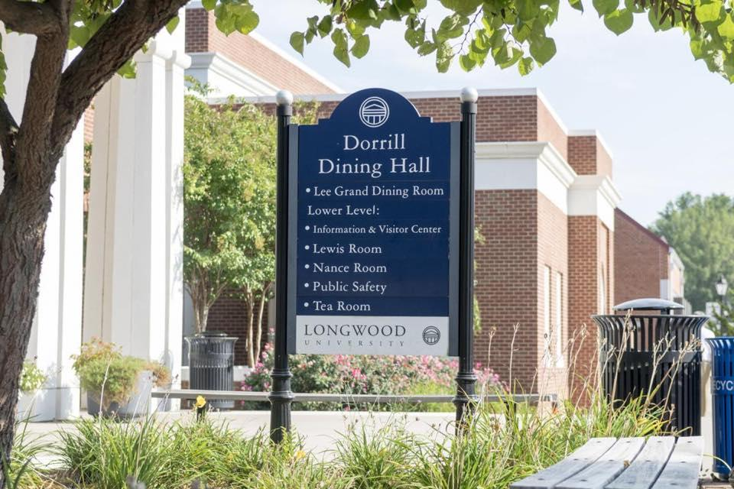
Locale
Focus area
D-Hall
Potential places for info
Walls next to dish rooms
Lobby in D-Hall
Notes:
focus area is in the dining hall. A potential place for sustainable information could be on the walls next to the dish rooms. This would be a perfect place to educate students about composting in the dining hall. The poster could include a photo and information on the pre-existing composting efforts in the dish room.

Slide 7
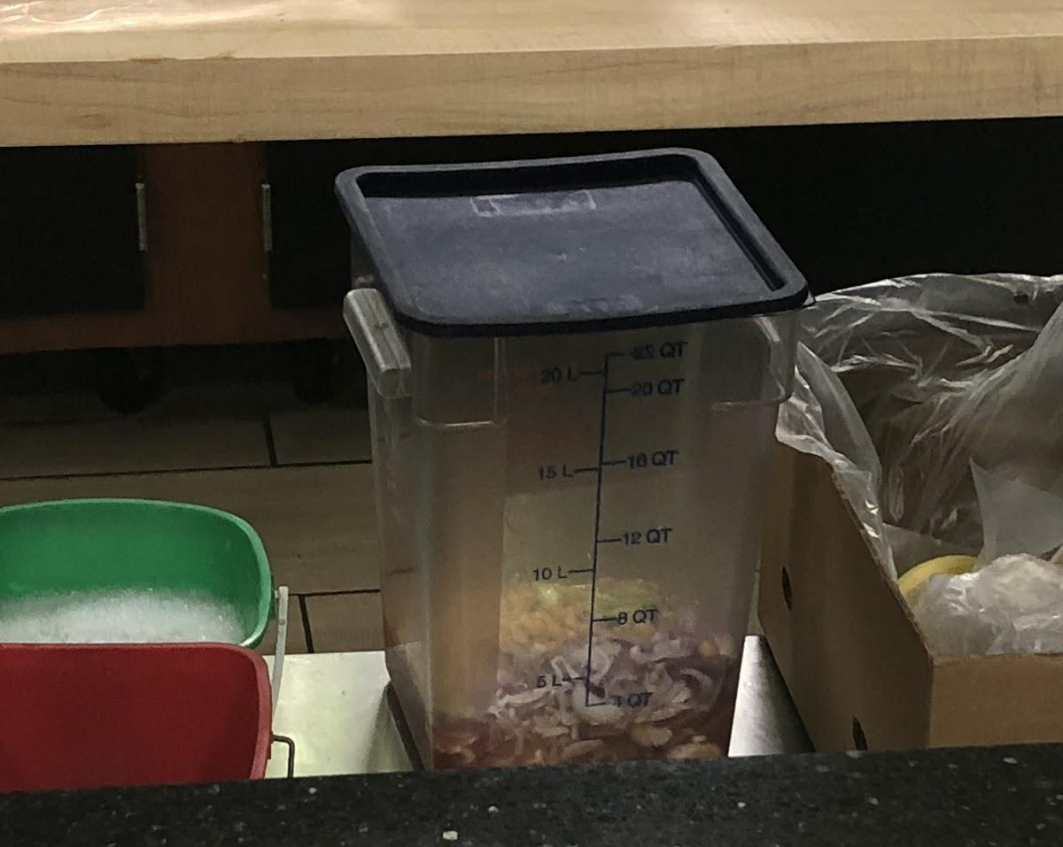
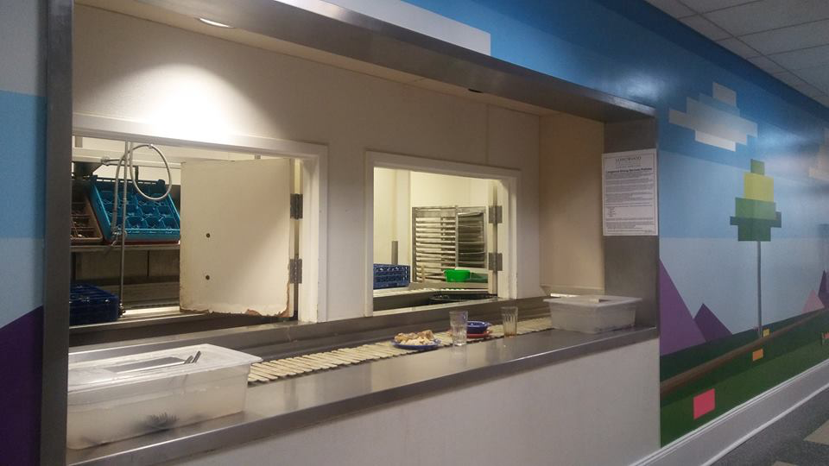
Example
Photo Credit - Ole Miss Office of Sustainability

Slide 8
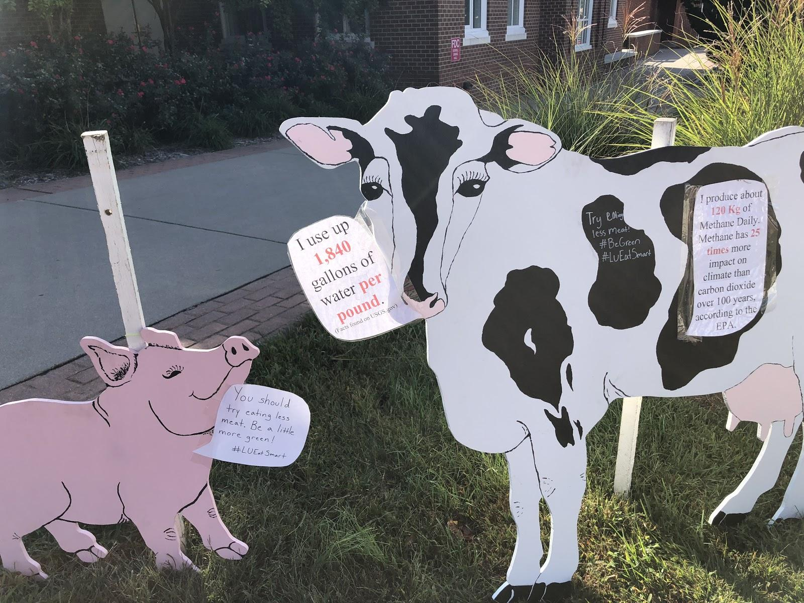
#LUEatSmart Campaign
This is a great example of education at d-hall. Rather than a simple paper flyer, the large wooden animals catch your eye and make you want to go and read the messages on them.

Slide 9
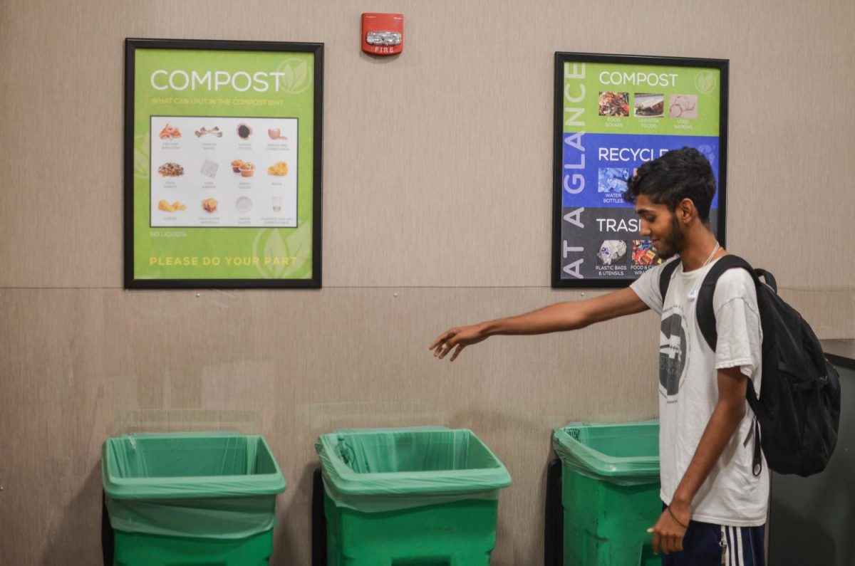
Research
Findings
This is an idea from Marquette University where students are engaged in the composting process rather than staff. It educates them about the process as well as encourages them to continue the practice later in life. Student engagement in this way is important because it makes composting more within the “norm” and more accepted by society.
This idea would apply perfectly to our school, seeing as we already have the means to compost, it’s just adding some big bins on the student side to engage everyone. This is also possibly a way we could get work study involved because they could be the ones to take the bins to the pulper.

Slide 10
Resource People
Grant Avent:
Ask where it is possible to hang permanent posters/signs/boards advertising D-Hall education
Get suggestions from him on other potential sources to answer further questions

Slide 11
Approach
Our Goal:
To inform students of the efforts D-Hall makes to be a sustainable dining hall
Talk to Grant Avent, determine where new posters can be placed, as well as find out who we can follow up with
Develop a design for posters that are eye catching and informative
Place posters in D-Hall

Slide 12
What We Are Already Doing
We purchase local, seasonal and responsibly raised, grown and sourced products whenever possible
We minimize our waste by reducing, reusing and recycling.
We implement practices to conserve natural resources and ensure operational efficiencies
We ensure our transportation programs reduce fuel usage and emissions.
Notes:
sdg

Slide 13
THE END

