Slide 1
Teaching Civic Engagement: Informing the Journey to Citizen Leadership
Citizen Leadership and Social Justice Education

Slide 2
Civic Engagement provides us with a unique opportunity to impact the lives of students in a very real and practical way. Our workshop will expose participants to the ideas of Civic Engagement and provide them with the basic foundation of what Civic Engagement is, how its principles can be applied in the classroom curriculum, and how it can be used as a tool to help form the lens of social justice.

Slide 3
Learning Outcomes
Upon completion of this workshop, participants will be able to:
Define Civic Engagement
Define Social Justice
List the 4 elements of Critical Consciousness
Identify the benefits of integrating civic engagement into the classroom/curriculum
Articulate how pedagogies promote student change
Identify 3 ways students can civically engage
Identify 2 strategies to incorporate civic engagement into classroom curriculum
Describe 4 different types of civic engagement competencies (knowledge, skills, dispositions, experiences) and explain why they are important for academic success

Slide 4
Key Definitions
Community Engagement—developing meaningful and mutually beneficial relationships between campus and community partners as we work collectively to make a positive impact for all members of the community. This is an asset-based approach that emphasizes community and capacity building.
Volunteerism—a policy or practice of giving one’s time and efforts to support the interests on one’s community, particularly the Longwood University community.
Community Service—outreach performed as direct/indirect service working alongside community members and service agencies to promote equity and empower all areas of the community.
Service Learning—a form of experiential education that integrates instruction and reflection with meaningful community service that is intentionally designed to promote student learning, teach civic responsibility, and strengthen communities.
Philanthropy—promoting the welfare of others expressed especially through the donation of money and/or goods to causes and charities.
Service Sites—the location(s) where community service is performed in partnership with community agencies.
Community Partners—organizations or agencies with whom we work alongside to provide service and support the community.
Notes:
These definitions came to be from the leadership of Jordan Bynum, Coordinator of Leadership and Service Learning and Jonathan Page.

Slide 5
What is Civic Engagement?
“Working to make a difference in the civic life of our communities and developing the combination of knowledge, skills, values and motivation to make that difference. It means promoting the quality of life in a community, through both political and non-political processes.” (excerpted from Civic Responsibility and Higher Education, edited by Thomas Ehrlich, 2000)
“Encompasses actions wherein individuals participate in activities of personal and public concern that are both individually life enriching and socially beneficial to the community.” AAC&U
Notes:
Within our office, and in general, Civic Engagement is essentially an umbrella term for all of the other terms we just reviewed. The terms we just discussed are ways in which people can be civically engaged.
Civic Engagement is also one of those terms that may make some people uncomfortable because it implies that there is a particular idea of a good society and what it would take to make our current society meet that standard. What constitutes justice to one may be dramatically different from what another believes it to be.
One of the most widely accepted definitions across most institutions is the definition provided by the Association of American Colleges & Universities.

Slide 6
What is Civic Engagement?
Learning from others, self, and environment to develop informed perspectives on social issues
Valuing diversity and building bridges across difference
Behaving, and working through controversy, with civility
Taking an active role in the political process
Participating actively in public life, public problem solving, and community service
Assuming leadership and membership roles in organizations
Developing empathy, ethics, values, and sense of social responsibility
Promoting social justice locally and globally
Notes:
The Coalition for Civic Engagement and Leadership (2005) states that civic engagement involves one of more of the following:

Slide 7
History of Civic Engagement?
Harvard University- established to train ministers who would then form both spiritual and civic centers
University of Virginia- to serve citizens by training them in their public duties
Stanford and the University of Chicago- pledged to work toward the civic well being of their communities
Benjamin Franklin and Thomas Jefferson- believed higher education should meet the needs of citizens.
Notes:
Many colleges and universities we’re founded for the purpose of civic engagement
Harvard University was established to train ministers who would then form both spiritual and civic centers
The University of Virginia to serve citizens by training them in their public duties
After the civil war Other Institutions like Standford and University of Chicago pledged to work toward the civic well being of their communities. (Daynes)
Benjamin Franklin and Thomas Jefferson were two leaders that believed that higher education should meet the needs of citizens and pushed for that. (Civic Engagement In Higher Education) “They considered informed and responsible participation essential to the success of the democratic experiment (Lawry, et al, 2006)
Following the Revolutionary War the focus of higher education slowly began to shift from the preparation of the individual to the building of a new nation.
During WW2, research universities worked closely with the federal government to create solutions to new problems.
John Dewey, one of the most influential voices for civic engagement in higher education said the liberal arts experience should have 3 things:
Engage students in the local community
Focus on problems to be solved rather than academic discipline
Collaboratively involve students and faculty
As Dewey notes “Education must be conceived as a continuing reconstruction of experience… the process and goal of education are one and the same thing” (Dewey 1897:79).- http://wiki.biologyscholars.org/@api/deki/files/2212/=Learning_Styles_and_Learning_Spaces__Enhancing_Experiential_Learning.pdf

Slide 8
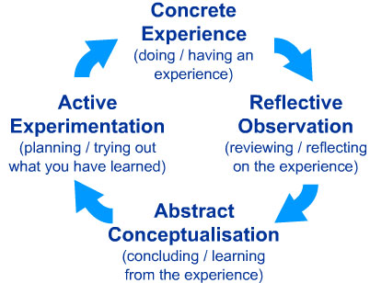
Relationship between Civic Engagement and Service Learning?
Notes:
John Dewey considered the father of experiential learning
Believed that learning was situational and happened through reflection
David Kolbs model of experiential learning becomes the foundation for S-L.
Kolbs model for experiential learning
Concrete experience- a new experience of situation is encountered, or a reinterpretation of an existing experience
Reflective Observation- of the new experience. Of particular importance are any inconsistencies between experience and understanding.
Abstract Conceptualization- Reflection gives rise to a new idea, or a modification of any existing abstract concept
Active Experimentation- the learner applies them to the world around them to see what results
As a result of practitioners wanting to take Service Learning to the next level. They wanted to move activism and politics from the margins, to the center of student learning as educators seek creative ways to move from service to civic engagement.” (Civic Engagement In Higher). Some have taken on new approaches to service learning that emphasis
Civic Engagement
Social Change
Social Justice

Slide 9
So why civic engagement for students?
Notes:
We want to encourage students to learn about and practice civic engagement so that they can create their own civic identities.
Civic identity- a student’s ability to see themselves as an active participant in society with a strong commitment and responsibility to work with others toward public purposes.- which can lead to social change.
In order to create this civic identity and lead to social change, it is important that students become critically conscious citizens.

Slide 10
Critical Consciousness Development
*Developed from interviews and survey responses from Benilde-St. Margaret’s School (BSM) alumni
Notes:
Susan Cipolle
The path to social change begins with developing a critical consciousness.
This model focuses on the development of critical consciousness of white middle to upper middle class people. Students of color and those of lower socioeconomic backgrounds will more than likely move through stages in a similar factory, however their would be different components due to their firsthand experiences with racism and classism.
The initial stage of critical consciousness development through service learning is charity. Being charitable is absolutely a positive characteristic, but given the possibility that students might exploit marginalized populations for their own benefit, it is important to guide students into the next stage of development which is caring.
The catalyst of the caring stage is relationship. As students interact with those they are serving, they develop compassion, see injustice, and question past beliefs. The dissonance between what they thought to be true and the reality they see makes them more aware of themselves, others, and social problems. If they stay in this stage long enough they will become compelled to do something to change the system and move into the social justice stage.
The social justice stage is the developing part. It is labeled developing and not developed because seeing others, the world, and ourselves is a never ending process. During this stage, individuals make a lifelong commitment to work as allies with oppressed groups, to understand the root causes of injustice and take action to make the system more equitable.
The third level of this model is the framework to help guide students on the path of becoming more critically aware. It focuses on providing accurate information on social issues, stage appropriate service experiences, and student reflection that focuses on clarifying their own values and obligation to others, as well as reflection on the current state of affairs and their vision for a better society.

Slide 11
Critical Consciousness Development
4 stages:
Developing a deeper awareness of self
Developing a deeper awareness and broader perspective of others
Developing a deeper awareness and broader perspective of social issues
Seeing one’s potential to make change

Slide 12
Developing a Deeper Awareness of Self
Having a clear understanding of your level of privilege, your values, your role in society, and your responsibility to others.
Participation in service and discussions about moral and civic obligations help individuals clarify their values and become committed to work for the common good.
Notes:
Effective service-learning opportunities help students develop a strong sense of self, giving them a sense that what they are doing is important.
When students take on leadership roles in service activities, it reinforces their self-image as capable and effective and increases their creativity, independence, and self-directedness.
Working with their friends is key because in searching for their own identity, they frequently look to others who are like them and have similar values.
Young people working alongside adults, confronting issues of poverty and discrimination, see social justice work as a possibility for themselves. It provides a basis for them to see their own privilege and power and examine how their actions can contribute to or fight against the status quo.

Slide 13
Developing a Deeper Awareness and Broader Perspective of Others
Students need to experience diversity and be in relationships with people who have different life experiences.
Students become less judgmental and more compassionate as a result.
Notes:
Having personal characteristics that set them apart results in learning the meaning of in-group and out-group which can lay the groundwork for seeing diversity and developing compassion for others.
For white, middle class students who have grown up in environments where they were predominantly around others like them, this is often achieved as a result of working with populations from different backgrounds. Students are out of their comfort zones and see injustice and inequity for the first time. Putting a face on poverty breaks down stereotypes, and statistics become meaningful. These experiences working with people of different background help to dismantle the wall between “us” and “them.”
Working with people of different ethnic or racial backgrounds, people living in poverty, or individuals with physical or mental challenges initiates a student’s exploration of difference, similarity, and diversity within inclusiveness. Students come to see people as individuals with their own stories, rather than as statistics and stereotypes.

Slide 14
Developing a Deeper Awareness and Broader Perspective of Social Issues
Students begin to question beliefs and assumptions that no longer provide adequate explanations for reality.
Students develop a more critical and complex view of the world and begin to see how power relations limit options for oppressed groups.
Students’ increased understanding of social issues fosters an institutional, systemic view of the causes of injustice and inequity, where they may have only seen individual deficits before.
Notes:
Occurs through accurate information, constructive service experiences, and critical reflection.
When students become more aware and informed about sociopolitical issues, they realize that what they had previously believed is often in accurate. Those beliefs no longer adequately explain the reality they see through their service work with diverse populations and communities.
Students see the contradictions between what they (and society) say they value and believe in and the injustices they see others experiencing. This leads to dissonance which leads to self-examination and questioning.

Slide 15
Seeing One’s Potential to Make Change
Having positive service experiences enhances their feelings of competency and efficacy.
Doing important work that has real impact on people and the community develops a sense of agency- the belief that you can make a difference.
Students develop an ethic of service and adopt it as part of their identity when they work with others in a culture that values it.
Notes:
Once students understand that the world is more complex and social problems are more widespread than they thought, service-learning becomes a vehicle for acting on their beliefs and making a difference.
Individuals who regard service as a part of their identity are more likely to connect their personal commitment to service with a profession where they can make social contribution to lead to social justice.

Slide 16
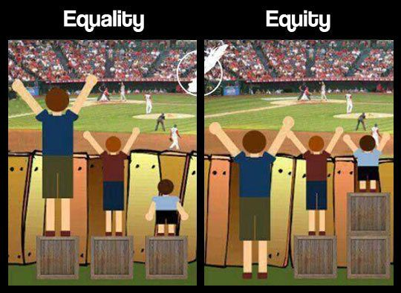
Defining Social Justice
“Social Justice Education is both a process and a goal. The goal of social justice education is full and equal participation of all groups in a society that is mutually shaped to meet their needs (Bell).”
Notes:
Equality is about SAMENESS. It promotes fairness and justice by giving everyone the same thing. BUT it can only work IF everyone starts from the SAME place. In this illustration, equality only works if everyone is the same height.
Equity is about fundamental FAIRNESS. It’s about making sure people get access to the same opportunities. Sometimes our differences and/or history, can create barriers to participation, so we must FIRST ensure EQUITY before we can enjoy equality.

Slide 17
Common Experiences of Adults Committed to Social Justice
Family
Common Service Experiences
Educational Environment
Notes:
Through Cipolle’s research, she found some common experiences of adults committed to social justice:
Their families instilled values and modeled service
They had a family situation that made them feel different from their peers
They had a broader, more inclusive definition of family.
They had extensive service experiences in multiple sites.
Had leadership roles in designing and implementing service projects
Worked directly with people from different backgrounds
Enjoyed service and participated in service with their friends
Worked alongside adults committed to social justice
Had service experiences abroad
Values were both taught and modeled in their schools.
Their classes provided opportunities to explore and discuss their beliefs and obligations to others.
Their schools’ missions included a commitment to service and social justice.
Their schools provided a mentoring environment.

Slide 18
Civic Engagement in the Classroom and Curriculum
A practical Application

Slide 19
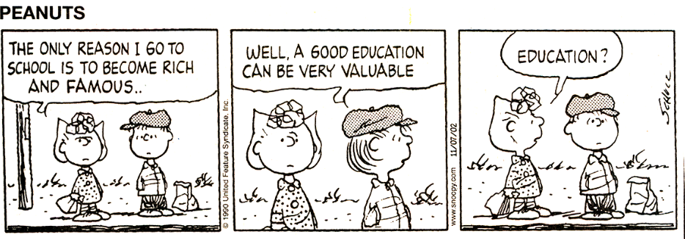
Why civic engagement matters

Slide 20
What does it mean to integrate CE into the classroom and curriculum?
For a student:
Learning actively not just through lecture
Understanding skills of active citizenship
Participating in service learning by serving the community
Recognizing s/he can make a difference and have an impact on many lives

Slide 21
For a faculty member:
Giving students a chance to reflect on what it means to be a responsible member of society
Taking SL a step further to include reflection on changed attitudes, the impact of the experience on the individual and the community, and an increased understanding of the responsibilities of living in a democratic society
Getting personally involved in service projects with or without students

Slide 22
For an institution:
Creating a culture of service and engagement
Embracing a mission of educating students for citizenship
Taking a greater responsibility to serve the community

Slide 23
For a community partner:
Creating collaborative partnerships between agencies and faculty
Informing and involving individuals in community building
Being actively involved in mentoring service learning students through reflection, guidance, and feedback
Notes:
How can faculty integrate concepts and exercises in a practical way that will encourage students to develop their own sense of civic responsibility?
How can faculty assess the development of civic responsibility in their students?

Slide 24
Pedagogies of engagement promote change
An increase in the value and significance that students attach to the principles of CE.
A change in the way that students relate to, and interact with, other members of the community.
An increase in the degree of confidence that students express in regard to their critical thinking skills.
An increase in the sense of efficacy that students express in regard to their ability to serve as agents of social and political change.

Slide 26
Your Turn
What do you see as the critical knowledge, skills, dispositions, and experiences that students must have to be active citizens and civically engaged?

Slide 27
Competencies: Partial to Pervasive

Slide 28
Strategies for incorporating CE in the classroom/curriculum
Develop novel approaches to research projects that enable students to relate their coursework to real world problems and increase student accountability by:
Assigning projects and/or designing websites that provide resources for community partners
Requiring students to take a stand on policy issues in written and oral assignments
Requiring students to conduct research in the community

Slide 29
Use exercises that enable students to empathize with individuals working for social and political change
Conducting mock electoral debates and conventions
Asking students to adopt historical personas in role-playing exercises
Teaching past and present social and political issues from the perspectives of multiple groups or individuals working for change

Slide 30
Provide opportunities for private and public reflection that connects coursework with civic engagement experiences by:
Using journals and informal reflective essays
Assigning written assignments that combine reflection with critical analysis and/or application to academic texts
Creating courses devoted to reflection after being away from campus for a semester or year-long civic experience
Make reflection public, especially using online media—blogs, websites, journals

Slide 31
Design collaborative and student-led projects that help students learn to work with diverse individuals and groups by:
Using student facilitators when interacting with community partners
Designing service learning components in which students teach what they have learned in class to members of the community and vice versa
Modeling democratic dialogues in class discussions

Slide 32
Expose students to differing opinions and approaches to help them view issues from multiple perspectives and relate coursework to multiple contexts by:
Offering team taught and/or interdisciplinary courses
Inviting guest speakers to class
Organizing interdisciplinary conferences on campus related to the subject matter of the course

Slide 33
The practice of civic responsibility and engagement
Activities discussion

Slide 34
AAC & U Civic Engagement VALUE Rubric

Slide 37
Questions

Slide 38
Bibliography
Campus Compact, Strategies for creating an engaged campus: Faculty development, an advanced service-learning toolkit.
Cipolle, S. B. (2010). Service-learning and social justice: Engaging students in social change. Lanham, MD: Rowman & Littlefield.
Daynes, G. (n.d.). The Use of History in the Movement for the Civic Engagement of Higher Education. Retrieved May 04, 2016, from http://ccncce.org/articles/the-use-of-history-in-the-movement-for-the-civic-engagement-of-higher-education/
Delano-Oriaran, O., Parks, M. W., & Fondrie, S. (n.d.). The SAGE sourcebook of service-learning and civic engagement.
Ehrlich, T., & Jacoby, B. (2009). Civic engagement in higher education: Concepts and practices. San Francisco, CA: Jossey-Bass.
Jacoby, B., & Howard, J. (2015). Service-learning essentials: Questions, answers and lessons learned. San Francisco: Jossey-Bass.
Berezowitz, Claire. Student Involvement Beyond the Classroom: Assessing Students’ Civic Competencies for Civic Engagement. Civic Engagement Workshop. University of Wisconsin, Feb. 2015. Web. 1 May 2016.
Ertle, Ellie, ed. Faculty Introduction to Civic Engagement. Tech. California State University at Chico, Jan. 2015. Web. 1 May 2016.
Gottlieb, Karla, and Gail Robinson, eds. A Practical Guide for Integrating Civic Responsibility into the Curriculum. 2nd ed. Washington, D.C: Community College, 2006. Print.
Liazos, Ariane, and Jan R. Liss. Civic Engagement in the Classroom: Strategies for Incorporating Education for Civic and Social Responsibility in the Undergraduate Curriculum. Rep. Project Pericles, Inc., Aug. 2009. Web. 1 May 2016.

