Slide 1
The ‘sexy psychopath’ and toxic masculinity
Panel presentation by Lindsey, Ethan Lewter, Maggie Bryant, Hannah Harrington, and Zion Keen

Slide 2
The ‘sexy psychopath’
Lindsey Marquardt

Slide 3
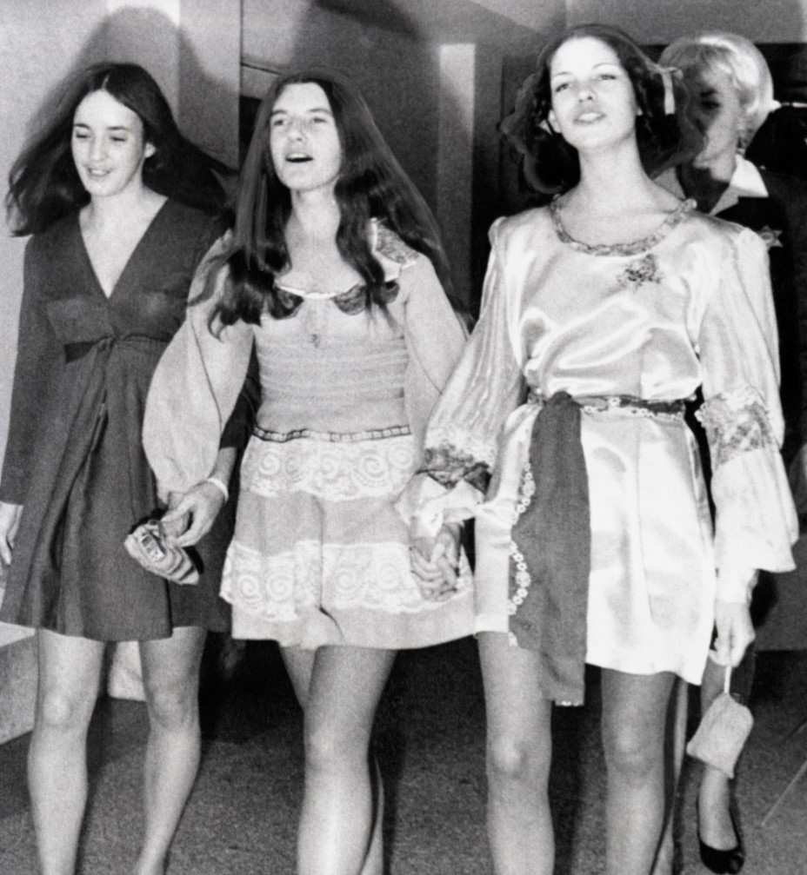
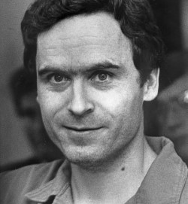

Slide 4
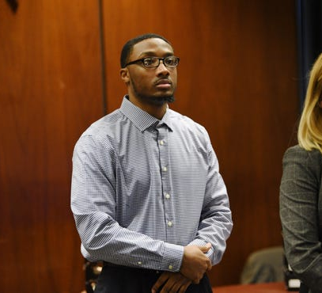
Khalil Wheeler- Weaver

Slide 6
Changing the female victim narrative
Zion Keen

