Slide 1
The charismatic killer
Maggie Bryant
This Photo by Unknown Author is licensed under CC BY-NC-ND

Slide 2
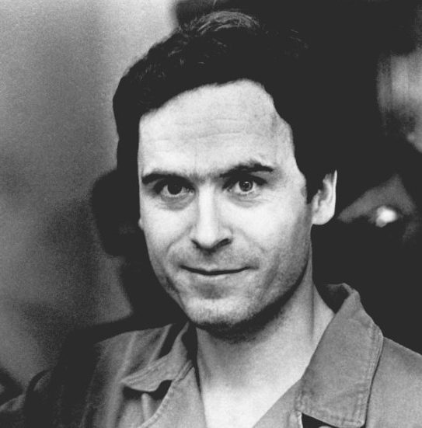
Forensic psychologist and FBI consultant Darrel Turner told INSIDER: …“he was charming and handsome and a charismatic young man.“
https://www.insider.com/netflix-asks-viewers-to-stop-obsessing-over-serial-killer-ted-bundys-hotness-2019-1

Slide 3
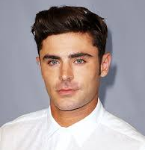
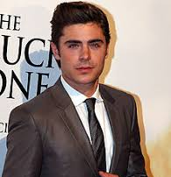
https://en.wikipedia.org/wiki/Zac_Efron https://www.flare.com/celebrity/zac-efron-as-ted-bundy/

Slide 4
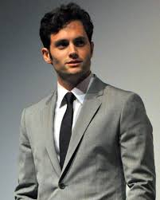
https://en.wikipedia.org/wiki/Penn_Badgley

Slide 5
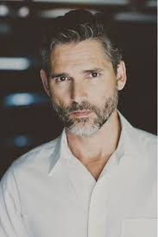
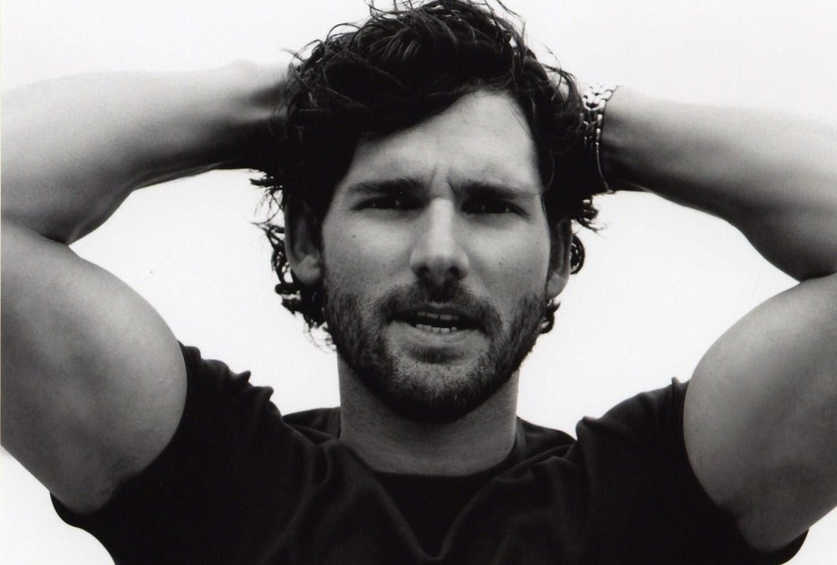
https://movietvtechgeeks.com/eric-bana-talks-dirty-john-bad-guys-and-getting-into-a-psychopaths-mindset/
https://www.imdb.com/name/nm0051509/

Slide 6
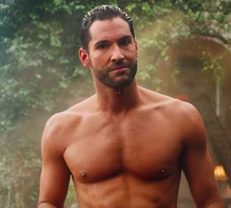
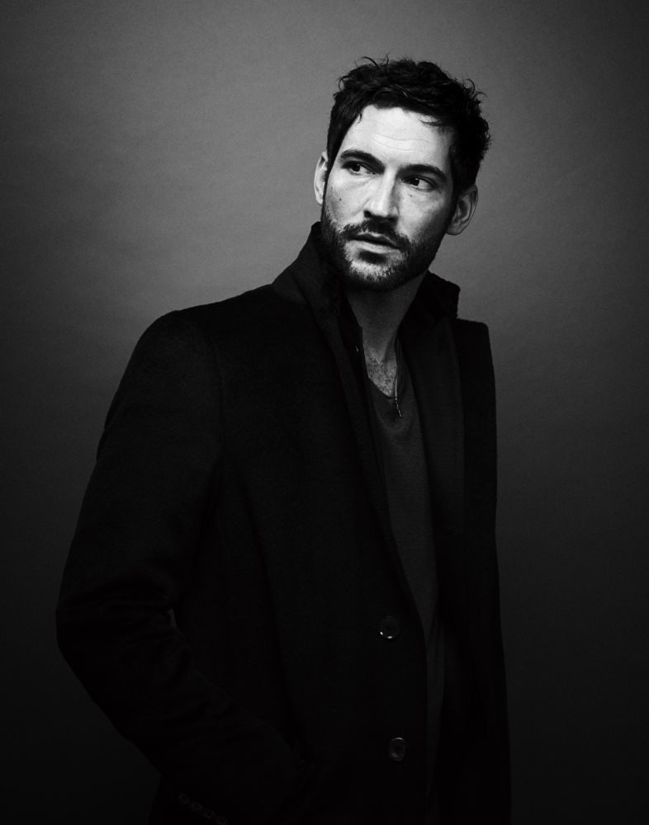
This Phot
http://www.newnownext.com/lucifer-tom-ellis-thirst-tweets-butt-shirtless/05/2019/ https://www.interviewmagazine.com/culture/tom-ellis

Slide 7
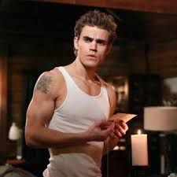
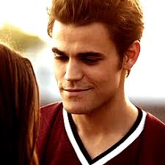
https://www.charactour.com/hub/characters/view/Stefan-Salvatore.The-Vampire-Diaries https://www.pinterest.com/pin/669980882038313637/?lp=true

