Slide 1
Variability in Dissociative Identity Disorder
Maggie Bryant

Slide 2
What is DID?
Type of dissociatve disorder
Used to be called Multiple Personality Disorder
2-100 personalities (Fox et al, 2013)

Slide 3
Relationships Between Alters
Levels of communication
Histories
Interactions

Slide 4
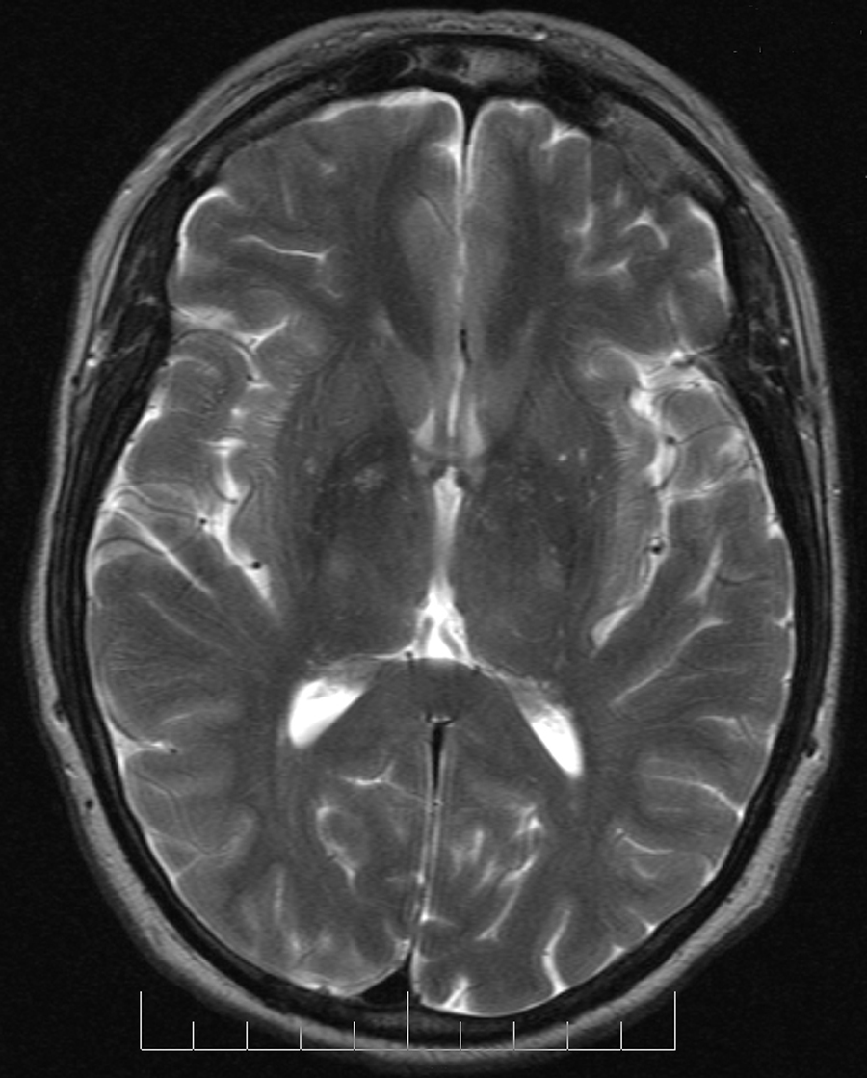
Memory/Amnesia
Morton Study (Morton, 2017)
Alters A and B given separate lists
Tested a week later on recognition of words
Results
Not total amnesia
Recognition on scans but not conscious memory
Exception

Slide 5
Characteristics
Physical characteristics
Speaking manners
Temperament
Intelligence
Talents
Gender/sexuality

Slide 6
Differing
Roles
Study by Fox et al.
Study by Zeligman et al.

Slide 7
References
Barlow, M. R., & Chu J.A. (2014). Measuring fragmentation in dissociative identity disorder: The integration measure and relationship to switching and time in therapy. European Journal of Psychotraumatology, 5 1-N.PAG. https://login.proxy.longwood.edu/login?url=http://search.ebscohost.com/login.aspx?direct=true&db=pbh&AN=94967623&site=ehost-live&scope=site
Fox, J., Bell, H., Jacobson, L., & Hundley, G. (2013). Recovering identity: A qualitative investigation of a survivor of Dissociative Identity Disorder. Journal of Mental Health Counseling, 35(4) 324-341. https://login.proxy.longwood.edu/login?url=http://search.ebscohost.com/login.aspx?direct=true&db=pbh&AN=91100210&site=ehost-live&scope=site
Humphreys, C. L., Rubin, J. S., Knudson, & R. M., Stiles, W. B. (2005). The assimilation of anger in a case of dissociative identity disorder. Counseling Psychology Quarterly, 18(2) 121-132. https://login.proxy.longwood.edu/login?url=http://search.ebscohost.com/login.aspx?direct=true&db=pbh&AN=17535220&site=ehost-live&scope=site
Morton, J. (2017). Interidentity amnesia in dissociative identity disorder. Cognitive Neuropsychiatry, 22(4) 315-330. https://login.proxy.longwood.edu/login?url=http://search.ebscohost.com/login.aspx?direct=true&db=pbh&AN=123602708&site=ehost-live&scope=site
Zeligman, M., Greene, J. H., Hundley, G., Graham, J. M., Spann, S., Bickley, E., & Bloom, Z. (2017). Lived experiences of men with Dissociative Identity Disorder. Adultspan Journal, 16(2) 65-79. https://login.proxy.longwood.edu/login?url=http://search.ebscohost.com/login.aspx?direct=true&db=pbh&AN=125541804&site=ehost-live&scope=site

