Slide 1
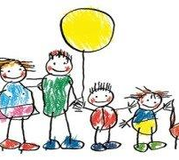
Developmental Effects of Having a Terminally Ill Sibling
Payten Bovat
Honors EDUC 245
Dr. Cosby
This Photo by Unknown author is licensed under CC BY-SA-NC.

Slide 2
Research Questions
What are the emotional effects of having a sibling with a terminal illness?
How does this affect the child's self-view?
How do parenting styles differ and what effect does this have on the child?

Slide 3
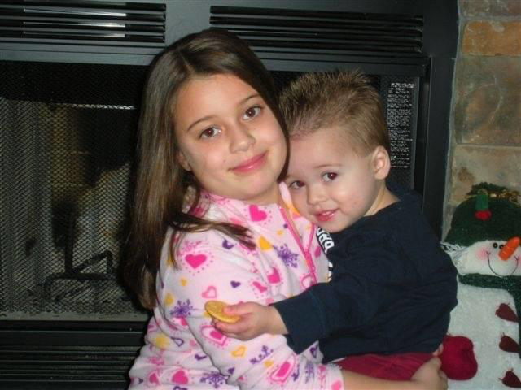
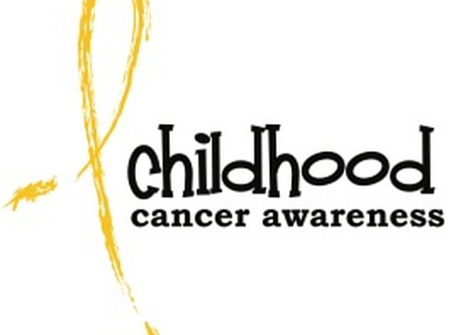
Meet Sydney and Billy
Sydney-7 years old
Billy- 2 years old
At 1-year old Billy was diagnosed with cancer.

Slide 4
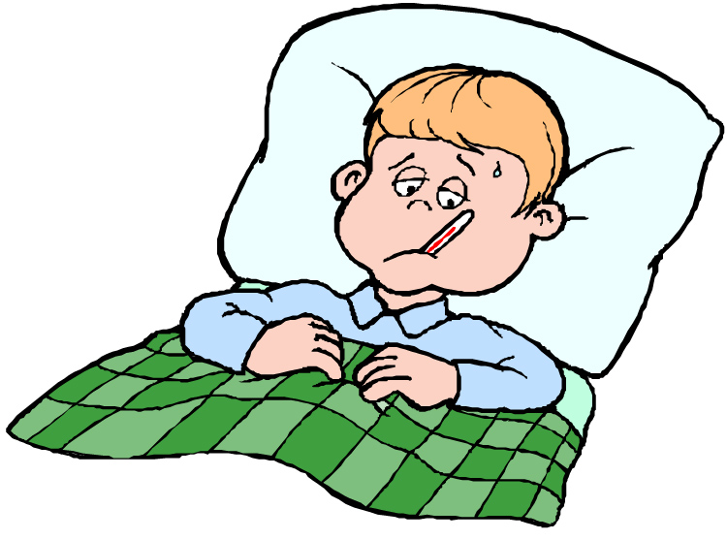
Physical Development Biological changes in the body and brain.
Due to constant worrying about their sick sibling, the child will often experience exhaustion due to lack of sleep (La Clare, 2013).
Typically after the sibling's initial diagnosis, the nutrition of the well child decreases as they go through stages of grief and depression (Fleary & Heffer, 2013).
As a result of both lack of sleep and poor nutrition, the well child's immune system becomes more susceptible to illness and may result in the already ill child getting sicker (Crehan, 2011).
Poor nutrition affects both cognitive and social-emotional development:
Poor nutrition + fatigued=poor cognitive performance and low emotional state

Slide 5
Physical Effects
Billy, Sydney's baby brother gets diagnosed with cancer
Sydney becomes depressed and begins to grieve
Sydney stops eating
Immune system declines due to poor nutrition
Sydney gets sick with a cold
Isn't allowed to visit Billy in the hospital
Depression worsens

Slide 6
Cognitive Development Changes in the way we think, understand, and reason about the world.
A child's cognitive development can be hindered for multiple reasons when their sibling is terminally ill:
Being present but not "present" in academic classes due to worry about their sibling
Parent's inability to get them to and from school because the need of the ill child to have an adult with them at home/in the hospital
Child does not feel mentally/emotionally up to the task of going to school and parent gives in to avoid conflict

Slide 7
Cognitive Development cont...
Being exposed to high stress situations in middle childhood, children explore healthy coping mechanisms at a much earlier age than the typical child.
Although there may be academic consequences, there are also positive cognitive effects such as:
Broadened vocabulary and understanding of medical terminology
Exposure to "adult problems" helps children move from the concrete operational stage into the formal operational stage where they become more inclined to think abstractly to better accommodate their ill sibling (Piaget's Theory of Cognitive Development)
The child can think ahead into the future –abstractly- as opposed to only thinking about the "here and now" -formally- (Piaget's Theory of Cognitive Development)

Slide 8
Social-Emotional Development Changes in the way we connect to other individuals and express and understand emotions
Having a sick sibling helps a child advance in understanding emotional display rules (La Clare, 2013) .
When the family gets bad news about Billy's illness, Sydney puts on a brave face for her baby brother by controlling her facial expressions and body language.
Even though Sydney does not have cancer, she is no longer allowed to go to a friend's house or have friends over to her house because Billy's chemotherapy makes him especially susceptible to catching a sickness.
Thus, Sydney's social development is hindered because she loses that typical contact she would normally have with peers and it is replaced by constant contact with family (La Clare, 2013).

Slide 9
Social-Emotional Development cont...
As the sick child's illness progresses and more intense care is required, the well child may begin to resent their sibling for taking up all their parent's time (Rosenberg, 2014).
Perhaps the greatest benefit of growing up with a sick sibling is that the children are shown to have greater compassion and empathy.
They also exhibit a greater overall appreciation and understanding of life (Sharpe & Lucille, 2002).

Slide 10
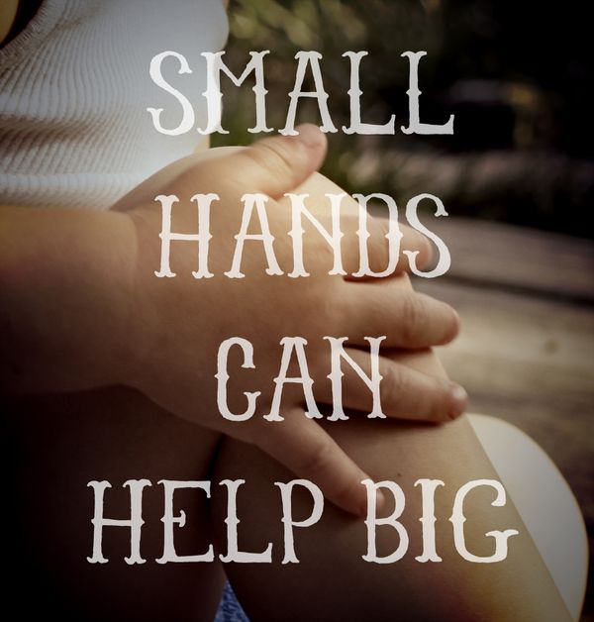
Behavioral Perspective
Research has shown that when the healthy child can contribute to caring for the ill child, they are less likely to act out for attention and generally have a better emotional response to their sibling's illness (Murray, 1999).
Behavior is learned from the environment through the process of observational learning (Bandura, 1977).
When the healthy child observes their parent(s) remain calm and display a positive attitude, the child then models that positive behavior
If a parent creates a positive environment to stressful situations through their responses, children will be more likely to imitate those same calming strategies when they are faced with adverse stress (Attention, Retention, Reproduction, Motivation)

Slide 11
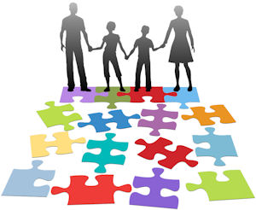
Parenting Styles
Authoritative- Have rules and use consequences, but also take the child's feelings and opinions into account
Authoritarian- Believe that children should follow the rules, no exceptions
Permissive- Lenient and typically only step in if there is a serious problem
Disengaged- Generally have little knowledge of what their child is doing

Slide 12
Parenting Styles cont...
Parenting styles truly do shape who children become, even more so when there is an illness being considered.
Often, parents will take a permissive parenting approach to the ill child because the child is "already going through enough" (La Clare, 2013).
In contrast, more responsibility is typically placed on the well child and therefore an authoritarian approach is taken (La Clare, 2013).
According to Sharpe and Lucille (2002), an authoritative approach is in the best interest for both the healthy and ill child.
Keeps well child from feeling neglected
Holds ill child to set standards that are reasonable, even though they are sick

Slide 13
Resources
Crehan, G. (2011). The Surviving Sibling: The Effects Of Sibling Death In Childhood. Psychoanalytic Psychotherapy,18(2), 202-219. doi:10.1080/14749730410001700723
La Clare, Heather L. (2013). The Impact of Childhood Chronic Illness on the Family: Psychosocial Adjustment of Siblings. Retrieved from Sophia, the St. Catherine University repository website: https://sophia.stkate.edu/msw_papers/218
Fleary, S. A., & Heffer, R. W. (2013). Impact of Growing Up with a Chronically Ill Sibling on Well Siblings Late Adolescent Functioning. ISRN Family Medicine,2013, 1-8. doi:10.5402/2013/737356
Jason Fletcher & Marsha Mailick & Jieun Song & Barbara Wolfe, 2013. "A Sibling Death in the Family: Common and Consequential," Demography, Springer;Population Association of America (PAA), vol. 50(3), pages 803-826, June.

Slide 14
Resources cont...
Murray, J. S. (1999). Siblings of children with cancer: a review of the literature. Journal of Pediatric Oncology Nursing, 16(1), 25-34.
Rosenberg, Abby R et al. “Long-term psychosocial outcomes among bereaved siblings of children with cancer.” Journal of pain and symptom management vol. 49,1 (2014): 55-65. doi:10.1016/j.jpainsymman.2014.05.006
Sharpe, Donald & Lucille Rossiter. “Siblings of Children With a Chronic Illness: A Meta-Analysis.” Journal of Pediatric Psychology, vol. 27, no. 8, 2002, pp. 699–710.
Yu Y, Liew Z, Cnattingius S, et al. Association of Mortality With the Death of a Sibling in Childhood. JAMA Pediatr. 2017;171(6):538–545. doi:10.1001/jamapediatrics.2017.0197

Slide 15
Can I answer any questions?

