Slide 1
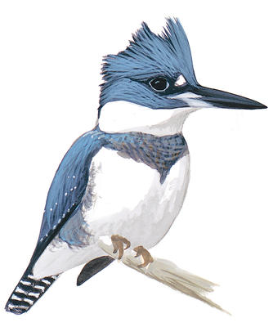
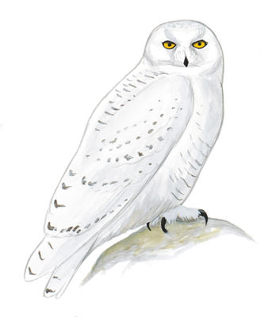
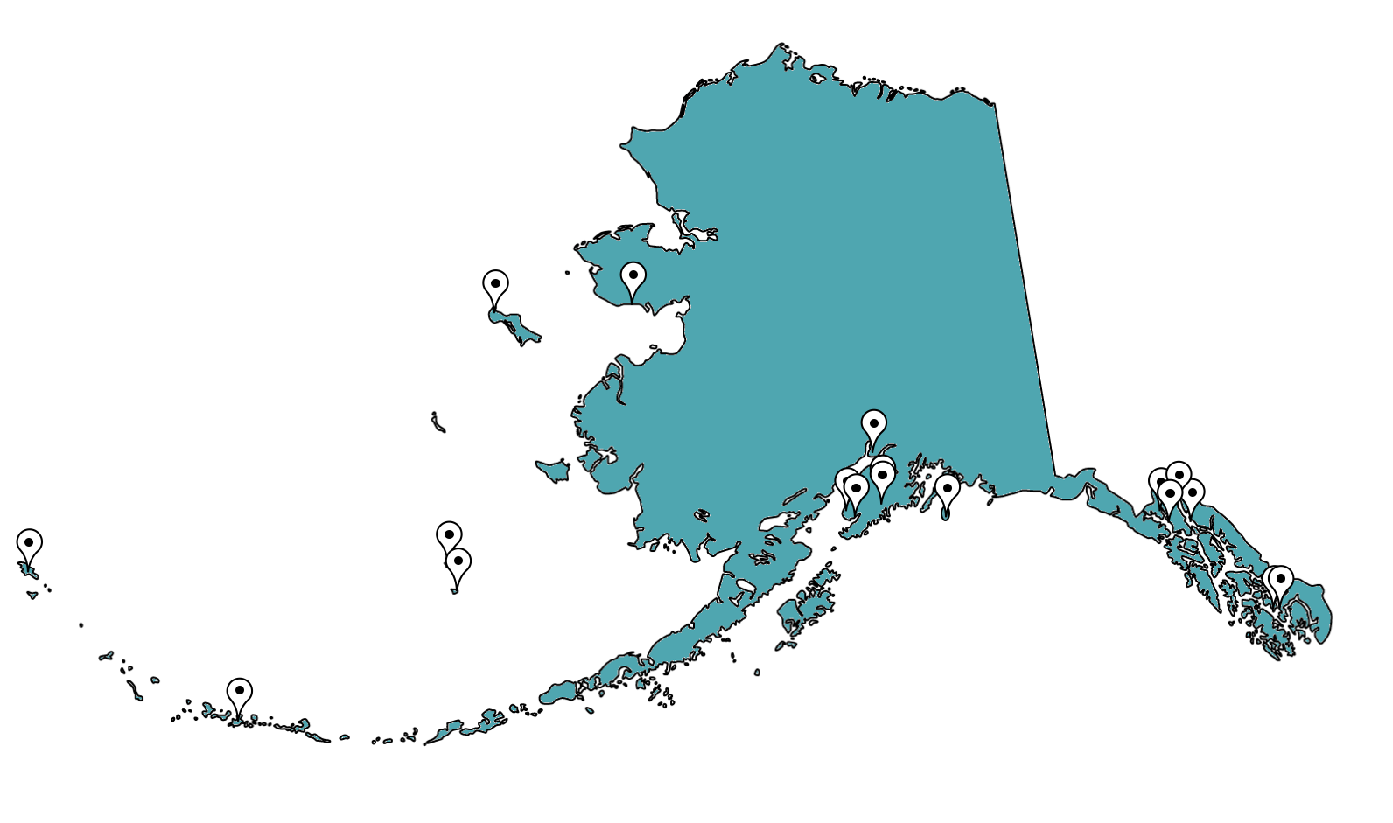
Seasonal Changes of Bird species diversity and COMMUNITY composition in ALASKA
BIOL 251: Introduction to Ecology and Evolution
Honors project
Megan Bland
Faculty advisor: Dr. Sujan Henkanaththegedara
Department of Biological & Environmental Sciences, Longwood University, Farmville VA 23909.
INTRODUCTION
Data Analysis
Bird abundance for waterfowl, loons, cormorants, birds of prey, shorebirds, owls, hummingbirds and swifts, and perching birds’ summer and winter seasons was analyzed using two-sample t-tests.
The average number of species per site for the summer and winter seasons was also analyzed using a two-sample t-test.
METHODS
RESULTS
The Artic region has critical breeding habitats for many migratory bird species (Ashenhurst et al 2007).
Bird abundance and diversity is high near bodies of water and in deciduous forests (Rooper et al 1998, Willson et al 1996).
However, the seasonal changes of species diversity and community composition in a regional scale are poorly documented.
We assessed the diversity and community composition of birds in Alaska during breeding season (June-July) and winter season (December-February) in selected locations.
Research Objectives
To analyze effects of seasonal variations on the diversity and community composition of birds in Alaska.
Individual data per bird group for breeding and winter seasons
RESULTS
Waterfowl, shorebirds, and perching birds are the most abundant bird groups seen in the breeding and winter seasons.
On average, the breeding season has a higher number of species and individuals (t = 8.62; p < 0.0001).
Bird Diversity Between the Breeding and Winter Seasons
METHODS
Data collection
Bird population data was collected from Cornell Lab of Ornithology and National Audubon Society’s eBird database (http://ebird.org/content/ebird/).
The 30 most species rich hotspots were selected for data collection.
Bird species were subdivided into 17 different bird groups and data was quantified for each site for the breeding and winter seasons.
Significance between breeding and winter per bird group
Bird Group | t value | P value
Waterfowl Breeding vs. Winter | 3.8949 | < 0.0001
Loons Breeding vs. Winter | 2.7471 | < 0.01
Cormorants Breeding vs. Winter | 2.672 | < 0.05
Birds of Prey Breeding vs. Winter | 3.0942 | < 0.01
Shorebirds Breeding vs. Winter | 9.2946 | < 0.0001
Owls Breeding vs. Winter | -1.0192 | 0.3128
Hummingbirds & Swifts Breeding vs. Winter | 6.292 | < 0.0001
Perching Birds Breeding vs. Winter | 6.9977 | < 0.0001
Average Number of Species Breeding vs. Winter | 8.6291 | < 0.0001
DISCUSSION
Each bird group, except for owls, has evidence at the 5% significance level that there is a difference in the breeding season and winter season.
From this, we can conclude that most birds migrate to Alaska to breed in the summer then migrate away from Alaska in the winter.
Future research includes the assessment of the spring and fall migrations to see if they differ. Other bird groups also can be studied to determine if there is significance in these seasons.
Average bird species data for breeding and winter seasons
REFERENCES
Ashenhurst, A.R., and Hannon, S.J. 2007. Effects of seismic lines on the abundance of breeding birds in the Kendall Island bird sanctuary, Northwest Territories, Canada. Arctic 61(2):190-198.
Rooper, C.N., Haldorson, L.J., and Quinn III, T.J. 1998. Habitat factors controlling Pacific herring egg loss in Prince William Sound, Alaska. Can. J. Fish. Aquat. Sci. 56:1133-1142.
Willson, M.F., and Comet, T.A. 1996. Bird communities of northern forests: patterns of diversity and abundance. The Condor 98:337-349.
Figure 1. Sampling locations for bird species diversity and composition.

