Slide 1
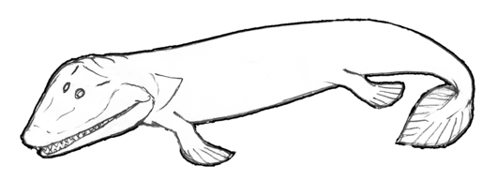
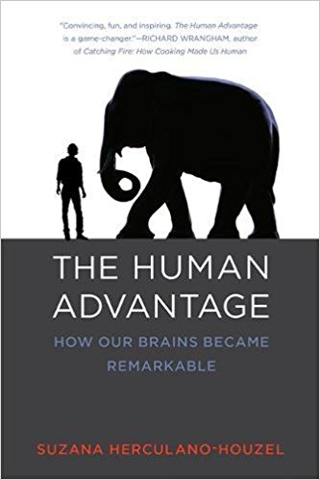
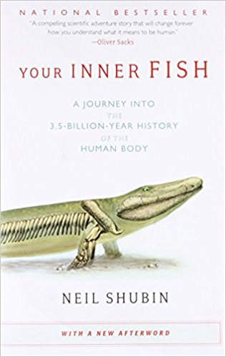
CHOOSING A COMPANION: YOUR INNER FISH or THE HUMAN ADVANTAGE
Megan Bland, Matthew Bowman, Hannah Hatke, and Alyssa Oppedisano
BIOL 399 Evolution Honors ⧫ Faculty Advisor: R. Adam Franssen, Ph.D.
Department of Biological and Environmental Sciences, Longwood University, Farmville VA 23909
PROJECT OBJECTIVE & METHODS
Evaluate Herculano-Houzel’s The Human Advantage as a possible companion text for BIOL 399 Evolution to replace Shubin’s Your Inner Fish. We read the book, created exam study guides, and discussed the book in context of the course student learning outcomes.
THE HUMAN ADVANTAGE
Suzana Herculano-Houzel
An exploration of what it IS about our brains that makes humans different
SPOILER ALERT! It’s not the size of our brain that makes our brain special, it is the fact that we have more neurons in the cerebral cortex
Text follows not only the research, but also the author’s journey to discovery
Why Read a
Companion Text?
YOUR INNER FISH
Neil Shubin
An exploration of how the theory of evolution allowed the author to predict the location on and eventually find a 375 mya “missing link”, Tiktaalik
Examines both morphological & molecular evidence that we’ve evolved from ancient organisms
Uses understanding of evolutionary past to understand medical issues facing humans today
Written from a different perspective than textbooks, potentially appealing to a wider range of learners
“Real-world” application of material learned in class
Help meet course’s student learning outcomes
Opportunity to cover additional topics or delve more deeply into specific concepts:
Your Inner Fish explores the predictive power of evolution
The Human Advantage make connections between neuroscience and evolutionary theory
ADVANTAGES | DISADVANTAGES
Inclusive! May inspire underrepresented groups to continue in the sciences Addresses relationship between humans and other great apes Figures are approachable Helps meet course SLOs 1, 2, 3, and 6 | Too much neuroscience? Not a topic addressed otherwise in the course LOTs of experimental data presented w/o explicit explanation of significance Not written for a general audience; too specialized
Student Learning Outcomes
BIOL 399 Evolution
Summarize the historical development of modern evolutionary theory
Describe the processes of biological evolution
Synthesize information in current media – including both peer-reviewed journal and popular press articles with “textbook” knowledge
Generate testable evolutionary-relevant hypotheses based on given information (morphological, molecular, geographic, etc.)
Write a scientific lab report including relevant figures
Explain how an strong understanding of biological evolution can be applied to modern-day issues such as global warming, mass extinction, or bacterial resistance
ADVANTAGES | DISADVANTAGES
Fascinating to read Eye-catching figures that appeal to all readers Tightly correlated with lecture topics Meets course SLOs 1, 2, 3, and 6 | Not many! Perhaps is too closely related and doesn’t expand into new realms of evolutionary knowledge
THE VERDICT
After reading both Your Inner Fish and The Human Advantage, we unanimously prefer Shubin’s text. Though both meet the objectives of a companion text and meet several SLOs, Your Inner Fish is a more engaging read and supports student learning of course content. For questions and references, email megan.bland@live.longwood.edu
Notes:
What Dr. Franssen had in his original email (about THA):
Student Learning Outcomes:
Read a general audience non-fiction text to learn about Evolutionary Neuroscience
Create appropriate exam questions in the form of a study guide for students
Discuss what you learn in the book in the context of existing BIOL 399 course outcomes
Recommend to adopt or not adopt The Human Advantage as a companion text in BIOL 399 Evolution.

