Slide 1
Radiation Shielding of Medical Personnel
Kaleigh Beale

Slide 2
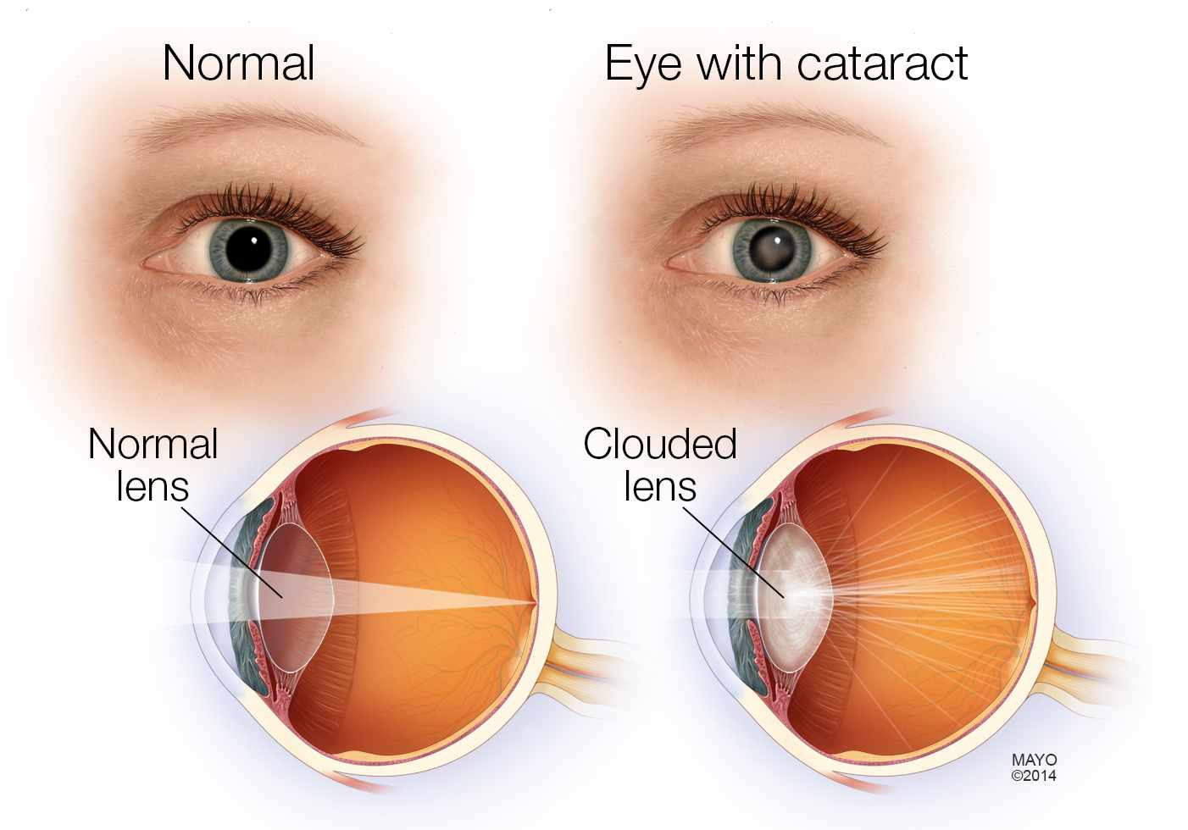
Effects of Radiation
Introduction Question Synthesis Conclusion
Cataracts
Brain Cancer (D)
(Vano, 2010) (Maeder, 2006) (Nikiforov, 2010)
Notes:
Reports on annual eye lens doses up to 900 mSv over several years and consecutive eye lens injuries (cataract) in nonoptimized interventional radiology laboratories [6] as well as reports about a higher incidence of brain cancer in interventional cardiologists [7] stress the potential hazard of scatter radiation to the unprotected head and underscore the importance of routine measurement of these local doses.(D)\
Study (B) proves that people who are constantly exposed to ionizing radiation and do not wear led glasses will get cararacts. It starts off very slowly and first shows as opacity but repeated exposure creates cataracts and that will eventually require surgery..

Slide 3
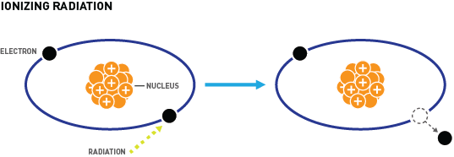
Introduction Question Synthesis Conclusion
(Mu, 2018)

Slide 4
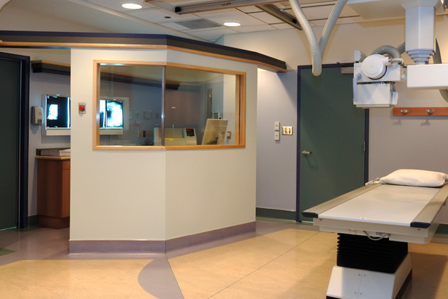
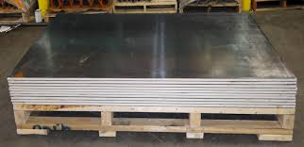
Structural Barriers
Introduction Question Synthesis Conclusion
Notes:
Where we are now. So starting from large to small, radiation shielding can be found in walls, movable barriers, aprons, gloves, and glasses.
WALLS- Lead is a common barrier for walls but any time two pieces of lead meet, another sheet of lead must be placed behind it to cover the holes. Concrete walls have been used but it must be very thick to ensure that radiation does not escape. Leaded glass or leaded acrylic have been used as a transparent barrier. (A) (INSERT DATA)
Movable barriers
Lead aprons- the lead is often mixed with a rubber-like material to make the aprons a little more flexible because if lead bends by itself, it will crack and a cracked apron exposes the wearer to radiation. There are different kinds of lead aprons (double-sided wrap, full front protecting, and skirt vest combinations) HOWEVER, lead vests are heavy
Lead gloves- typically have a lead equivalence of .25 mm BUT it is suggested that you wear at least .5mm of lead equivalence if you experience primary exposure. Some leaded gloves are heavy to wear and reduce the manual dexterity of the wearer buty they are essential for lowering the dose.
Lead Glasses- They should be shaped like goggles so that they cover all angles of the eye. If they were just glasses you would have no protection if you moved your head. They typically reduce radiation by 30-70%

Slide 5
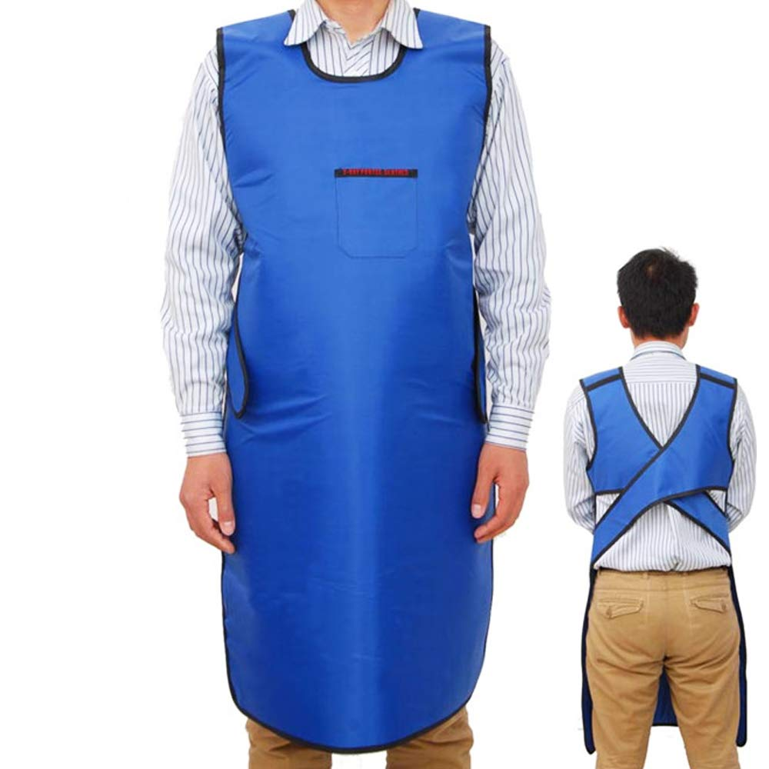
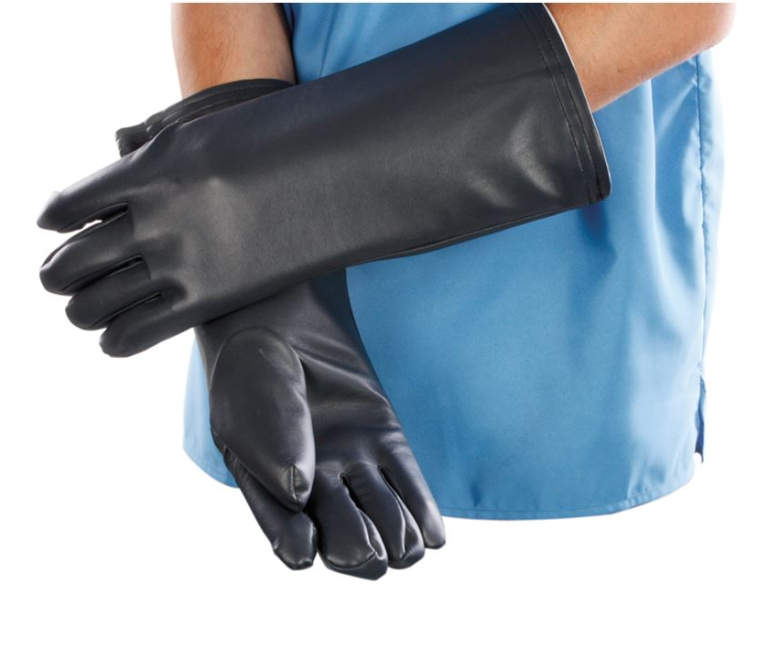
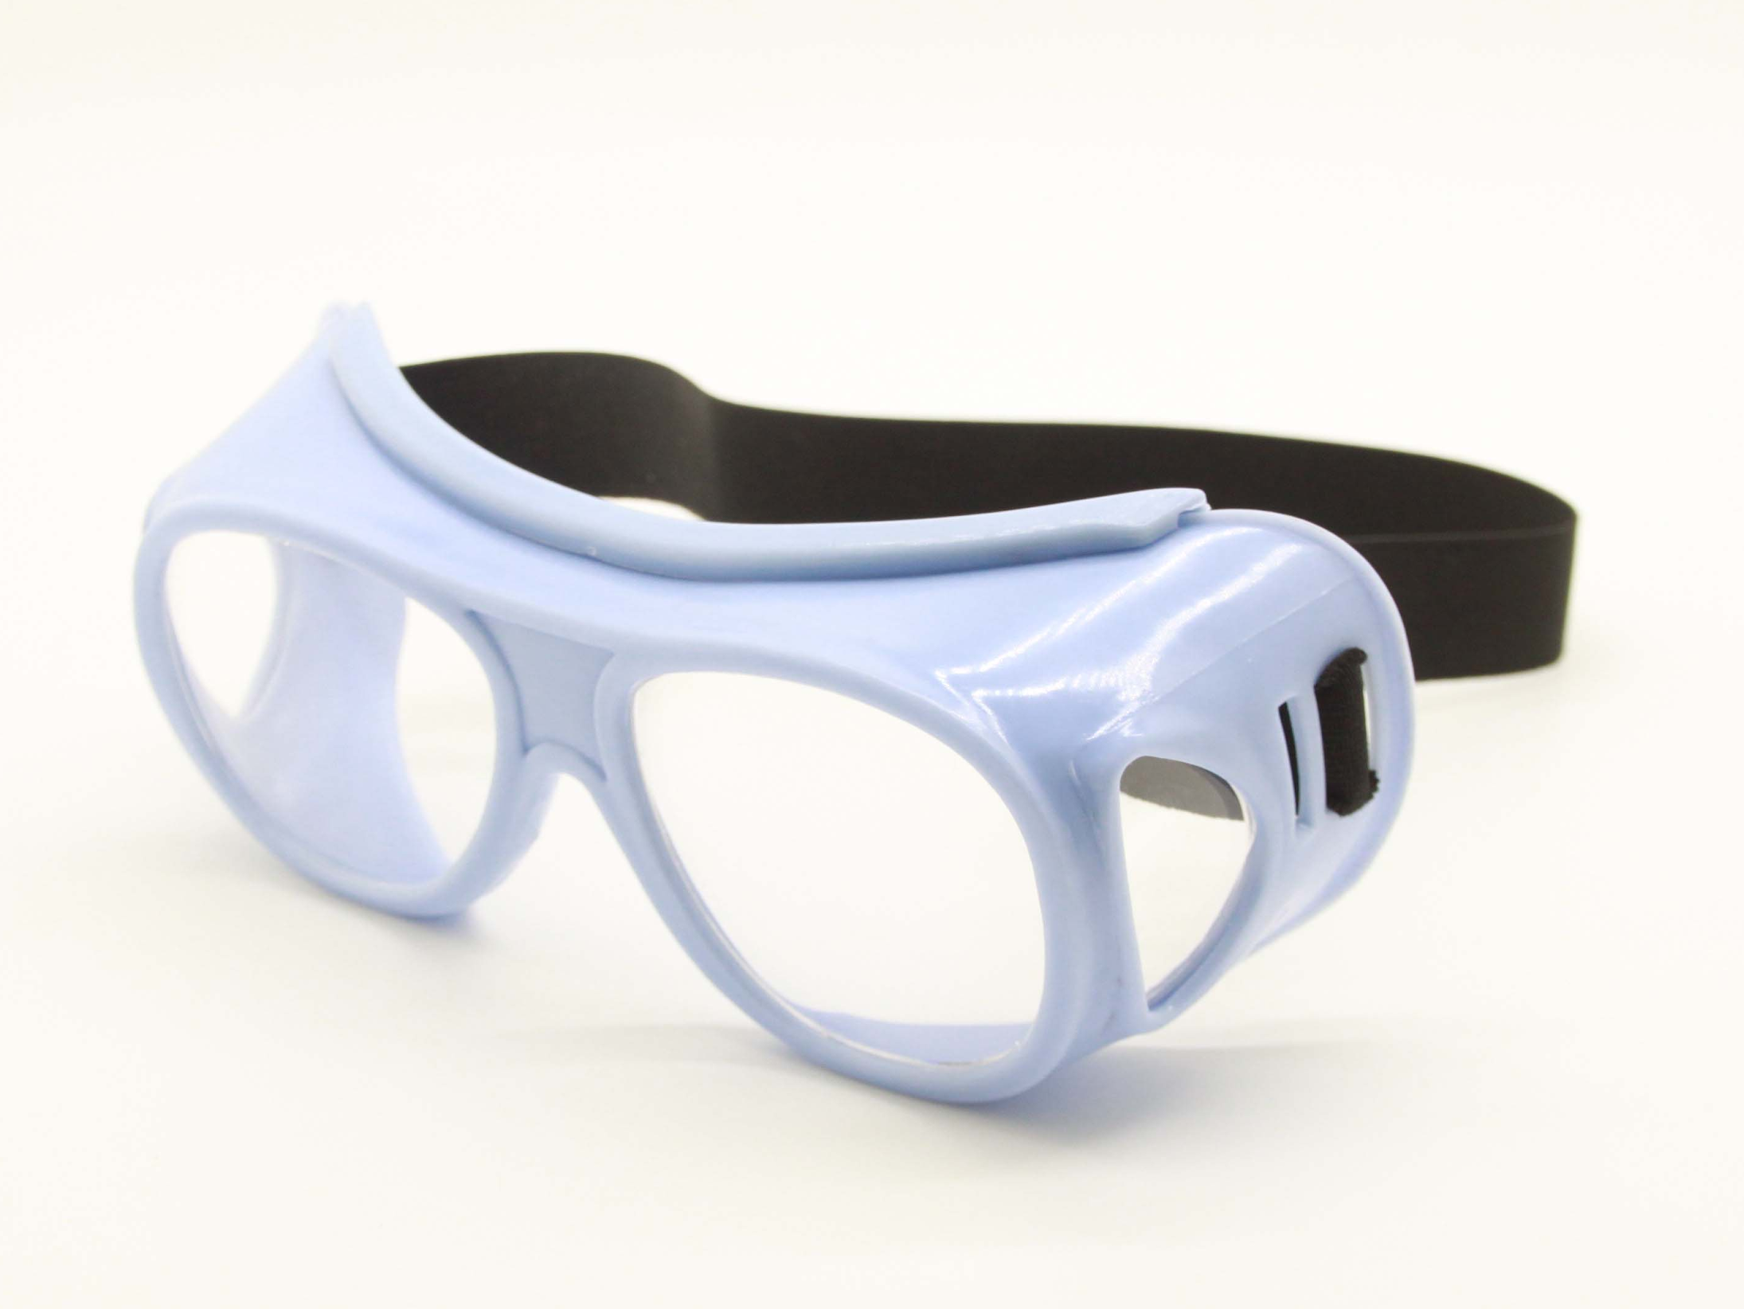
Personal Protective Equipment
Introduction Question Synthesis Conclusion

Slide 6
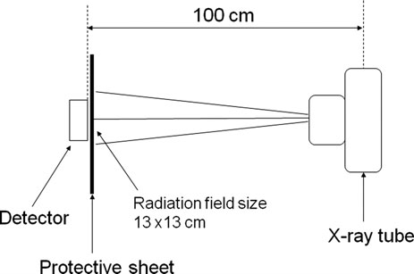
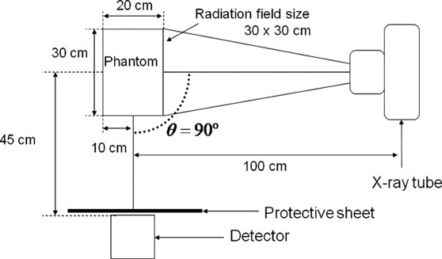
Types of Radiation
Introduction Question Synthesis Conclusion
Primary Radiation
Secondary Radiation
(Zuguchi, 2008).
Notes:
Primary radiation exposure occurs when an x-ray beam is directed towards the patient
Secondary radiation exposure comes from places other than the x-ray beam
Leakage occures when radiation other than the primary beam escapes the x-ray tube.
Scattered radiation is emitted by the patient and is the primary concern for radiation exposure to medical personnel.

Slide 7
Transparent Lead Glass Screen
Introduction Question Synthesis Conclusion
(Maeder, 2006)

Slide 8
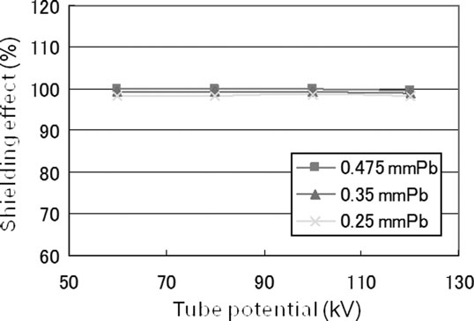
Non-Leaded Aprons vs. Leaded Aprons
Introduction Question Synthesis Conclusion
Figure 6. Shielding effect in terms of X-ray transmission of the non-lead apron against scattered X rays (Zuguchi, 2008).

Slide 9
How can radiation shielding be improved?
Introduction Question Synthesis Conclusion

Slide 10
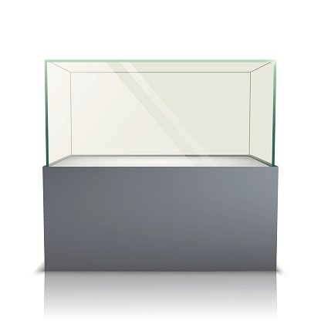
Introduction Question Synthesis Conclusion

Slide 11
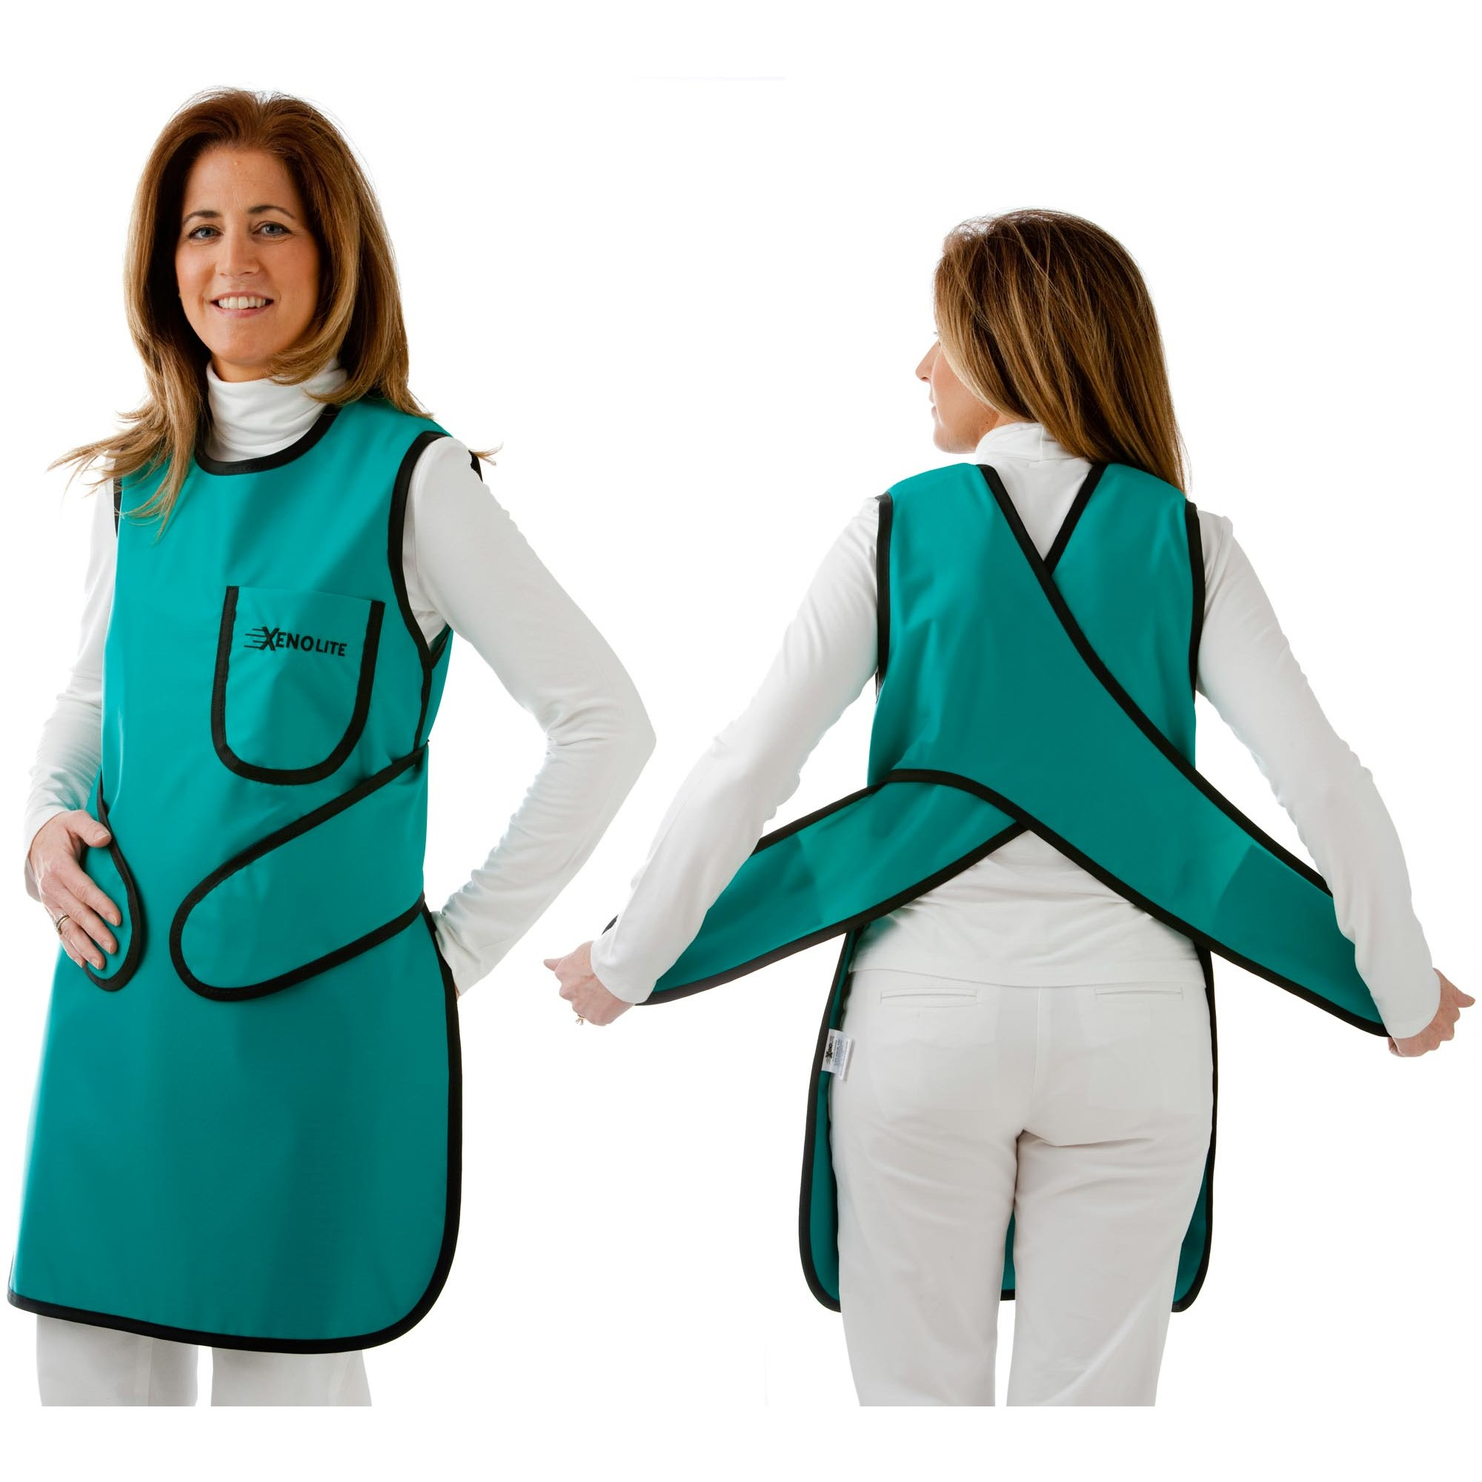
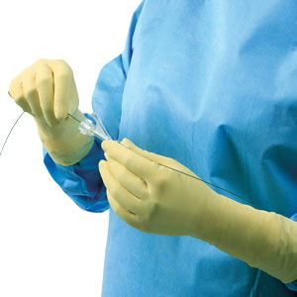
Non-leaded materials
Introduction Question Synthesis Conclusion

Slide 12
Conclusion
Introduction Question Synthesis Conclusion
By combining the technology that already exists, we can design structures that will provide better radiation shielding for medical personnel.

