Slide 1
Moral Education
An Argument By: Kristján Kristjánsson
Presented By: Taylor Bauer

Slide 2
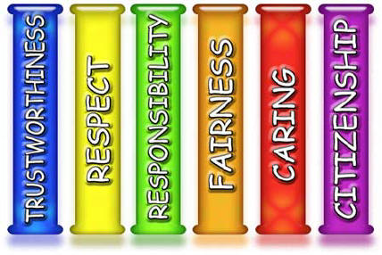
Non-expansive Character Education (NECE)
teaching “basic and fundamental virtues and values” (Kristjánsson 137)
Example
The Pillars of Character

Slide 3
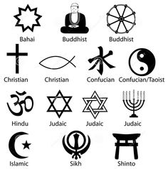

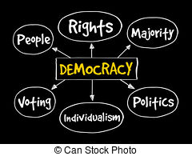
Expansive Character Education (ECE)
Teaching “goes beyond the fundamental and the basics to more complex qualities of character and virtue” (Kristjánsson 138)
Examples
Religious Moral Reasoning Civic Education

Slide 4
The Non-expansive Character Education in Schools Argument
If ECE is not applicable to all people and NECE is sufficient then, NECE should be taught in schools.
It is the case that ECE is not applicable to all people and NECE is sufficient.
Therefore, schools should teach NECE.
1,2 Modus Ponens

Slide 5
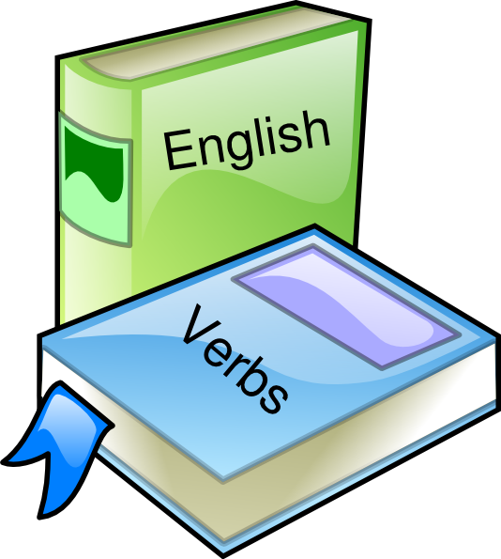
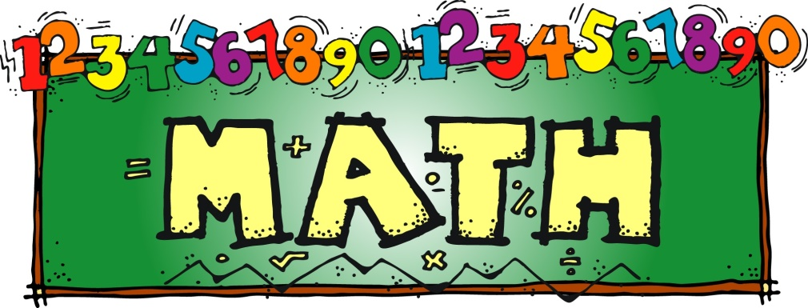
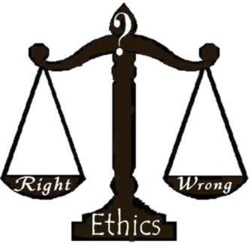


Assumption
Morality should be taught to students at school as part of the curriculum

Slide 6
Premise 1
A typical ECE program would focus more on topics of moral reasoning and less on habits
ECE has a variety of possible foundations
“reasonable to confine character education to the ‘moral basics’ which can appeal to every reasonable person, irrespective of cultural identity, political affiliation or religious creed” (Kristjánsson 138)

Slide 7
Premise 2
There are “three main factions of ECE” which are “religious-based character education, civic education and liberationist pedagogy” (Kristjánsson 139)
schools at minimum are in existence to teach the minimum amount of information necessary for survival in society

Slide 8
Objections
If ECE is not applicable to all people and NECE is sufficient then, NECE should be taught in schools.
It is the case that ECE is not applicable to all people and NECE is sufficient.
Therefore, schools should teach NECE.
1,2 Modus Ponens
Assumption
Morality should be taught to students at school as part of the curriculum

Slide 9
Works Cited
Kristjánsson, Kristján. "In defence of ‘Non–Expansive character education." Journal of Philosophy of Education, vol. 36, no. 2, 2002, pp. 135-156.
*All art displayed is clip art for public use

