Slide 1

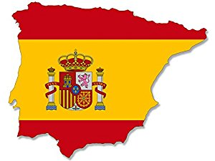
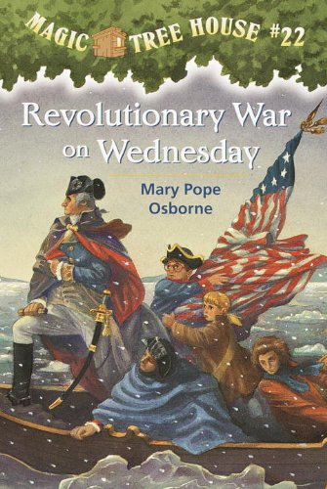
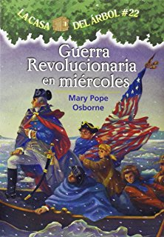
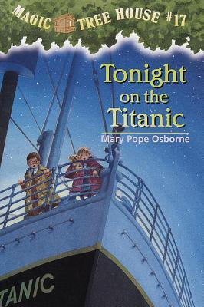
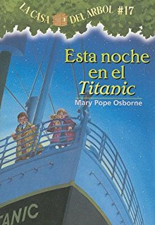
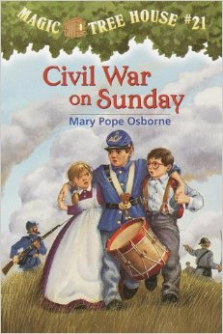
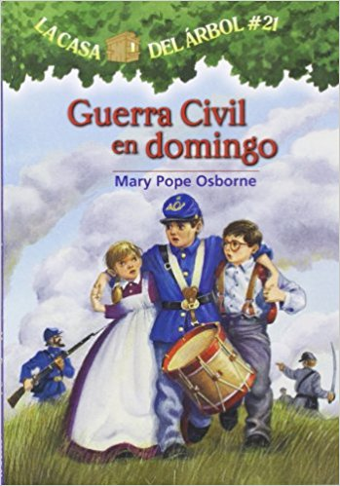
Adapted in Translation
An Exploration of the Cross-cultural Translation of the Magic Tree House series
Created by Taylor Bauer
Abstract
In a global world like ours, translated texts are one type of adaptation that is becoming more common. This article explores Tonight on the Titanic, Civil War on Sunday, and Revolutionary War on Wednesday in English and Spanish to find they were cross-culturally translated to match ideology in Spain on machismo and outlooks on wars while relaying American history. The prevalence of cross-cultural translations in Spain is the result of several factors discussed including Spanish history, political climate, and reigning pedagogical theory.
Defining Cross-cultural Translation
Cross-cultural translation is the process of translating texts across languages and purposefully altering sections to assimilate the content into the new or target culture. This typically occurs when there is either content deemed inappropriate for an audience based on cultural expectations of a particular age group or the text contains explicit or implicit messages which contradict target culture norms.
Defining Machismo
In the United States gendered cultural expectations are often referred to as gender stereotypes, while in the Hispanic world the social codes governing behavior specifically by gender is called machismo. According to gender stereotypes men should be tough, competitive, adventurous , and willing to take risks while women are caring, nurturing, and delicate. According to machismo men should be fearless, brave, authoritarian, stoic, strong, brave, responsible, honorable, and elicit respect while women are emotional, caring, homemakers, and in need of protection.
Quotes
Revolutionary War on Wednesday
“‘We have to,’ said Jack. He hated the suffering he’d seen in the Civil War. But they had no choice” (Osborne, Revolutionary…7)
“Odiaba el sufrimiento que había visto en la Guerra Civil. Pero, tenían que ayudar a Morgana a salvar a Camelot. ‘¿Todavía tienes ganas de ir?’ preguntó Annie” (Osborne, Guerra Revolucionaria …7).
Tonight on the Titanic
“‘S.O.S.’, whispered Jack” (Osborn, Tonight …29)
“‘S.O.S.’, susurró Annie” (Osborne, Esta …29)
Civil War on Sunday
“Wishing for the war to cease…”and “looking for the right to see the dawn of peace” (Osborne, Civil …67-68).
“Que anhelan poder vivir …” and “que de tanto padecer velan por un nuevo amanecer” (Osborne, Guerra Civil …67-68)
Significance
Revolutionary War on Wednesday
The order of text has Jack’s response serve as justification for his answer that although he is not pleased with the circumstances they have to fulfill their obligation. In the Spanish version Jack’s same explanation serves as an example of stoicism counter to the emotionally difficult choice presented previously.
Tonight on the Titanic
The call for help conflicts with machismo values. However Annie could call for help as women are not expected to be fearless, brave, or stoic.
Civil War on Sunday
Glory and status for men in Spain was often determined by feats of bravery on the battlefield. Asking for war to end would be like asking to forfeit a chance for honor and glory which are values of the social code derived from war, machismo.
Historical Context
Today about 50% of Children’s Literature in Spain has been translated from another language namely English, French, and German, English to Spanish being the most common (Fernández López 224)
Machismo arose from the sustained acts of war in the country’s history since before the crusades to the modern Basque Conflict
Cross-cultural translation of children’s literature has been normalized by the propaganda , “biological pedagogy” used in the Franco regime during and after the Spanish Civil War
Works Cited
Fernández López, Marisa. "Children's Literature Research in Spain." Children's Literature Association Quarterly, vol. 27 no. 4, 2002, pp. 221-225.
“Great Seal of the US.” July 12, 2016. JPG File.
Osborne, Mary Pope. Civil War on Sunday. Illustrated by Sal Murdocca, Vol. 21, Random House, 2000.
---. Esta noche en el Titanic. Illustrated by Sal Murdocca, Translated by Marcela Brovelli, vol. 17, Lectorum Publications, 2008.
---. Guerra Civil en domingo. Illustrated by Sal Murdocca, Translated by Marcela Brovelli, vol. 21, Lectorum, 2011.
---. Guerra Revolucionaria en miércoles. Illustrated by Sal Murdocca, Translated by Marcela Brovelli, vol. 22, Lectorum, 2011.
---. Revolutionary War on Wednesday . Illustrated by Sal Murdocca,Vol. 22, Random House, 2000.
---. Tonight of the Titanic. Illustrated by Sal Murdocca, Vol. 17, Random House, 1999.

