Slide 1
Three Ages Project
By: Hope Barnhart

Slide 2
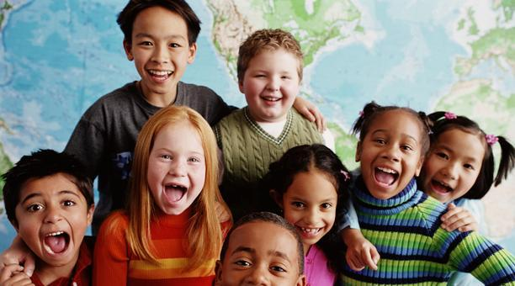
Selection of Interviewees
Hannah
4 years old
Early Childhood
Seth
10 years old
Middle Childhood
Paisley
15 Years old
Adolescence

Slide 3
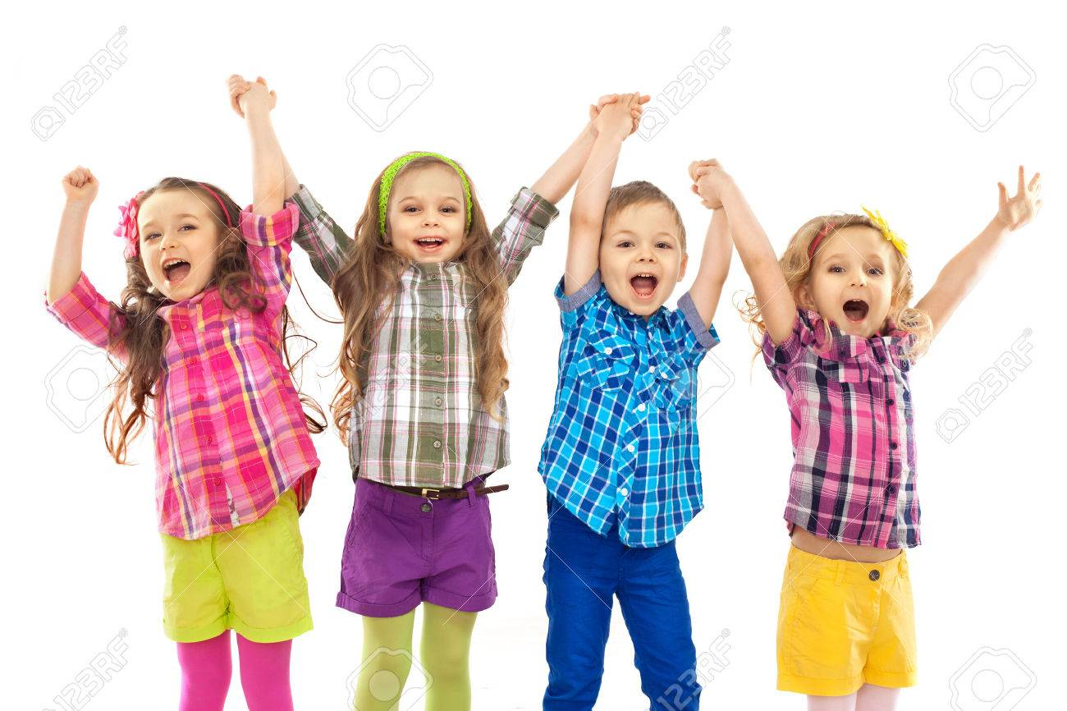
Hannah’s Social-Emotional Development
Do you like working in a group or by yourself?
- “I love working with my friends!”
- This shows how her social-emotional development is continuing to grow because she is a very social person who enjoys talking to other people. I was surprised by how well she was doing socially because her parents are divorced.

Slide 4
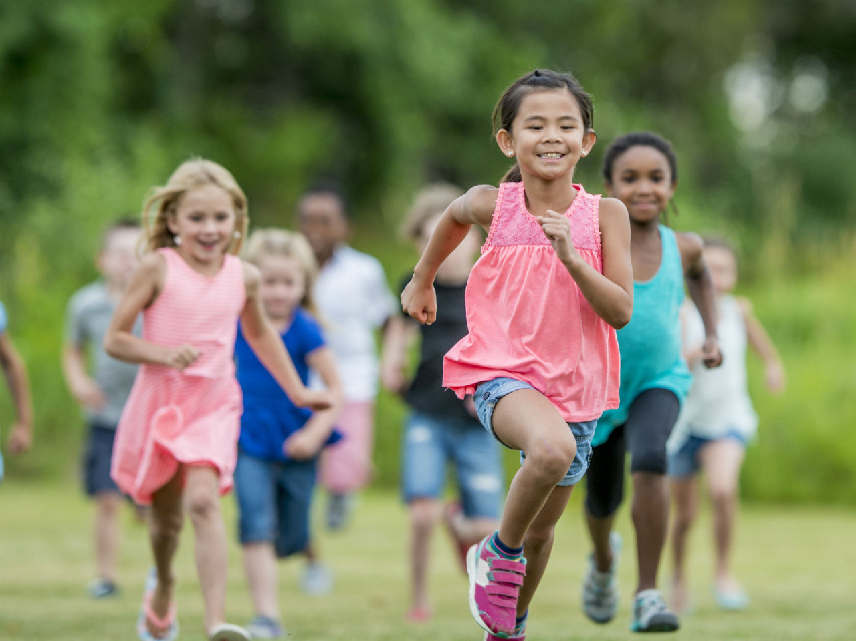
Hannah’s Physical Development
Can you run faster than your friends?
“YES! I bet you can’t run faster than me.”
During our race, I observed that when Hannah was running, she was wobbling from side to side and also bobbing up and down. This is normal for a child her age because their gross motor movement is not fully developed yet.

Slide 5
Hannah’s Cognitive Development
Do you know how flowers grow?
“My mommy and I go to the store to buy flowers and then we plant them in the yard and water them.”
This showed me that Hannah’s cognitive development was on track with other children in early childhood because most younger children do not exactly know how flowers grow.

Slide 6
Seth’s Social-Emotional Development
What makes you happy?
- “Watching and playing soccer.”
- After a few follow up questions, I could tell that he has a passion for soccer. He is well developed in his social-emotional stage of development because he is actively engaged with others on and off the field.

Slide 7
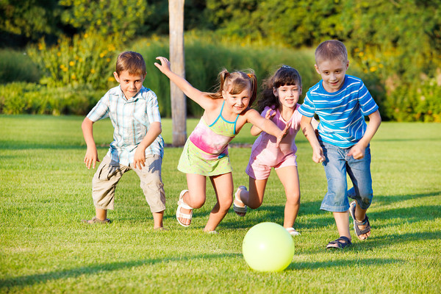
Seth’s Physical Development
How much exercise do you get each day?
“I get about three hours.”
This proves that Seth is above average in his physical development because his gross motor skills are more developed since he plays soccer on a regular basis. Three hours of physical activity is health for a child his age.

Slide 8
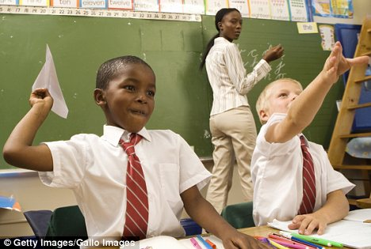
Seth’s Cognitive Development
I observed his attention span during the interview.
Throughout the interview Seth was really paying attention to what I was saying unlike my interview with Hannah when I struggled to keep her focused. This shows that Seth is more cognitively developed.

Slide 9
Paisley’s Social-Emotional Development
If you witnessed bullying, would you stand up to the bully?
- “Of course I would. No one deserves to be treated badly for no reason by someone who doesn’t really know them.”
- This shows she is well socially developed because she cares about people other than herself.

Slide 10
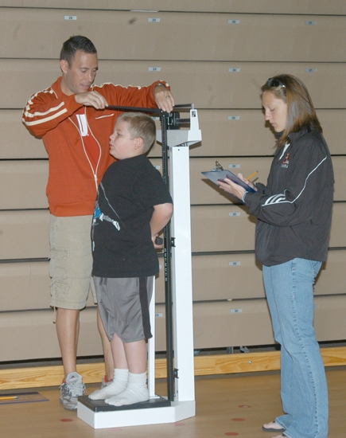
Paisley’s Physical Development
Are you taller or shorter than her peers?
“I am taller than some of my friends, some of them are the same height as me, but I am shorter than most of the boys.”
This shows she is the most physically developed because she takes into account everyone’s height not just her own.

Slide 11
Paisley’s Cognitive Development
What is your favorite thing to learn about in school?
“I love to learn about math. I love numbers, but I hate geometry. I am really good at Algebra though.”
Paisley did not think long about this question, she had an instant answer. She was the most cognitively developed because she elaborated about what she is good and bad at in math.

Slide 12
Conclusions
If I could do this project again, I would try to prepare myself more for the different personalities of the people I was interviewing.
I learned how evident development is in the different developmental stages.
Piaget claimed that children develop at different stages in their lives and this was evident in my interview with Paisley.

