Slide 1
Three Ages project
Grace Auld
Fall 2018

Slide 2
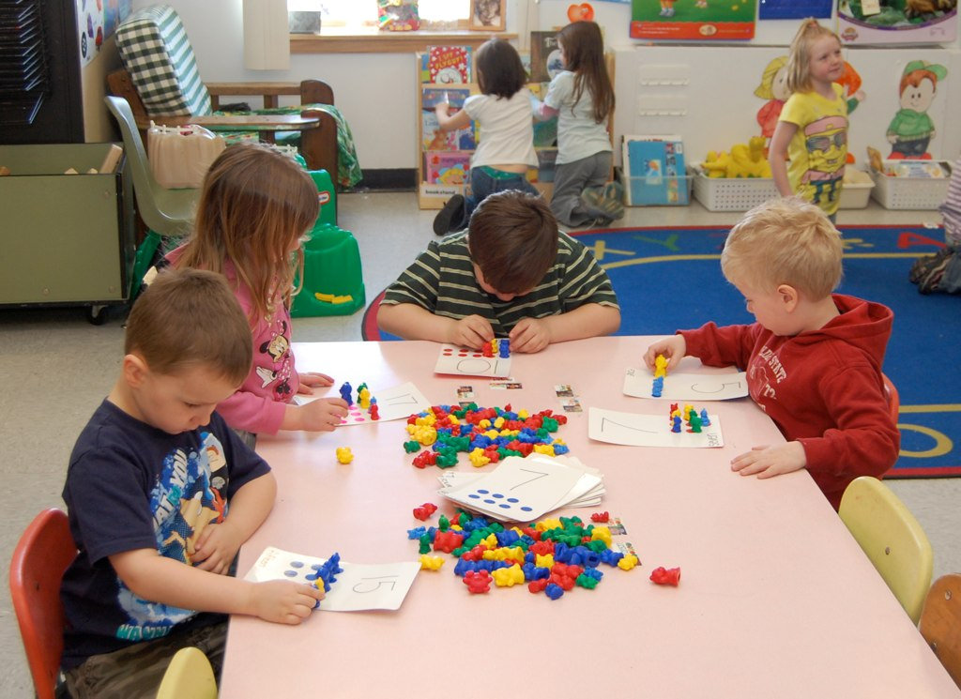
Interviewees
Daniel
Ethan
Emma
5 years old
Early Childhood Group (ages 3-6 years old)
12 years old
Later Childhood Group (7-12 years old)
15 years old
Adolescence Group (13-19 years old)
This Photo by Unknown Author is licensed under CC BY-SA
This Photo by Unknown Author is licensed under CC BY
This Photo by Unknown Author is licensed under CC BY-NC-ND

Slide 3
Daniel Physical aspect of development
Question: “When you’re playing outside, what activities do you typically do?”
His response: Very energetic and excited, he likes to run around and play lots of sports, ride his bike, and walk his puppy
This question assessed gross motor skills → based on his answer, he has developed good gross motor skills

Slide 4
Daniel Cognitive Aspect of development
Question: “Do you enjoy going to school?”
His response: Very energetic, he loves going to school. He loves his teacher and is very eager to learn new things
His favorite word right now is “Why?”
He has begun to develop intuitive thought
This Photo by Unknown Author is licensed under CC BY-SA-NC

Slide 5
Daniel Social aspect of development
Question: “Describe a day in which he has complete control over what he gets to do.”
His response: Eating breakfast in bed with “Mommy, Daddy, and Ethan,” reading lots of books, playing outside with his friends, and cooking dinner with Daddy
He has a relationship with his family which reflects on how interacts socially with his peers
This is also a rather realistic response for a 5 year old, I was expecting something more grandiose and less attainable

Slide 6
Ethan physical aspect of development
Question: “Describe your eating habits.”
Response: He eats a lot of protein, salads, sushi, and the occasional sweet or salty snack
Ethan seems to eat better than most kids his age
Based on what he eats, he does not appear to be at risk for obesity
I was surprised by his response, what he typically eats is not what many of his peers probably eat
This Photo by Unknown Author is licensed under CC BY-SA

Slide 7
Ethan cognitive aspect of development
Question: “Are you involved in an enrichment program at your school?”
His response: Yes, the program is called AVID
Ethan had to test into this program
Ethan is considered a gifted student
This had positive effects on him socially

Slide 8
Ethan social aspect of development
Question: “Do you care what other people think of you, why or why not?”
His response: Yes, he cares what others think because he wants others to look up to him and to think he is a good person in general.
His thought process reveals that he is beginning to develop a sense of self-esteem
He is making the normal shift from external characteristics of himself to internal psychological traits
Caring about what others think can also be a form of social comparison

Slide 9
Emma physical aspect of development
Question: “How has puberty affected you?”
Her response: Puberty has not gone over well, especially in terms of acne. She has developed acne that has been treated by medication
This reaction is quite normal, especially for girls
This trouble with puberty physically has made her more self-conscious and moody

Slide 10
Emma cognitive aspect of development
Question: “If you could do one thing, what would it be?
Her response: Not to get so anxious about little things. She wants to get to the point where anxiety no longer runs her life or determines the decisions she makes
I was not expecting this as an answer for this question
Based on her response, I concluded that she does in fact struggle with anxiety
Although she struggles with anxiety, she does not struggle socially
This Photo by Unknown Author is licensed under CC BY-NC-ND

Slide 11
Emma social aspect of development
Question: “How do you spend your free time?”
Her response: Spending time with her friends. She looks forward to seeing them at school everyday. She really enjoys making plans to see her friends outside of school as often as possible
Emma is socially flourishing
It is normal that she first thinks of spending extra time with friends instead of family

Slide 12
Conclusions
This project gave me the opportunity to apply what I have learned this semester to real life scenarios
It gave me the opportunity to grow closer to the people I interviewed, especially my younger sister
Overall, I feel that the people interviewed were quite mature and insightful for their age groups
I was able to confirm my rationale: All three aspects of child development are connected and interdependent of one another

