Slide 1
Using Professional Portfolios as an End-of-Program Assessment
Dr. Karla B. Collins, Assistant Professor
Dr. Audrey P. Church, Professor
School Librarianship Program
College of Education and Human Services
Longwood University

Slide 2
Review of Literature
Usage in the field
Latrobe and Lester (2000) note “use of portfolio as a requirement appears to be at early stages of adoption in LIS graduate education” (p. 201) and suggest “it is critical to determine if the use of the portfolio to instill self-reflective assessment of professional growth in the LIS setting assists in transforming the educational experience to one that is learner-centered…” (p. 202-203)
Survey of LIS faculty showed “portfolio was most widely preferred top choice of EPAs [end of program assessments] (Burke & Snead, 2014, p. 26)
Concerns
“very time consuming for faculty” and “very time consuming for students” (Burke & Snead, 2014, p. 31)
Portfolio as learning experience
“artifacts aligned with state and national standards, required written reflections, and faculty advisors to mentor students through the process [provide] rich learning experiences” (Brown, 2002, p. 1)
“…ePortfolios …powerful, reflective, Web 2.0 enhanced learning experiences that demonstrate school library candidates’ mastery of professional standards” (Jones, Downs, & Repman, 2012, p. 12.)
“The experience of creating and presenting their ePortfolios provides students with a high level of self-efficacy and confidence in their abilities to master new tools, a disposition that is critical to their future success in the ever-changing world of school libraries (Jones, Downs, & Repman, 2012, p. 18)

Slide 3
Review of Literature
Other benefits
“Graduates who complete portfolios are significantly more likely to be satisfied with their job and LIS career, to like being a librarian or information professional, to say they would choose and LIS career ‘all over again,’ and to encourage others to choose a career in LIS (Rathbun-Grubb, 2016, p. 51)
Need for research
“It would be useful … to collect data from students and graduates about whether they found their portfolio experience to be a helpful tool in professional acculturation” (Burke & Snead, 2014, p. 38)

Slide 4
Background
Trend in many fields to use portfolio as more authentic assessment for culminating assignment
Fall 2014 transition from School Library Media program to newly approved School Librarianship program
Shift from comprehensive exam requirement for master’s candidates to professional portfolio for master’s and endorsement candidates
Anecdotal evidence and informal feedback of overall satisfaction
Need for documented assurance of quality

Slide 5
Purpose
Research Question:
For School Library program graduates, is the professional portfolio a more effective culminating experience than the comprehensive exam?

Slide 6
Participants
Participants:
Comps: Fall 2011-Summer 2016 – 66 people (only master’s students)
Portfolio: Spring 2015 – Summer 2016 – 67 people (master’s and endorsement students)
Fall 2016 portfolio students were included in focus groups following their portfolio presentations.

Slide 7
Methods
Pilot:
2 people who completed portfolio in Fall 2014
2 people who completed comps Fall 2014
Data Collection:
Comprehensive exam questionnaire
Portfolio questionnaire
Focus group
Data Analysis:
Descriptive statistics
Independent samples t-test
Content analysis of focus groups

Slide 8
Instruments
Instruments | Data
Comprehensive Exam Questionnaire | 37 questions: 1 informed consent; 9 demographics Job Searching/Interviewing – 3 closed, 1 open-ended Future Career – 3 closed, 1 open-ended Process – 6 closed, 5 open-ended Impact – 3 closed, 5 open-ended
Portfolio Questionnaire | 44 questions: 1 informed consent; 10 demographics Job Searching/Interviewing – 5 closed, 1 open-ended Future Career – 5 closed, 1 open-ended Process – 6 closed, 5 open-ended Impact – 4 closed, 6 open-ended
Focus Group | 8 questions Process Learning Experience Impact

Slide 9
Questionnaire Results
Data Collection:
Closed-ended, 4-point Likert-like scales
Open-ended questions
Response:
Comps: 25/66 = 38%
Portfolio: 39/67 = 58%

Slide 10
Job Search/Interviewing Results
Comprehensive Exam
Question | N | Mean
Summary Paper | 24 | 2.75
Studying | 24 | 2.666
Completing Exam | 23 | 2.478
Portfolio
Question | N | Mean
Self-Reflection | 37 | 3.621
Creation | 37 | 3.540
Choosing Artifacts | 37 | 3.513
Explaining Standard | 37 | 3.540
Presentation | 37 | 3.837

Slide 11
Job Search/Interviewing - Findings
Job Searching/Interviewing:
Mean scores higher for Portfolio
Portfolio participants scored “self-reflection” higher than Comprehensive Exam participants scored “summary paper.” (Statistically significant, p<.05) These are similar activities within the culminating experience course.
Portfolio:
“I liked being able show and reference my portfolio. Showing off a thesis isn't quite as impressive!”
“Practice presenting in front of a panel.”
“The portfolio allowed me to show many different facets of myself without "talking" too much!”
“After formally presenting my portfolio, I felt well prepared for a job interview. I actually enjoyed the interview and left with no regrets.”
Comps:
“As I was interviewing, it was helpful that I had already been reflective/purposeful about my vision of librarianship. “
“The ability to put everything together and think of the library media specialist I wanted to become, gave me a clear vision that I was able to share in my interviews.”
“I prepared more for this exam than for any other in my lifetime. Knowing that I mastered the program objectives gave me confidence to comfortably discuss library issues without having real job experience.”

Slide 12
Future Career Results
Comprehensive Exam
Question | N | Mean
Summary Paper | 24 | 2.791
Studying | 24 | 2.583
Completing Exam | 24 | 2.416
Portfolio
Question | N | Mean
Self-Reflecting | 38 | 3.736
Creating Portfolio | 38 | 3.684
Choosing Artifacts | 38 | 3.605
Explaining Standard | 38 | 3.5
Presenting Portfolio | 38 | 3.684

Slide 13
Future Career - Findings
Future Career:
Mean scores higher for Portfolio
Portfolio participants scored “self-reflection” higher than Comprehensive Exam participants scored “summary paper.” (Statistically significant, p<.05) These are similar activities within the culminating experience course.
Portfolio:
“Listening to the experiences of our classmates and getting ideas from their portfolios showed how keeping in touch with our peers will be beneficial in the future.”
“I liked the small group setting, with colleagues and professors because it reminded me of other professional presentations I have to give now in my role as LMS.”
“Learning how to create a website and it was good practice for providing artifacts which librarians have to do for their PGPP-L.”
“It helped me to pull together what I consider to be some of the most important things that I will be able to offer as a librarian.”
Comps:
“It did allow me to apply various things I had learned in a situation that I might encounter in my job as school librarian.”
“I felt I couldn't use that knowledge to directly apply to jobs the way a portfolio might have.”

Slide 14
Process Results
Question | Comprehensive |  | Portfolio |  | Comparison
 | N | Mean | N | Mean | P-value
Program Reflection | 24 | 3.5 | 38 | 3.815 | 0.026
Growth Reflection | 24 | 3.166 | 38 | 3.842 | 0.000
Knowledge Reflection | 24 | 3.166 | 38 | 3.631 | 0.038
Learning Opportunity | 24 | 1.375 | 38 | 1.973 | 0.000
Effort | 24 | 2.791 | 38 | 3.263 | 0.012

Slide 15
Process - Findings
Process:
For both groups, the activity as an additional learning opportunity scored lower than the rest of the categories.
Both groups felt strongly that the activity allowed them to reflect on the entire program.
Statistically significant differences at .05 level across each category, showing Portfolio as consistently more effective than Comprehensive Exam
Portfolio:
“Having to choose activities and projects that reflected my learning was one piece. Being able to share that with others was another whole level of learning and reflecting.”
“I got to gather my actual learning and realize what all I had gained/gathered throughout the whole program. You don't stop and consider that during the process, so having to pull away/step back allowed me to see the true depth of knowledge I gained. That self-reflection is an important part of learning...as I learned in-depth through this program.”
Comps:
“It allowed me to review the material and then apply it in a format which was a culmination of that knowledge.”
“By synthesizing everything I learned from the program during the Comp Exam, I feel like it was an additional learning opportunity.”

Slide 16
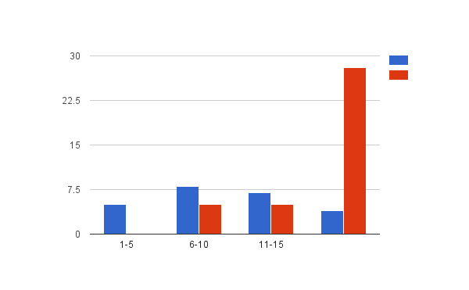
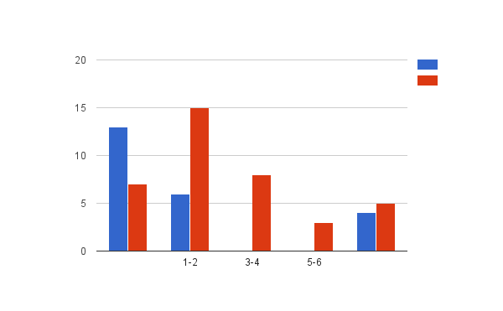
Impact Results
Question | Comprehensive |  | Portfolio |  | Comparison
 | N | Mean | N | Mean | P-value
Usefulness | 24 | 2.125 | 38 | 2.945 | 0.002
Time Beneficial | 23 | 2.869 | 38 | 3.605 | 0.004
Satisfaction | X | X | 38 | 3.631 | X
Hours preparing
Times used since completion

Slide 17
Impact - Findings
Impact
Statistically significant differences at .05 level across both categories, showing Portfolio as consistently more effective than Comprehensive Exam
28 out of 38 Portfolio respondents indicated they spent over 15 hours preparing, whereas the majority of Comprehensive Exam respondents indicated spending 15 hours or less in preparation.
Some Comprehensive Exam respondents reported examples of how they use the experience in their current practice:
“I have performed the activities described in the comprehensive exam in my career as a school librarian. I have also explained the experience to my students to help them understand possible testing scenarios they may encounter while in college and how it relates to the seriousness and honesty they should display while taking End of Course, SOL's, or other testing activities.”
One Portfolio respondent talked about the transition from classroom teacher to librarian:
“I think that it helped me to see my transformation from classroom teacher to librarian. This was not an easy transition for me. I really loved being a classroom teacher. The portfolio helped me to see what I was preparing for in the next step of my career.”

Slide 18
Additional Findings
Benefits of Portfolio:
Reflection
Connection with peers
Preparation for interviewing and future career
Showcase/Organize information from entire program
Learning & applying new skills – website and professional portfolio creation
Drawbacks of Portfolio:
Stress/Anxiety
Time – preparation and presentation
Unclear expectations – format of portfolio and presentation
Lack of feedback after presentation

Slide 19
Additional Findings
Benefits of Comprehensive Exam:
Reflection
Test – process & format
Bonding – study groups
Drawbacks of Comprehensive Exam:
Format – not comprehensive
Stress
Travel for test – expense, location (Longwood & testing room)
Time – preparation & test day
Lack of feedback

Slide 20
In Summary
“Reviewing and preparing for the portfolio was very beneficial to me for self-reflection and growth. It was both satisfying and rewarding to see what all I had accomplished in the program and how far I'd come since I'd begun the program. The process helped me to see more clearly that I was indeed prepared to assume the role of school librarian upon hire.”
“I know plenty of straight A and knocked out of the park people who took the exam and were not effective teachers. I know people who didn't do great on the test and have awards as librarians under their belts. I'm not sure if the comprehensive exam proves to really be comprehensive.”

Slide 21
Implications
Research Question:
For School Library program graduates, is the professional portfolio a more effective culminating experience than the comprehensive exam?
Although considerably more time-consuming for the students, the professional portfolio is a more effective culminating experience than the comprehensive exam. Based on this research, the School Librarianship program at Longwood University will continue to offer the professional portfolio as the culminating activity for the program.

Slide 22
Instructor Considerations
Scaffolding needed
Throughout the program
During the Professional Portfolio semester
Instructor time throughout the semester and at the end
Location and timing of final portfolio presentations
Set clear expectations at the beginning
Examples of portfolio
Presentation guidelines

Slide 23
Next Steps
How can we provide clearer expectations while still maintaining individuality in the products?
How can the Portfolio become a working document that a practicing librarian will want to maintain?
8/34 respondents reported updating the portfolio after program completion.
What new tools are being used by school divisions to create professional portfolios?

Slide 24
References
Brown, C. A. (2002). Planning portfolios: Authentic assessment for library professionals. School Library Media Research, 5. Retrieved from http://www.ala.org/aasl/SLMR/vol5/portfolio/portfolio.html.
Burke, S. K., & Snead, J. T. (2014). Faculty opinions on the use of master’s degree end program assessments. Journal of Education for Library and Information Science, 55, 26-30.
Jones, S. A., Downs, E., & Repman, J. (2012). The evolution of ePortfolios for school library education: A case study. School Libraries Worldwide, 18(2), 12-20.
Latrobe, K., & Lester, J. (2000). Portfolio assessment in the MLIS program. Journal of Education for Library and Information Science, 41(3), 197-206.
Rathbun-Grubb, S. (2016). End of program assessments and their association with early career success in LIS. Journal of Education for Library and Information Science, 57(1), 43-56.

Slide 25
Thank you!
Thank you for your interest in this research study.
Dr. Karla B. Collins
Assistant Professor
collinskb@longwood.edu
Dr. Audrey P. Church
Professor
churchap@longwood.edu
School Librarianship Program
Longwood University

