Slide 1
’I’m All Shook Up’: Assessing the Impact of Criminal Justice Experiential Learning using The eLVIS (Experiential Learning Variables and Indicators Scale)
Connie M. Koski, Assistant Professor of Criminal Justice Studies
koskicm@longwood.edu
Longwood University, Farmville, VA

Slide 2
Background & PURPOSE
Assessment of the residual/long-term value of students’ experiences following their participation in a project focused on illegal immigration enforcement and detention while interacting with detainees through teaching non-native English speakers English as a Second Language at the Farmville Immigration Detention Center (ICA).
Adds a long-term follow-up component not often utilized in the discipline
Assesses a student learning experience other than internship experiences
Most common type of assessment of experiential learning in Criminology & Criminal Justice literature
Assists program coordinators in better understanding the value of the experience
Utilizes an instrument that serves as a quantitative alternative to more frequently used narrative-based/qualitative instruments

Slide 3
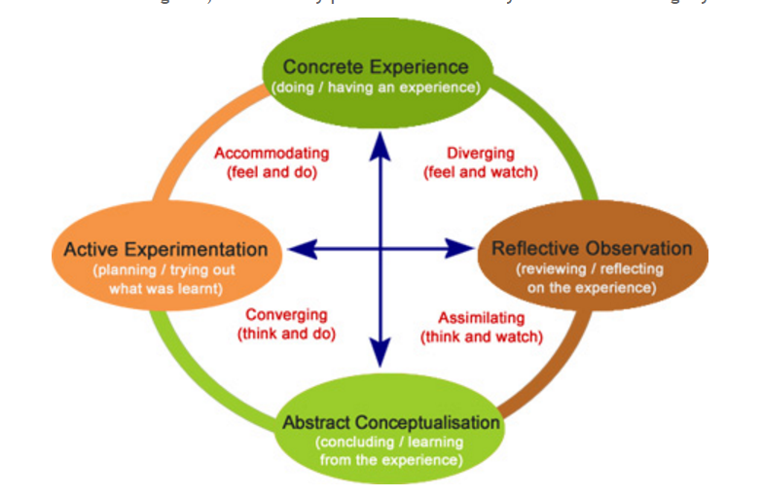
Kolb’s (1984) Experiential Learning Theory (ELT)
Four Stages of Learning from Experience:
Concrete Experience (experiencing)
Reflective Observation (reflection)
Abstract Conceptualization (thinking)
Active Experimentation (acting)
Source: https://www.talentsprint.com/insights/experiential-learning-1

Slide 4
The ICA Experience
Students enrolled in CRIM 210-Introduction to Policing option to choose participating in final project focusing on learning about the illegal immigration enforcement, detention and court process over the course of a 15-week semester:
Must attend a Volunteer Orientation session
Assist in teaching basic ESL courses at the facility a minimum of 5 times
Directly interacting with detainees of all security levels (some of whom previously convicted of crimes) in a classroom environment
One “pre-test” reflective journal; five reflections intermittently throughout the semester, one final post- or “summary” reflection on their experience
These journals are being analyzed as part of separate study

Slide 5
METHODS
Participants:
All students who have participated in the ICA Farmville experience via CRIM 210 course between Fall 2014 and Spring 2016 semesters (a minimum of 6 months post-experience) were surveyed (n=75)
Methods:
Fall 2016: Emailed invitation to participate and link to Google Doc survey (initial solicitation + 1 emailed reminder)
Anonymous survey included consent, *ELVIS Instrument, Service Learning survey, open-ended/narrative-based questions, interest in participating in future focus group indicator & demographic questions

Slide 6
Experiential Learning Variables & Indicators Scale (ELVIS)
Created as an alternative to narrative-based (qualitative) approaches for assessing practical educational activities and experiential learning
7 Likert-scale questions ranging from 1 (shallow) to 5 (deep)
Developed at the Experiential Science (XSci) Education Research Collaborative of the University of Colorado Center for STEM Learning.
Synthesizes many of the leading evidence-based models for experiential learning abbreviates them down into a practical assessment tool
A description of the seven characteristics of experiential learning featured in the ELVIS is provided on the next slide. Each characteristic can be scored separately or in combination to produce an overall ELVIS score.
Cumulative ELVIS scores below 14 are considered low in experiential learning value, while scores above 28 are considered high.

Slide 7
The ELVIS Instrument
7 characteristics of Experiential Learning rated from 1 (shallow) to 5 (deep)
Locus of control (teacher vs. student)
To what degree is the experience student-driven vs. educator-driven?
Physical involvement (engagement of all six senses)
Is the experience active & multisensory?
Intellectual involvement
How much do students need to contribute intellectually to your own learning? (The more the better).
Social/emotional involvement (communication & collaboration)
To what degree does the experience involve others, and does it provoke emotional involvement to “go through the head as well as the heart?”
Narrative transport (is the experience a “story” worth sharing?)
Perceived risk (including physical, intellectual & emotional)
Can students take risks & possibly fail? Fosters sense of mastery, confidence & efficacy
Embedded reflection
Does the experience allow time & support to reflect and share? Should be embedded throughout the experience; not just at the end.

Slide 8
Table 1. Sample Characteristics
Variable | N | % | Variable | N | %
Semester Participated | (14) | (100) | Race/Ethnicity | (14) | (100)
Fall 2014 | 4 | 28.6 | Non-Hispanic White/Caucs. | 9 | 64.4
Spring 2015 | 3 | 21.4 | Afr. American | 2 | 14.3
Fall 2015 | 2 | 14.3 | Asian/Middle Eastern | 1 | 7.1
Spring 2016 | 5 | 35.7 | Hispanic | 1 | 7.1
Academic Standing | (14) | (100) | Other | 1 | 7.1
Junior | 3 | 21.4 | Current Age | (14) | (100)
Senior | 8 | 57.2 | 20 | 5 | 35.7
Graduated | 3 | 21.4 | 21 | 7 | 50
Gender | (14) | (100) | 22-25 | 2 | 14.3
Female | 10 | 71.4
Male | 4 | 28.6

Slide 9
Table 2. Findings From the ELVIS (n=14)
Variable | Mean | Median | SD | Potential Range | Actual Range
Locus of Control | 4.36 | 4.00 | .63 | 1-5 | 3-5
Physical Involvement | 4.36 | 5.00 | .84 | 1-5 | 3-5
Intellectual Involvement | 4.57 | 5.00 | .76 | 1-5 | 3-5
Social & Emotional Involvementª | 5.00 | 5.00 | 0 | 1-5 | 5
Narrative Transport | 4.57 | 5.00 | .51 | 1-5 | 4-5
Perceived Risk | 3.64 | 3.00 | .93 | 1-5 | 3-5
Embedded Reflection | 4.36 | 5.00 | .93 | 1-5 | 2-5
ª4 participants did not respond to this question

Slide 10
Case-in-point: Narrative data to Augment ELVIS Q#6
ELVIS Question: “Do you feel that students were allowed to take physical, intellectual, and/or emotional risks during your ICA experience, and possibly fail?”
…vs. Narrative-based question: “Do you feel as though your experience at ICA-Farmville helped to empower you in any way?” (~ sense of mastery, self-confidence & self-efficacy)
Mastery: “I was thrown into teaching situations and I believe that this improved my leadership abilities. It also made me more adaptable.”
Confidence: “Because I was challenged so outside of my comfort zone, I feel empowered in the sense that I was able to accomplish something that I otherwise would never have done.”
Efficacy: “Before I went in, I was nervous about speaking with someone who may not know my language, and I was nervous about teaching someone who may have committed a crime. Afterwards, in day-to-day life, I became more confident in speaking to other people, especially those who don’t speak the same language as I do.”

Slide 11
STUDY LIMITATIONS
Extremely low overall response rate
Difficult to generalize
Usefulness of the ELVIS in assessing this particular experience unclear (but promising)
Interest in participating in future in-depth Focus Group also low (only n=5)
The ELVIS is not yet a methodologically validated instrument (B. D. McLain, personal communication, 3/29/2016)
Instrument may have reliability and validity issues

Slide 12
DISCUSSION & Conclusion
Overall, cumulative ELVIS score for this student learning experience = 30.86
Out of possible highest score of 35
The instrument authors note that 28 is considered to be a “high quality” experiential learning opportunity
The ELVIS useful for tying the value of experiential learning to the components of Kolb’s (1984) ELT
Yet offers no in-depth data as to why or how the student felt those components were, or were not, achieved
If, as noted by Kolb (1984) learning is truly a “process,” the ELVIS appears most useful immediately post-experience, but not for long-term/lasting effects.
Qualitative narrative data far more informative…
The overall study, which was designed to assess the long-term effects of having participated in such a unique experience (6-mos. to 2 yrs. later), benefited from a mixed-methods design, rather than just the ELVIS alone,
Future directions

Slide 13
I welcome your questions & feedback.
Thank you for watching.
*Special thanks to the longwood university l.a.m.p. committee for their support of this research

