Slide 1
Down Syndrome
Rebecca Morra & Amanda Patterson

Slide 2
Overview
Definition
Diagnosis
Physical Traits
Associated Health Problems
Working with Patients
Fun Facts
Summary
Questions

Slide 3
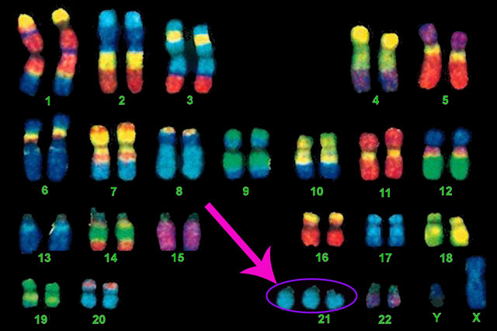
What is Down Syndrome?
Individual has a complete or partial extra copy of chromosome 21.
Normal nuclei have 23 pairs of chromosomes.
The chromosomal alterations originate from the father or mother (5% of Down syndrome cases are traced to the father).

Slide 4
https://youtu.be/ejWBx4A3u2M

Slide 5
Question
How many TOTAL chromosomes does an individual with Down syndrome have?

Slide 6
Answer
47 – The addition of an extra chromosome 21 makes the total 47 instead of 46 (23 pairs).

Slide 7
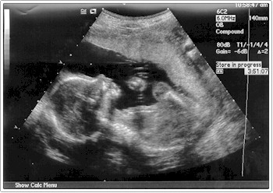
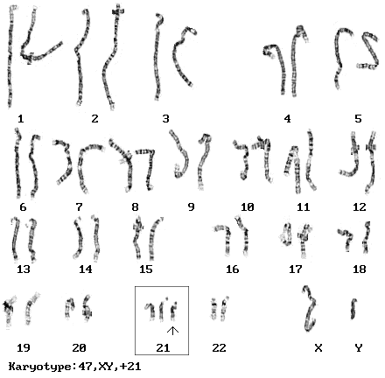
Diagnosis
Prenatally
Screening (blood test & ultrasound)
Predicts the change of fetus having Down syndrome
Only provides a probability, not certainty
Diagnostic (chorionic villus sampling & amniocentesis)
Provides almost %100 certainty
At Birth
Presence of specific physical traits
Chromosomal analysis (karyotype – more on next slide)

Slide 8
Karyotype
Blood sample drawn to examine cells
Chromosomes are photographed and grouped by size, number, and shape
Doctors examine this to diagnose Down syndrome

Slide 9
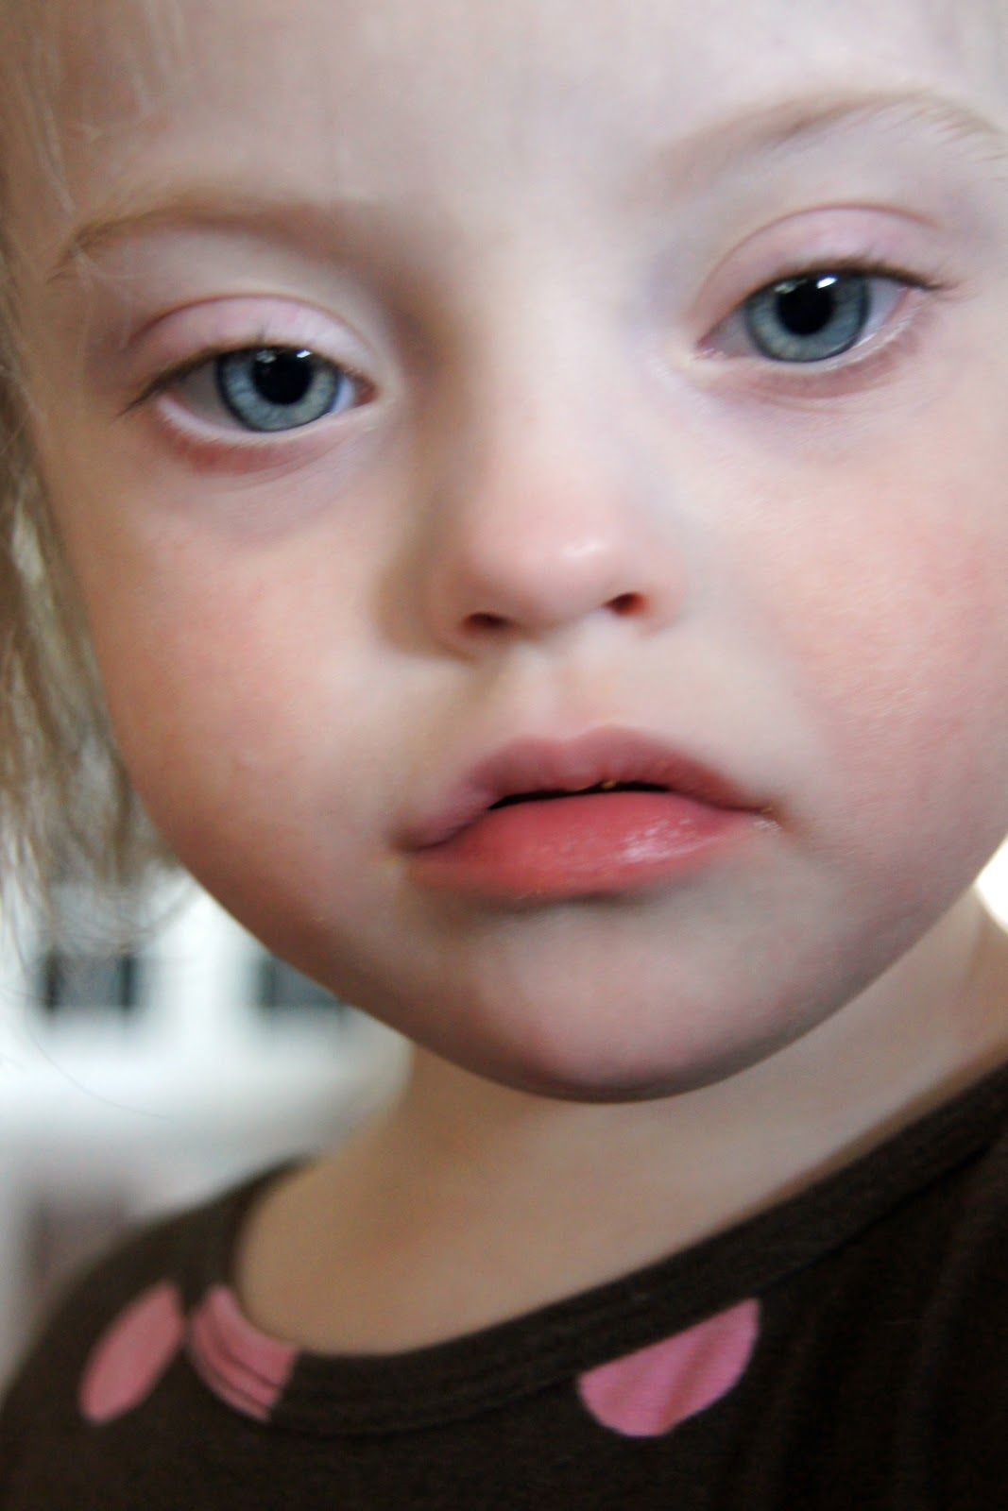
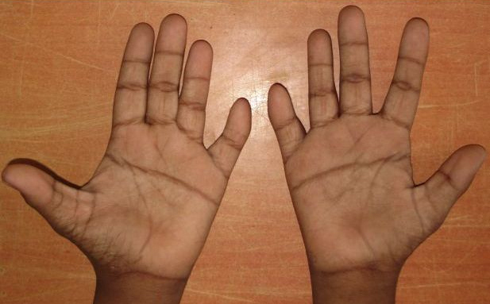
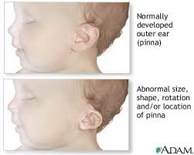
Physical Traits
Low muscle tone
Small stature
Upward slant of the eyes
Single deep crease across center of palm
Flat facial features with small nose
Small skinfolds on the inner corner of eyes
Small, abnormally shaped ears
Hyperflexibility
Enlarged tongue

Slide 11
Question
What are 3 physical traits associated with Down syndrome?

Slide 12
Answer
Low muscle tone
Small stature
Upward slant of the eyes
Single deep crease across center of palm
Flat facial features with small nose
Small skinfolds on the inner corner of eyes
Small, abnormally shaped ears
Hyperflexibility
Enlarged tongue

Slide 13
Associated Health Problems
Heart defects
Hormonal problems (thyroid disease)
Visual problems (cross-eyed, cataracts, near/far sighted)
Leukemia
GI abnormalities
Alzheimer's disease

Slide 14
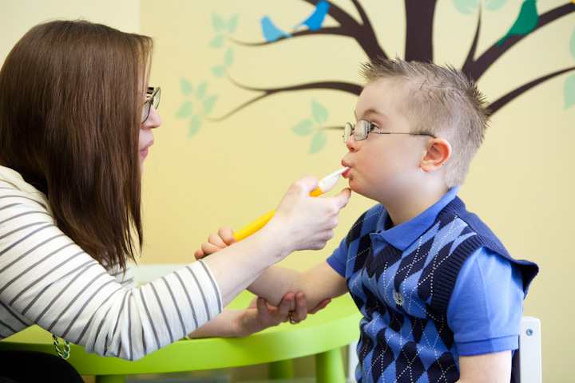
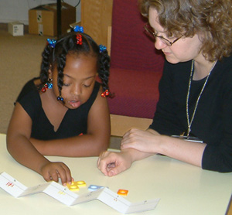
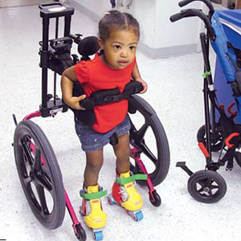
Working with Patients
Therapy
Speech
Educational
Physical
Occupational
Social Involvement
Patience
Safety

Slide 16
Question
What is a health problem associated with Down syndrome?

Slide 17
Answer
Heart defects
Hormonal problems (thyroid disease)
Visual problems (cross-eyed, cataracts, near/far sighted)
Leukemia
GI abnormalities
Alzheimer's disease

Slide 18
Fun Facts
Most common chromosomal abnormality in live-born newborns.
One in every 691 infants in the U.S. has Down syndrome.
About 400,000 Americans have Down syndrome.
Down syndrome causes disability; it is not an illness
In 1960, life expectancy was 10 years old of an Australian with Down syndrome; it is now 50-60
Learning starts at birth and continues throughout life, just like people without Down syndrome

Slide 19
Summary
Extra copy of chromosome 21 (total of 47 chromosomes)
Can be diagnosed prenatally or at birth
Physical traits that are associated with Down syndrome
Associated health problems
How to manage individuals with Down syndrome

Slide 20
Questions?

Slide 21
Sources
"What Is Down Syndrome?" - National Down Syndrome Society. N.p., n.d. Web. 05 Oct. 2015.
Asim, A., Kumar, A., Muthuswamy, S., Jain, S., & Agarwal, S. (2015). Down Syndrome: an insight of the disease. Journal of Biomedical Science, 22(1), 1-9.
Bhandari, S. (Ed). (2015, March 4). Understanding Down Syndrome –Signs.
Dsnsw’s channel. (2010, March 7). Ten things people with Down syndrome would like you to know [Video file].
Twenty Wonder. (2011, March 16). What Causes Trisomy 21 (Down syndrome)? [Video file].
Photos
http://www.doctortipster.com/3349-down-syndrome-mongolism-or-trisomy-21.html
http://ellietheurer.blogspot.com/2013/03/world-down-syndrome-day-equal.html
https://palmreadingperspectives.wordpress.com/tag/down-syndrome/
http://masterman7thscience.pbworks.com/w/page/73047113/7311%20GDR%20Characteristics%20and%20Symptoms
http://physical-therapy.advanceweb.com/Features/Articles/Mobility-For-Down-Syndrome-Patients.aspx
http://www.flourishtherapyohio.com/2013/09/17/is-all-speech-therapy-created-equal-what-is-oral-placement-therapy/
http://www.dseusa.org/en-us/about-us/
http://www.babble.com/babble-voices/the-most-important-friend-your-child-may-ever-make/
http://sites.tufts.edu/tuftslcs/programs/special-olympics/
http://mrsvf.weebly.com/down-syndrome.html
http://dna-laboratories.com/?page_id=302
http://lettercase.org/sevenly/

