Slide 1
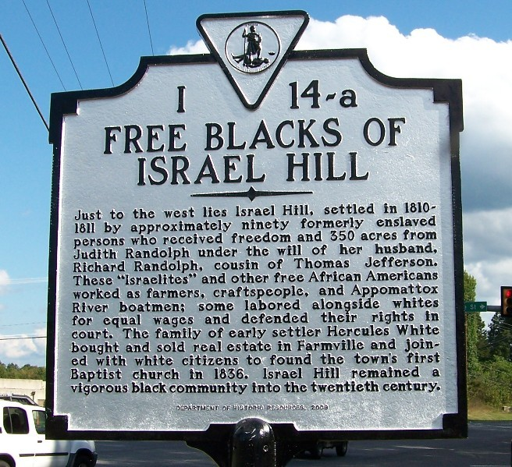
Free Blacks of Israel Hill
By: Tatianna Griffin
Allison Slocum
GNED 400 HN

Slide 2
Overview
Former site of 90 freed slaves in 1796 in present day Prince Edward County
Independence from and coexistence with white neighbors
Land willed to freed blacks by Richard Randolph
Believed slavery was “violation of every sacred law of nature”
Vision to grant slaves freedoms and land
Idolized as a “promised land” for African Americans
Freedoms remained unequivalent to white male citizen counterparts
Commercial community grew rapidly
Artisans, farmers, boatmen, etc.
Economic exchanges facilitated white/black ties
Notes:
star

Slide 3
Overview
Freed blacks advanced without much resistance (up until Civil War)
Great productivity and peace in conjunction with whites compared to 19th and 20th century (Massive Resistance)
Following Civil War, whites became more intimidated
New found freedom came with less social, political and legal defense (from master)
Accomplishments heavily unrecognized
Economic trade, rifle ownership, interracial marriages, law suits
Notes:
star

Slide 4
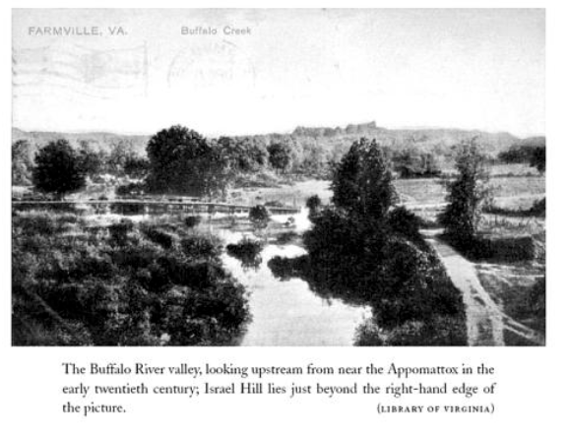

Slide 5
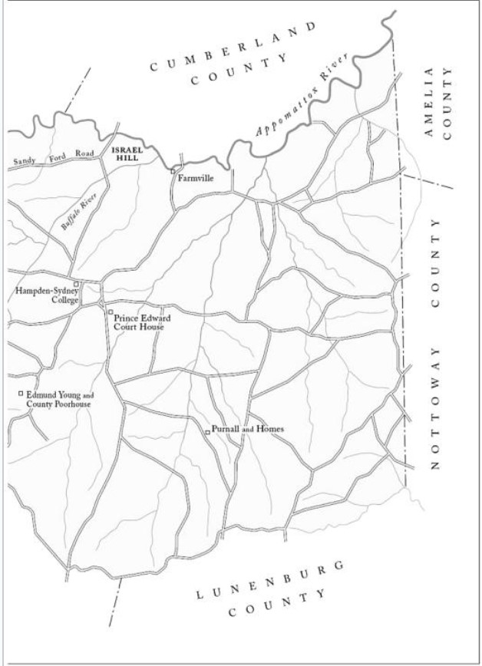

Slide 6
Historical Significance
Opposition of the emancipations: believed freed blacks would disrupt social system of order
Owning slaves as property → freed slaves owning property
Resulted in white resentment towards free blacks
For freed blacks Israel Hill was a “product of it’s own time”
Site of “promised land” for those African Americans able to move freely about Prince Edward County
Blacks were free of harsh corporal punishments from masters, but experiences their own worry of outside physical mistreatment and discrimination
Initial reactions of white: locals much more supportive than state legislators and other distance southerners
Notes:
star

Slide 7
Interpretive past
Southern economy: largely agricultural, need for slave labor, first arrived in 1619, continued throughout the 19th century in the U.S.
Slave labor: seen as property, worked in fields and in other various trades
1810: 16% of U.S. population were slaves
VA: 40.27% slaves
1830: free nonwhite population increased from 30,570 (in 1810) to 47,348 (3.9 % population of VA), also experienced increased by 77,239
Prince Edward 1830s: 61% enslaved, 3.3% free blacks (growing), increase in both of these populations through the 1860s
Notes:
t

Slide 8
Interpretive Past
Important part of southern society
Free and enslaved blacks: increased population and economy
Taxes, businesses, homes
Freed blacks:
Participated in a society that still enslaved people of their ethnicity
Worked hard, took advantage of opportunities
Notes:
t

Slide 9
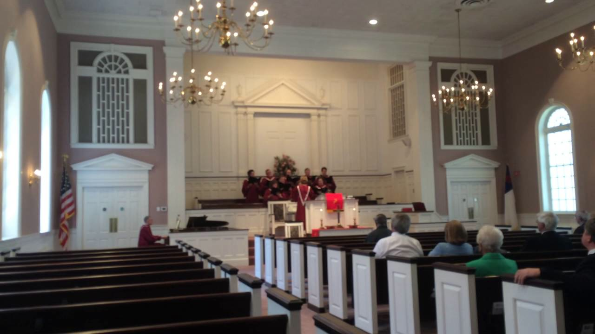
Necessity for memorializing Israel hill
Historical marker I-14 along W 3rd Street, 2009
Free flourishing black community symbolized ability to coexist
Settlement flourished beyond wildest dreams of free nonwhites or enslaved peoples
Economic freedoms increased, while civil liberties remained constricted
Judicial system participation
Farmville Baptist Church
Viewed as successful
independent from whites over time
Notes:
t

Slide 10
Hercules White
Free black of Israel Hill
multitude of door hinges and 30 lbs of nails (built immediately on land)
Simple tools: axes, hammers plows
Houses made of simple materials, log
Portrayed considerable work ethic
Broke stereotypes:
blacks were incapable of living independent of whites
blacks were the inferior race
Challenged pre-existing conceptions of blacks
Notes:
t

Slide 11
Economy of Israel hill
Acquired trades for financial advances
Field labor freed blacks:
planted crops such as cotton flax, corn, tobacco
Draft animals and domesticated livestock
Herded sheep, wool
Cattle: hides, meat, milk
Crops sustained settlement, surplus sold
Other trades: weaving, boatmen, shoemaking, carpentry
Three brothers: Billy, Tom, Zack
Successful while choosing not to live on Israel Hill, integrated into surrounding communities
Self-determination in a very controversial society
Flourished without guidance of whites
Notes:
star

Slide 12
Necessity for memorializing (continued)
Vital contributions to Farmville community
Farmville Baptist Church, 1836: conveys extent of legacy
Symbol to entire nation regarding benefits of interracial cooperation
Notes:
t

Slide 13
Interpretation of site
Currently: grass and trees where Israel Hill once stood
Museum to be built:
Outline positive and negative details of the settlement
Realistic vision of life at Israel Hill in the 1800’s
In the form of a replica of the Farmville Baptist Church, perfect atmosphere, placement in same area settlement once was
Inside of the museum:
Outlined history, similar to Moton Museum displays
Provides strengths and successes of community
Public responses to emancipation and successes
Interactions with white community members
Recreated settlement
Visitors can interact with reenactors and the land the free blacks of Israel Hill occupied
Notes:
star

Slide 14
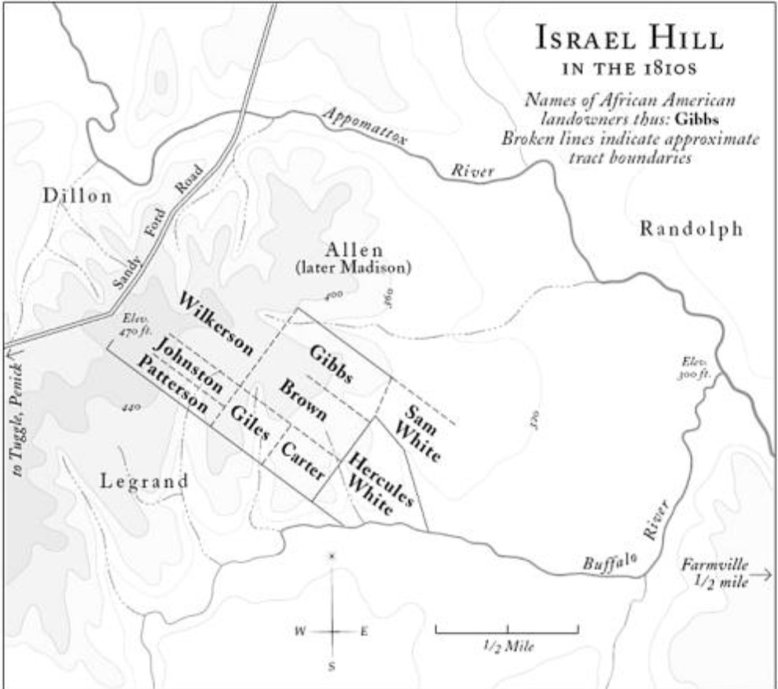
Israel hill 1800’s Settlement

Slide 15
Recreation of Settlement
No previous archeological work done in the area, Dr. Brian D. Bates
After museum built, archeological work should be initiated and provided to the building
Artifacts on exhibit
remnants of post molds (fences and barriers once stood, plots of land)
Construction of recreation can begin following excavation
Recreation of Israel Hill Settlement:
Replica of 1810 settlement, different plots, houses, fences, fields, animals
Reenactors on site for interaction and education
Notes:
star

Slide 16
Layout of site
Church museum between the river and the recreation site
Separates stories between the two
Settlement specific to free blacks, church museum encompasses that in addition to white narratives
Separation of the religious affiliation of the church, not a direct part of settlement, serves as symbol of the contributions to the Prince Edward County community as a whole
Visitors to interact with the history
Understand successes of this group of freed blacks, with social constructs of the time
Notes:
star

Slide 17
Opposing ideas for Memorializing the site
Large financial costs: archaeological work and funding to create site
Could use tools such as GPR to look underground before digging, save time and costs
White neighbors deserve recognition too
Contributions will also be displayed in museum
Notes:
t

Slide 18
Additional benefits of a memorial site at Israel hill
Visitors comprehend what people did with the land and the tools used to do so, portrays the determination of the freed blacks despite social setting
Revenue to the county through tourism
Outlet for employment for Farmville and surrounding towns
Gives multiple perspectives to the site of successful free blacks in the slaveholding antebellum south
Educate public regarding history of site and surrounding community
Honor ancestors to the blacks who settled on Israel Hill
Facilitator for cultural exchange for all that visit
Apply concepts to civil strifes that continue today
Slavery has been abolished for a while, but civil discord remains
Notes:
t

