Slide 1
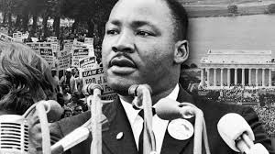
Martin Luther King, J.R. Memorial
Allison Slocum
ART 101
NVCC

Slide 2
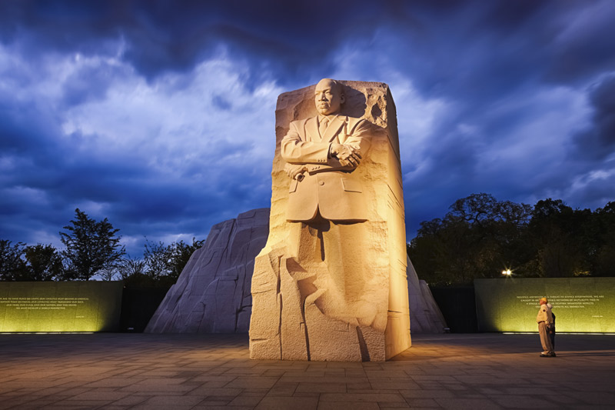
Martin Luther King, J.R. Monument
Sculpted by Master Lei Yixin
Located in Southwest Washington, D.C.
Completed on November 24, 2010
Also referred to as the “Stone of Hope” (3)

Slide 3
Description
Materials: shrimp pink granite from MN, comprised of 159 pieces that were eventually assembled into the structure
Foreground: in the front of the memorial stands King in the relief form sculpture, the stone is enormous, but the face of King reminds that we still have a long way to go in regards to Civil Rights equality
Middleground: in the middle lies a place for visitors to travel through, lined with quotes, that also allows visitors to ponder the achievements from the past to the present
Background: the two outer stones are placed behind the main stone in the memorial set-up
Iconography: this memorial symbolizes the extraordinary efforts made by King in regards to American Civil Rights, symbolizes the horrors but everlasting existence of the past, while also symbolizing the duty of Americans to continue to work together to achieve the full civil rights equality that inevitably fails to exist today
Relief: the memorial is in this style as the body of King is carved onto a flat background of the same granite stone
Intaglio: the quotes that remain on the memorial are in this particular style as the are engraved into the stone surface and do not protrude out but actually concave inwards of the memorial
The two stones in the background of the main part of the King memorial represent the past and the hardships that prevented equality in the U.S.
The stone of Kings body in the front suggests a break in the struggle and movement forward, as King was able to achieve through the leadership of his Civil Rights movement

Slide 4
Description
Component parts:
Lighting: at night only shines on the piece with King in the front, does not light up the stone in the back which emphasizes and relays to visitors to remember how far we have come, but that the past still exists and we must not forget about it as we continue to fight for equal civil rights for all
Etching: the stone is carved underneath the outline of King to look as if the ground is crumbling which symbolizes the unstable and unequal civil rights foundation of the past that King was able to lead millions of Americans to overcome
Placement of King: he is not placed on the top of the mountain, which allows visitors and Americans to recognize that we still have a ways to go to conquer the “mountain” that remains of unequal civil rights in America across genders, races, and sexual orientations
Size: 30 ft tall
This size could have been larger, kept modest proportions for the memorial
Still emphasizes the magnitude of King’s efforts, without being overbearing as a symbolism to his humble yet successful personality
The positioning of Kings body in the memorial is arms folded, feet shoulder length apart, and face looking down at the visitors below.
This makes visitors feel as if King is still watching down and expects more change in the positive direction in the future
His facial expression humanizes him in a positive light without making him seem godlike or arrogant
Location of Washington D.C.
This allows for the symbolism of the memorial and the examples set by King in general to be set and visible for and as the U.S. as a whole
Foreign tourists, who frequent the city, can learn a lot about American history in regards to Civil Rights from the memorial

Slide 5
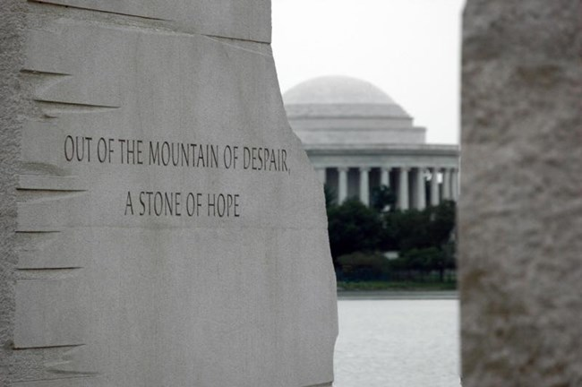
Detail Image of the Memorial
Quote engraved into the side of the memorial

Slide 6
Significance of the Detail
Direct significance to his struggle with civil rights
As there are two blocks of stone in the background, it also directly symbolizes the memorial itself as the stone piece with Kings full body in the foreground appears to be carved out of the middle of the other two pieces of stone in the back
The writing is written in block shaped font that emphasizes the concrete and everlasting effect King still has today
The etching around the quotes symbolizes that the triumphs did not come without a price and that the victories made left permanent battle scars and imperfections (even today, the fight for equal civil rights is not over)
This quote also uses the comparison of a stone to a mountain, which possibly represents the fact that while King made huge strides in the right direction, there was and is still enormous efforts that need to be made to achieve full and equal civil rights for all individuals in America

Slide 7
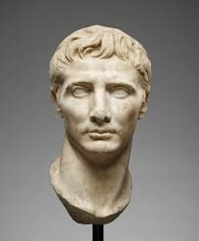
Image of Comparison
Head of Augustus

Slide 8
Similarities
Of Head of Augustus and King Memorial:
Both depict the image of person that is highly respected and idolized within society at that given time
Both made of expensive stone (while Augustus is marble and King is granite)
Both do not contain colors or use the techniques of complimentary colors as they remain true to their natural stone color throughout (this emphasizes the concreteness of the two figures as American’s hope that King Will remain, and as Romans probably hoped Augustus would remain

Slide 9
Differences
Of Head of Augustus and King Memorial
King is in the relief sculpture style as the body is carved with the background of a flat surface while the Head of Augustus is free standing in the round
King includes full facial features in the memorial sculpture, while Augustus appears to be without eyes
This emphasizes the importance of King while he has eyes, as it is suggesting him and all who fought with him are still watching and waiting for the rest of the Civil Rights movement to have all of the goals achieved
Head of Augustus is significantly smaller than the entire memorial itself and the carved image of King alone. Does not necessarily symbolize that King meant more to society today, but possibly portrays the difference in the style of art at the time (free-standing head sculptures) or the lesser access to materials that the Ancient Romans had in comparison

Slide 10
Conclusion
The King Memorial reminds visitors of the personal achievements of the Civil Rights leader, while also educating and remembering the successes of the U.S. as a whole
Similarities can be drawn between ancient art and modern day sculptures and memorials despite the extreme variations that remain between the history of the centuries
The design of the memorial incorporates techniques of symbolism, materials, sculpture, iconography, and form that have existed for thousands of years by evidence of art history study and research

Slide 11
References
“Building the Memorial.” National Parks Service, U.S. Department of the Interior, www.nps.gov/mlkm/learn/building-the-memorial.htm.
Google Images, Google, images.google.com/.
NPS.gov Homepage (U.S. National Park Service). www.bing.com/cr? IG=4BFA985F1F194CEDBBBC013E095ADF53&CID=3B82450DFC3F652527354EA9FD906422&rd=1&h=_K0OgRjGIPsyjYE0HDNdfW_ah-Gm5Hjq97GnjllIHx8&v=1&r=https%3a%2f%2fwww.nps.gov%2findex.htm%3fsite%3dpc23&p=DevEx,5061.1.
Notes:
https://safeshare.tv/x/ss5661ab2ca061d
Google images
Nps.gov
Washinton.org
https://www.nps.gov/mlkm/learn/building-the-memorial.htm

