Slide 1
A Survey of Attitudes on the Death Penalty
Allison Slocum
Longwood University

Slide 2
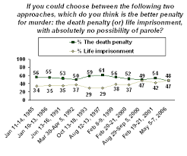
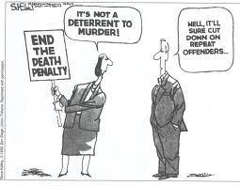
Why I Chose This Topic

Slide 3
Method of Data Collection
72 people responded to all 4 questions

Slide 4
Question 1: It is okay for inmates to spend ten or more years on death row.

Slide 5
Question 2: In cases where materials for lethal injection are not available, it is okay for inmates to be executed by hanging.

Slide 6
Question 3: Capital punishment should never, under any circumstances, be applied as a sentence.

Slide 7
Question 4: The legalization of the death penalty deters individuals from committing such heinous crimes.

Slide 8
Conclusions
In general, results were as I expected
Was surprised at how many people weren’t okay with execution by hanging, but also the majority weren’t okay with inmates spending 10+ years on death row
Was surprised at how many people disagreed or strongly disagreed to Question 4 (“The death penalty deters individuals from committing such heinous crimes”)
People obviously agree that there are other justifications for capital punishment

